Slide 1
Hydrogen Refuelling Solutions: Demonstration to Deployment
www.fuelcellsystems.co.uk

Slide 2
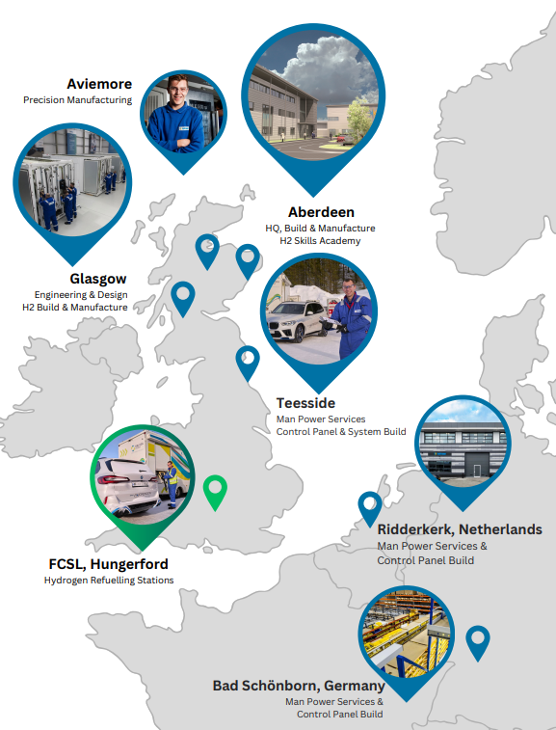
One Company – Multiple Solutions
Fuel Cell Systems
Packaged HRS solutions
R&D Centre of Excellence
Sale, deployment and support
Hydrasun
Fuel Cell Systems parent company
Manufacturing partner
Design and full EPC large scale HRS solutions

Slide 3
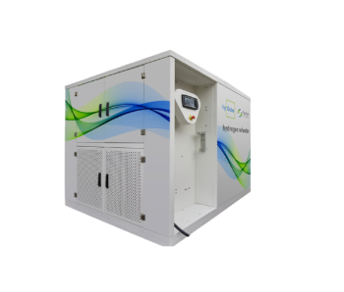
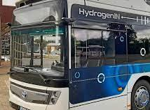
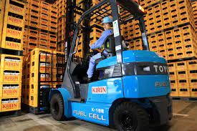
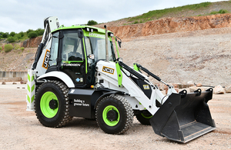
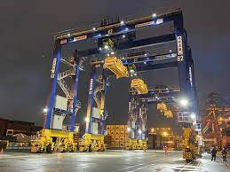
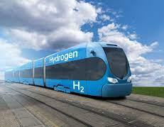
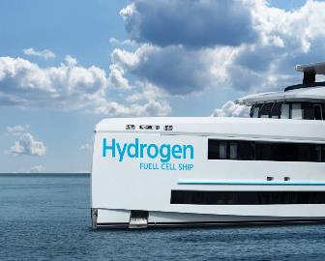
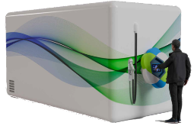
Packaged HRS Solutions Supports early adoption of hydrogen in multiple sectors
Small-Scale HRS
Small Scale 350 bar and 700 bar HRS with compression, flow control & metering
Bus and Refuse Vehicles
Materials Handling
Construction
Medium-Scale HRS
Containerised HRS with internal compression and storage with 350 bar and 700 bar (including gas chilling)
Ports
Trains
Small Marine

Slide 4
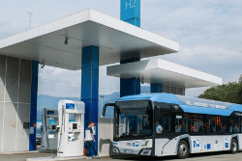
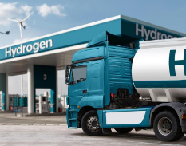
Scalable HRS Packaged Solutions and Reference Designs
Packaged HRS Solutions
HRS Reference Designs
Small-Scale (Adopter)
HRS with compression,
flow control and metering.
350 and 700 bar
SAE J2601(Ambient) CEP
Medium Scale
(Fleet Growth)
HRS with compression and storage.
350 and 700 bar
SAE J2601/1/2 / CEP
Large Scale
(Commercial HRS)
Static HRS
SAE J2601/1/2 Light duty and heavy duty fuelling protocols.
XL
(Heavy Duty HRS)
Static HRS
SAE J2601/5
High-Flow Prescriptive Fuelling Protocols
1 20
1 20
Buses , Trucks, Vans and Passengers Vehicles
20 60
Heavy-Duty Long-Haul Trucks
Light-Duty Truck e.g., FC Hilux
60 320
Refuelling Method​ | ​Cascade via external storage
Available to Market | Series Production Now
Refuelling Method​ | ​Cascade via internal storage
Available to Market | Under Development Now Customer Units – Q1 2025
Refuelling Method​ | SAE J2601/1 Fueling Protocols for Light Duty J2601/2 Fueling Protocol for Heavy Duty
Available to Market | Now
Refuelling Method​ | SAE J2601/5 High-Flow Prescriptive Fueling Protocols, 300g/s
Available to Market | Now
Notes:
Packaged HRS Solutions
FCSL Contract (Hardware and Aftermarket)
FCSL Design
Hydrasun Build
HRS Reference Designs
Hydrasun Contract
Hydrasun Top Level Design
FCSL providing dispensing system (HyFlow)
Hydrasun Build

Slide 5
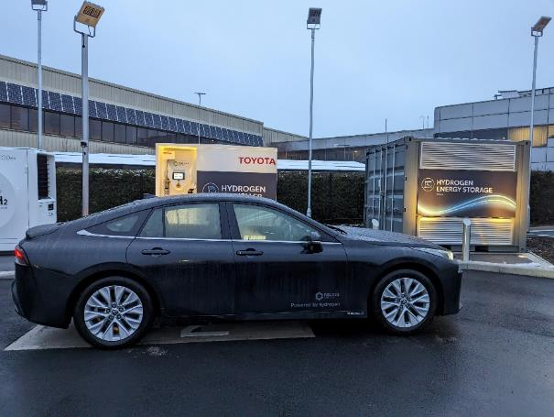
HyPro + HyQube: Toyota, Derby
Notes:
Because of the specific site parameters (secure, CCTV and security, site speed limit), we worked together with the Toyota facilities and H&S teams to be ‘light touch’ in terms of the obvious safety features – so there’s bollards and ATEX lighting. But the rest of the site has been neatly put together so that it’s hugely accessible for site visits. This demonstrates confidence in hydrogen within the built environment.

Slide 6
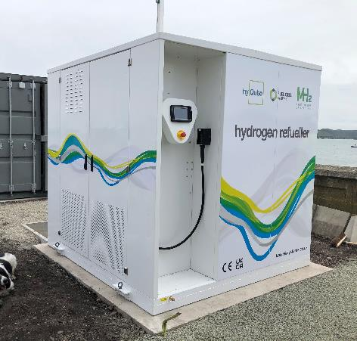
HyQube
Description
Small Scale HRS with compression and flow control with metering
J2601:2010 Ambient refuelling protocols
IR communications option: CEP/TME compliant ensuring vehicle compatibility
Refuelling Method
Three stage cascade via source and two external storage connections with compression recharge
Performance
1-10 kg per hour compression (depending upon source pressure)
40 g/sec max flow rate
Cost
Purchase Price: £250k Base refueller
£350K With external gas buffer storage
(3,000ltr @500 bar storing approx. 100kg)
Commercial Off The Shelf (COTS) solution
In series production now

Slide 7
HyQube
Options
350 bar or 700 bar
IR communications / CEP Protocols
External storage
Site specific manifold and pipework
Cold weather variant
Engineering consultancy (site risk assessments / HAZOP etc)
Commercial Off The Shelf (COTS) solution
In series production now

Slide 8
HyQube small fleet solution
Technical Specification
HyQube 500 4
Compression 8 to 24kg/hr
Input Pressure 75 to 500 bar
Storage Bundles 4 (2 banks of 2)
Storage Volume 2 x 9,800 litres
Storage Mass 2 x 310kg
Back to Back 10 buses (25kg fill, 100 bar to 350bar)
Fill Time 10 to 15 minutes
Power Requirements 4 x 63A Three Phase (4 x 25kW)
Cost
Purchase Price: £1.5m (excluding site specific pipework)
Commercial Off The Shelf (COTS) solution
In series production now

Slide 9
HyQube 500 small fleet solution
Site layout

Slide 10
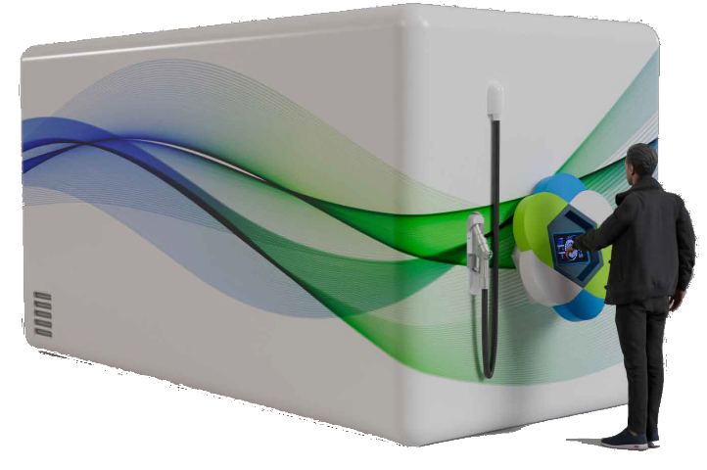
HyFleet
Description
Hydrogen Refuelling System with internal compression and storage with 350 bar and 700 bar (including gas chilling)
Refuelling Method
Cascade with compression
Markets
Bus Depot, Council Fleets, Utility Fleets, Car Fleets, Construction Sites
Performance
250 kg to 500kg per day dispensed
In product development now
Customer deployment Q1 2025

Slide 11
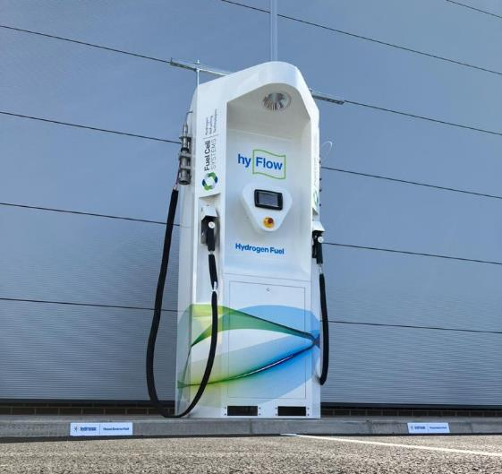
HyFlow
Description
Hydrogen dispenser with internal cascade control and flow control with metering
Refuelling Method
Cascade via external storage
Markets
Forecourt dispenser for fixed filling station
Cost
Target Price: £180k
In product development now
Prototype deployment now

Slide 12
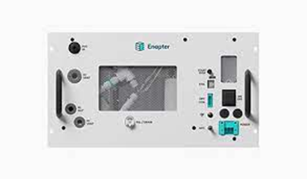
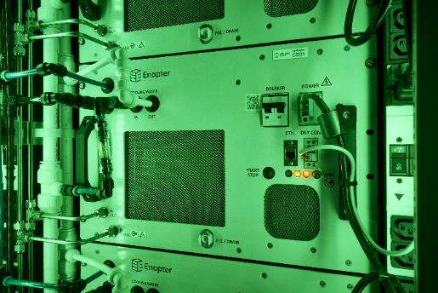
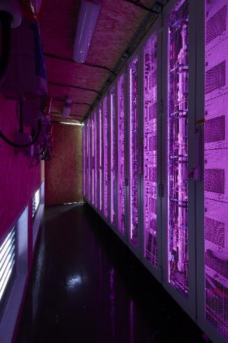
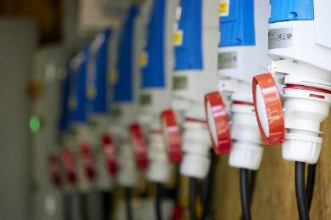
Electrolyser Products
Small scale package electrolysis for fleet demonstrations
Up to 40kg per day production

Slide 13
From demonstration to large scale deployment
Packaged HRS Solutions
Static HRS
Small-Scale (Adopter)
350 and 700 bar.
SAE J2601(Ambient) CEP
Up to 40g/s
20 to 40kg / day
Medium Scale
(Fleet Growth)
350 and 700 bar
SAE J2601/1/2 / CEP
Up to 60g/s @700bar Up to 120g/s350
250 to 500 kg per day
Large Scale
(Commercial HRS)
SAE J2601/1/2 Light duty and heavy duty fuelling protocols.
Up to 60g/s @700bar Up to 120g/s350
Typically 1 to 2 tonnes per day
XL
(Heavy Duty HRS)
SAE J2601
High-Flow Prescriptive Fuelling Protocols
Fuelling Protocols, 300g/s
Typically > 2tonnes per day
1 20
1 20
Buses , Trucks, Vans and Passengers Vehicles
20 60
Heavy-Duty Long-Haul Trucks
Light-Duty Truck e.g., FC Hilux, First Hydrogen Vans
60 320
Refuelling Method​ | ​Cascade via external storage
Available to Market | Series Production Now
Refuelling Method​ | ​Cascade via internal storage
Available to Market | Under Development Now Customer Units – Q1 2025
Refuelling Method​ | SAE J2601/1 Fueling Protocols for Light Duty J2601/2 Fueling Protocol for Heavy Duty
Available to Market | Now
Refuelling Method​ | SAE J2601/5 High-Flow Prescriptive Fueling Protocols, 300g/s
Available to Market | Now
Notes:
Packaged HRS Solutions
FCSL Contract (Hardware and Aftermarket)
FCSL Design
Hydrasun Build
HRS Reference Designs
Hydrasun Contract
Hydrasun Top Level Design
FCSL providing dispensing system (HyFlow)
Hydrasun Build

Slide 14
Our Hydrogen Journey
Power
Transport
>30
H2 Projects
Industry
For over 40 years Hydrasun have provided fluid management and instrumentation solutions to the global energy market offering specialist knowledge in the design, specification and installation of small- bore tubing and instrumentation in explosive environments
1976
2016
Over the past 7 years, Hydrasun has diversified its business to include hydrogen-specific integrated products and services, delivering over 30 key projects across the mobility, power and industrial sectors.
H2
HRS Solution Provider and H2 System Integrator
Project experience covers design, products supply, integration, installation and commissioning of piping systems, as well as design, build and integration of Hydrogen Refuelling Stations (HRS)
Projects extend across Transport, Industrial and Power Sectors and include:
Hydrogen Mobility applications – Solutions for Automotive Fleet Services
Assembly, Commissioning and Maintenance of Hydrogen Refuelling Systems (HRS)
Fuel Switching in Industrial Gas Systems
Hydrogen Compression, Storage and Dispensing Systems

Slide 15
Deployment Examples
www.fuelcellsystems.co.uk

Slide 16
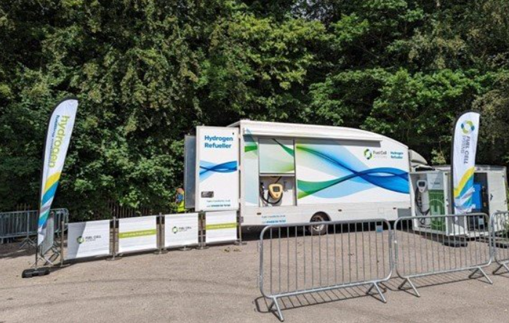
HyTruck: Goodwood FoS
Notes:
Delighted to support some fuelling at the Goodwood Festival of Speed this year. You can see the pic of this Toyota GR Yaris H2 which is a hydrogen combustion vehicle. We also fuelled the BMW H2R vehicle which is another hydrogen combustion car. Protium Hydrogen

Slide 17
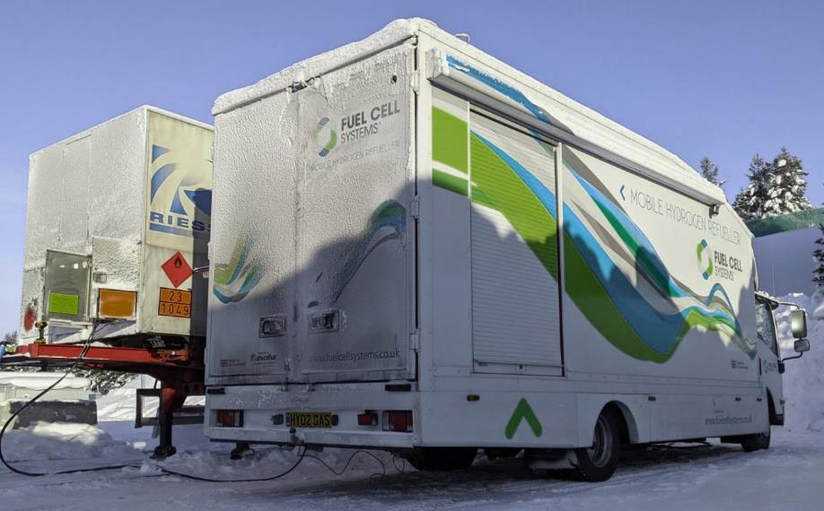
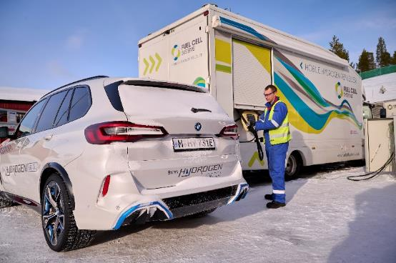
HyTruck: BMW ix5 Refuelling

Slide 18
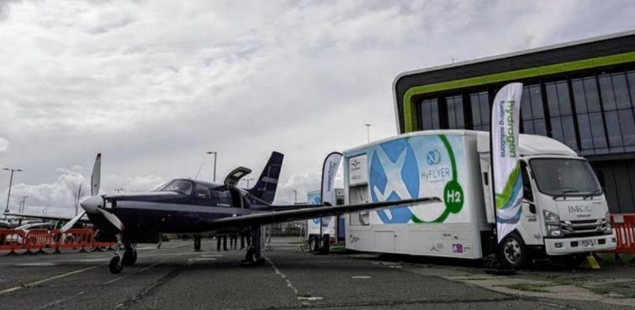
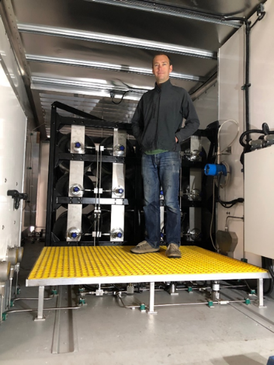
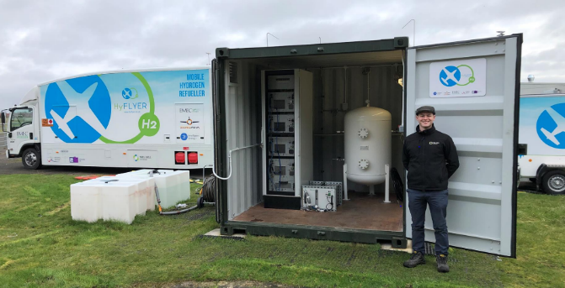
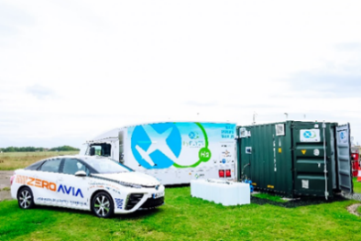
HyTruck:HyFlyer I

Slide 19
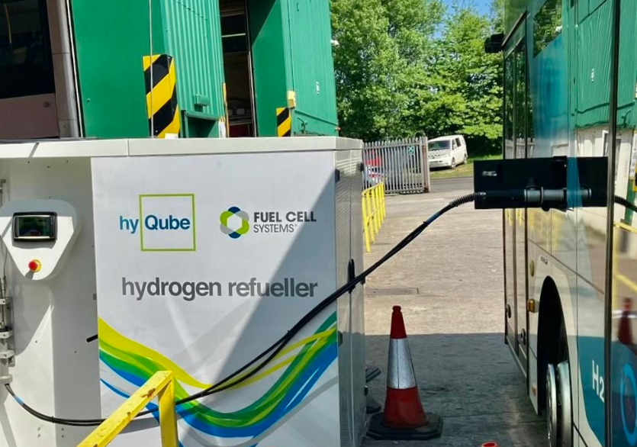
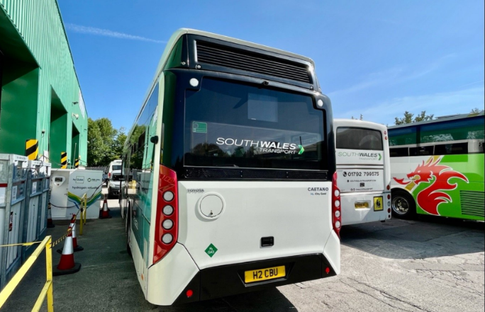
HyQube: South Wales Buses
Notes:
Businesses in South Wales are showing the potential of hydrogen for transport in a demonstration of green, zero-emission public transport in the Neath Port Talbot and Swansea area. A recent initiative led by a private sector consortium, aims to address the climate change emergency and promote sustainable transportation solutions. Bus operator South Wales Transport and private hire operator Hyppo Hydrogen Solutions are at the forefront of this project, utilising locally-produced electrolytic hydrogen derived from renewable energy and local water sources.

Slide 20
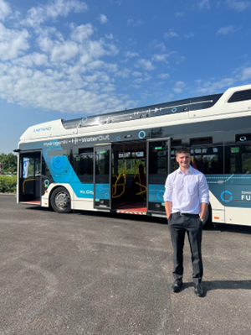
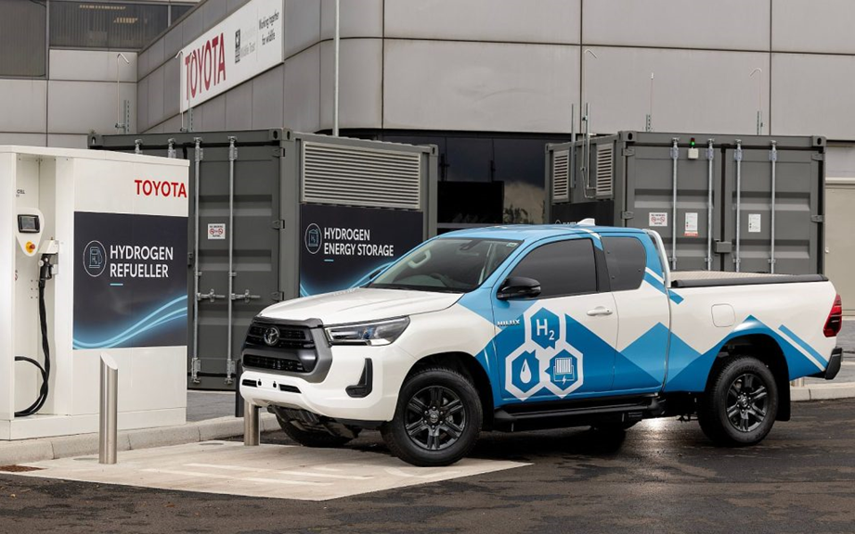
HyQube: Toyota, Derby
Notes:
Cars, buses, fork lift trucks, HiLux. Production of 10kg/day.

