Slide 1
The latest on what’s happening in the UK H2 for heavy duty
Birmingham April 2024

Slide 2
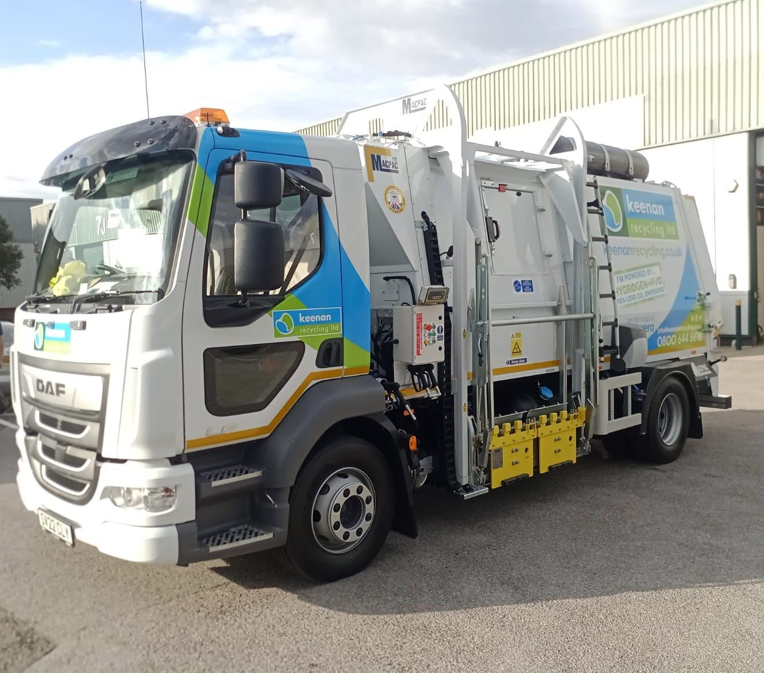
Enabling fleets to use hydrogen to reduce GHG emissions
Vehicle requirement knowledge
Vehicle standards and regulatory compliance
Economic model of replacement cost and total lifetime costs
H₂ supply chain knowledge
Patented engine and H2 safety technology
Track record of delivering different solutions across a range of vehicle types

Slide 3
Features of H2
Benefits speed & cost to change
High power
Sustained power
Power take off
Same performance seasonally
Sustainable productivity of operation
Flexibility of refuelling location
Faster refuelling
Similar range to conventional fuel
Similar vehicle or machine specification in terms of payload, power performance and design

Slide 4
H2 Opportunity in Construction
Need for off grid solutions
Electrification is extremely challenging due to the high energy demands across multiple machines & operation time
H2 can be transported and stored which addresses some of the significant operational changes
However, the energy density of H2 means that the machines will need to fill up more frequently
And yet safety concerns limits appetite for onsite storage
Therefore, there will be both electric and hydrogen solutions on site

Slide 5
What’s happening, today?

Slide 6
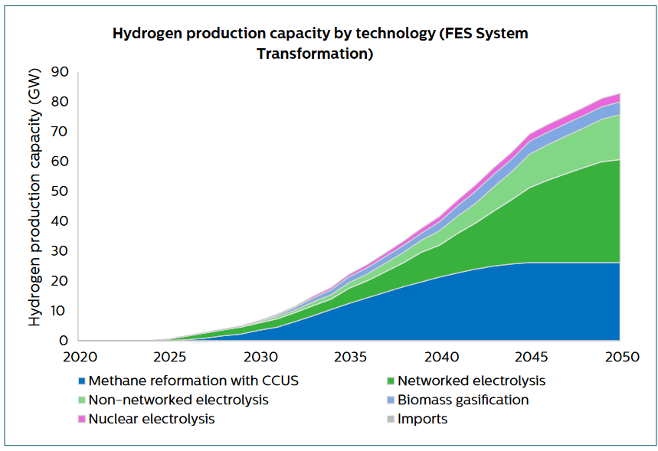
The Ambition…..
Effectively “none” today

Slide 7
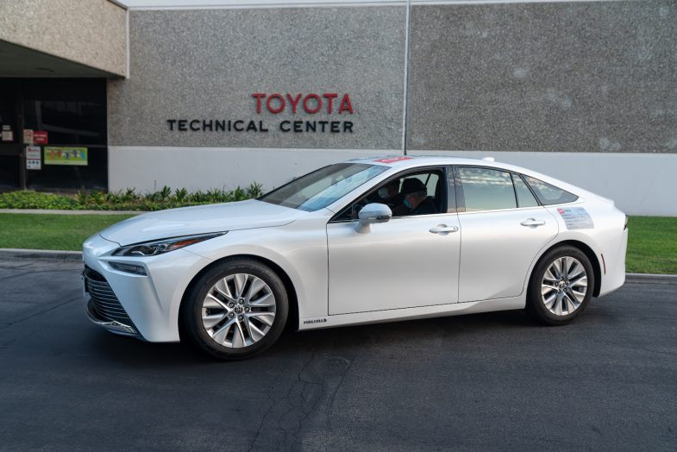
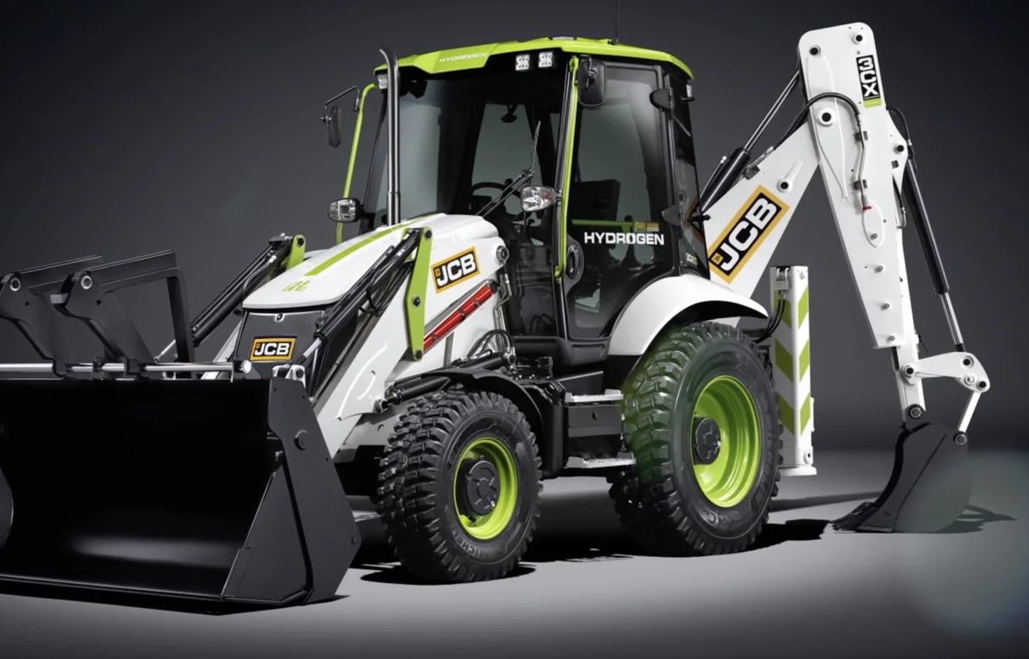
Vehicle availability today (and for next 5 years?)
Fuel Cell Cars & Buses
- Toyota Mirai & Hyundai Nexo
- Innovative SME’s prototypes: Riversimple etc
- Other OEM “launch by” dates
Vans
- OEM “launch by” dates
- Innovative SME’s prototype: e.g. First Hydrogen
Fuel Cell HGV & Buses
- Chassis conversions – Electra, Faun Zoeller
- Innovative SME’s prototypes:
HVS, Quantron
- Other OEM “launch by” dates
(2030 and beyond)
Hydrogen ICE
- JCB launch date 2024
- OEM engines; Cummins etc
- Other OEM “launch by” dates
(2030 and beyond)

Slide 8
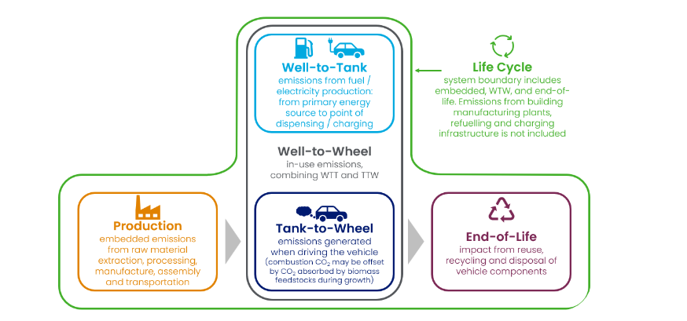
Upcycling, Upgrading and Repowering can address a real need for vehicles and sustainable soltions

Slide 9
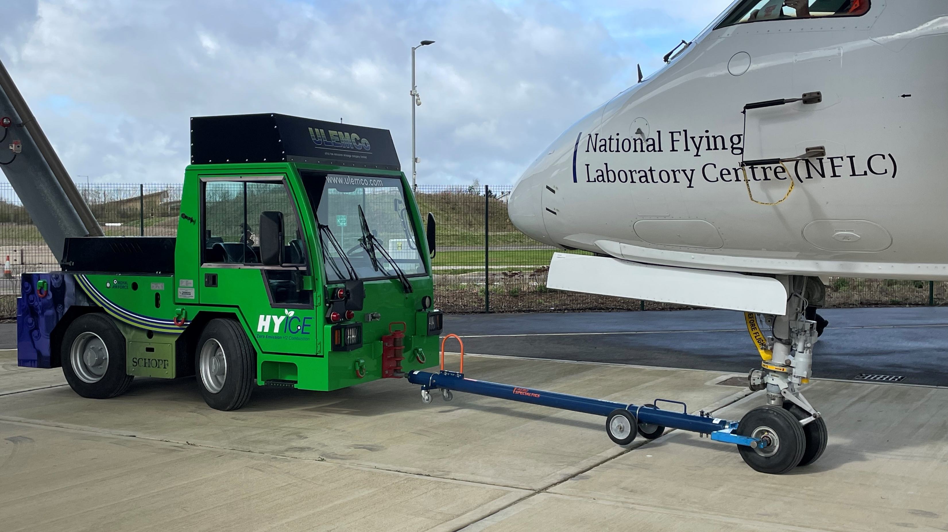

Slide 10
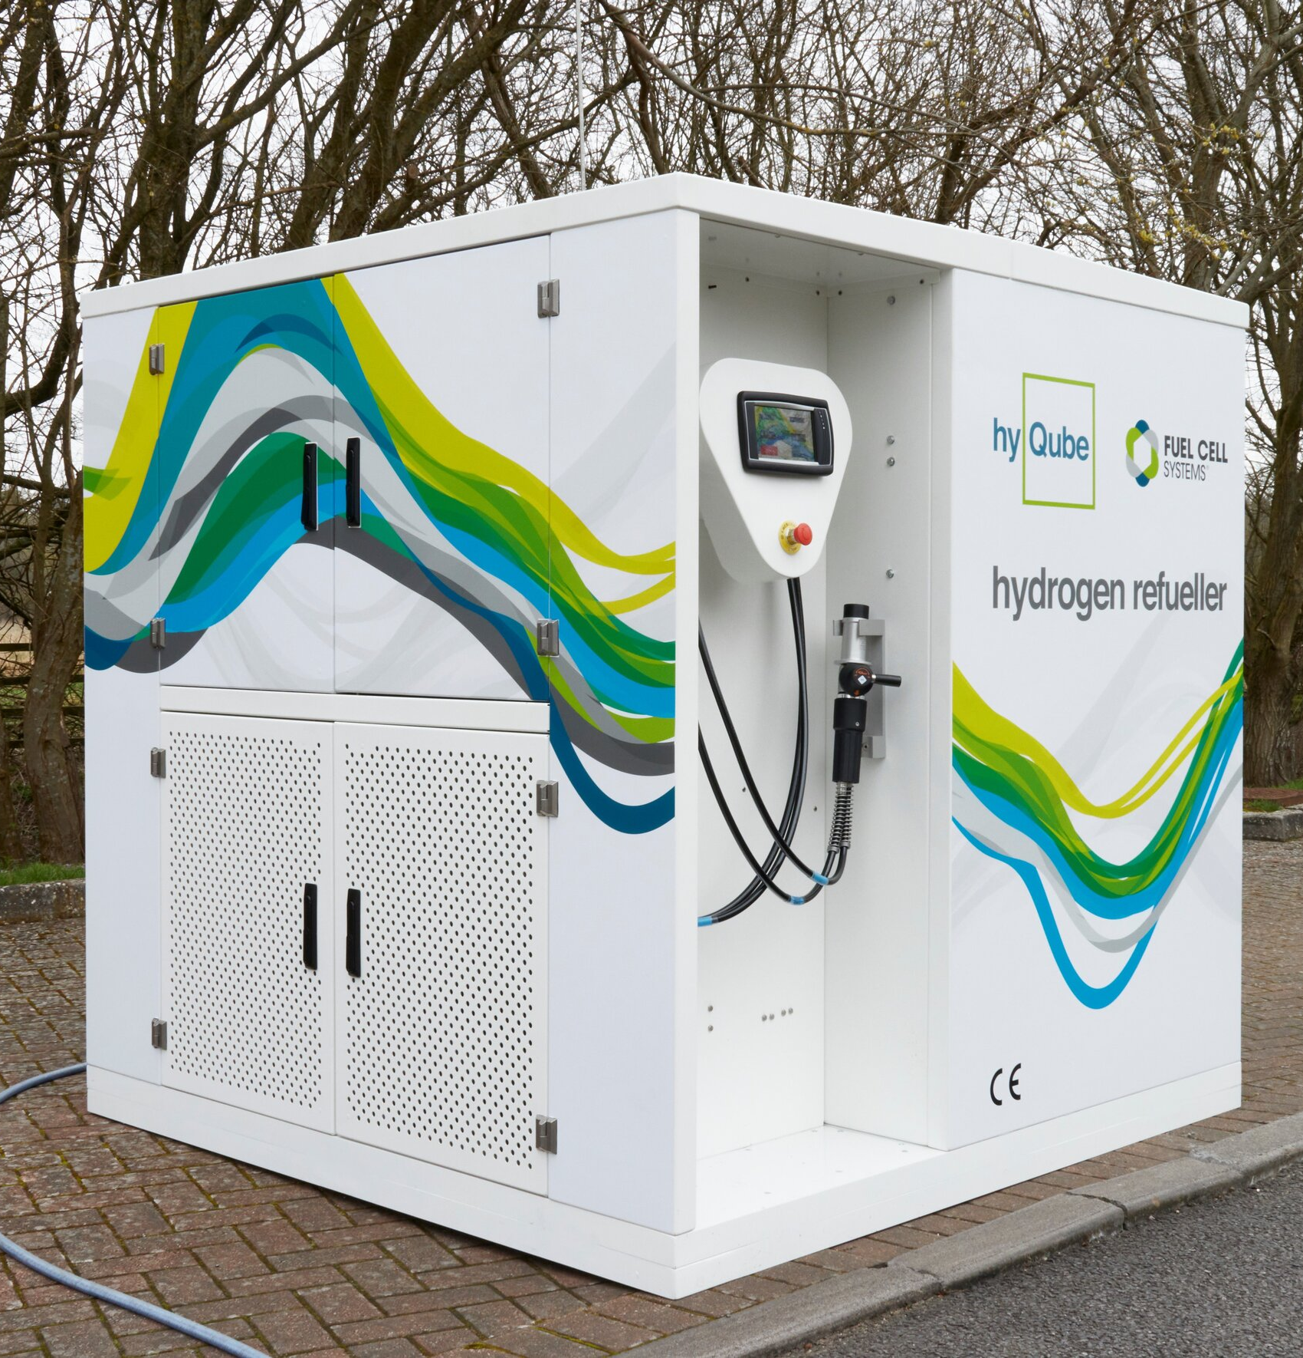
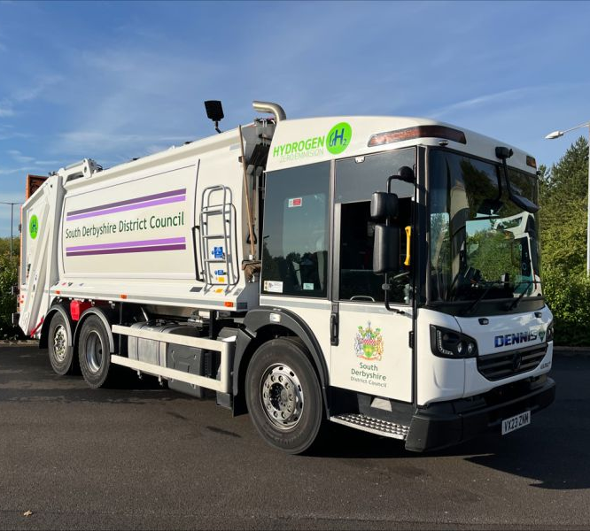
Upgrading with
Dual-fuel technology, H2ICED®
Owner: South Derbyshire Council
Type of Vehicle:
Dennis Eagle Elite 2 Refuse trucks
No. of vehicles converted: 2 in 2023
Estimated CO₂ savings:
Hydrogen supply:
Demo – H2 by external supplier
Similar project delivered at East Cheshire Council in 2022

Slide 11
Neither vehicle or machine availability & no availability of refuelling facilities

Slide 12
Hydrogen – Tomorrow’s Fuel TODAY!
Email: alyne@ulemco.com | www.ulemco.com

