Slide 1
BREAKTHROUGH: RENEWABLE ENERGY AT KEELE UNIVERSITY Kevin Kendall 07903757389 HydrogenUnited.org K Kendall, Low carbon integrated vehicles & buildings Mech Eng Adv (2024)

Slide 2
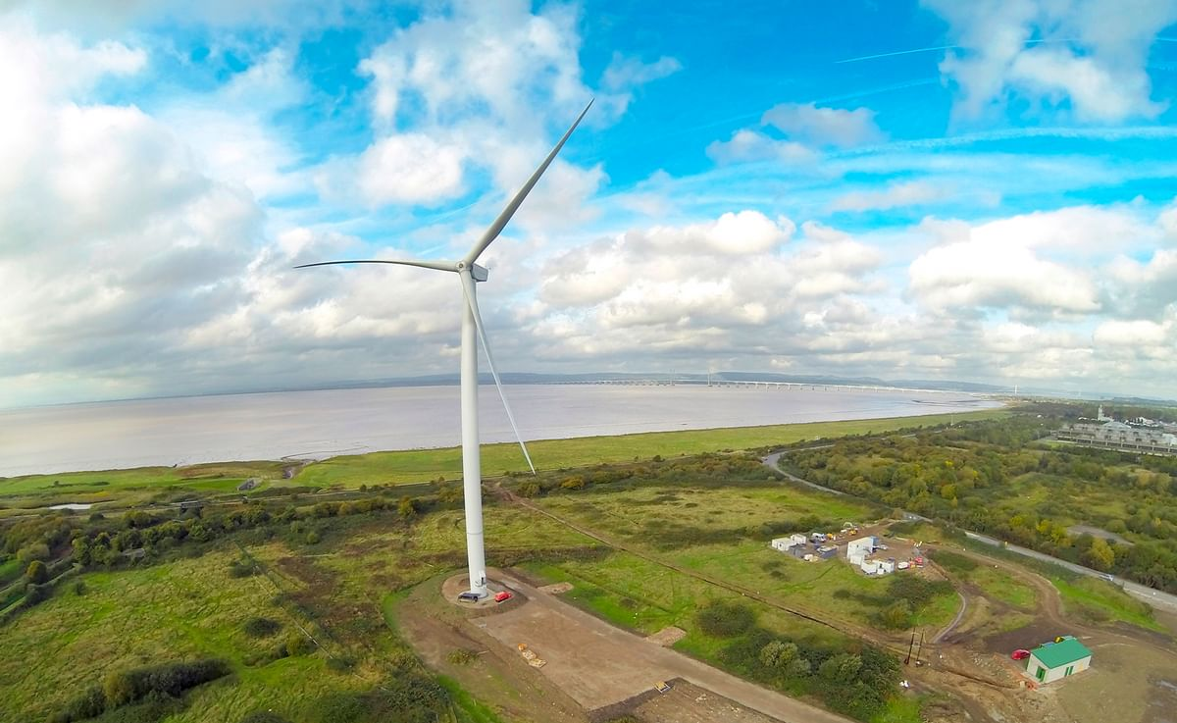
WHAT CAN A CHARITY DO?
EXAMPLE of AmbitionLW.org
Bristol boys club charity
MARK PEPPER
7 years to install biggest
onshore wind turbine in UK
In July made £300k on 4.2MW

Slide 3
PROBLEMS
1 NEEDED BUYER: OVO-energy
2 NO SOLAR
3 NO HYDROGEN STORAGE

Slide 4
ESSENTIAL IDEAS
1 BIGGER SCALE 4-Year Payback
2 GRID is back-up only
3 WIND + SOLAR 50% availability

Slide 5
ESSENTIAL IDEAS
1 BIGGER SCALE 4-Year Payback
2 GRID is back-up only
3 WIND + SOLAR 50% availability

Slide 6
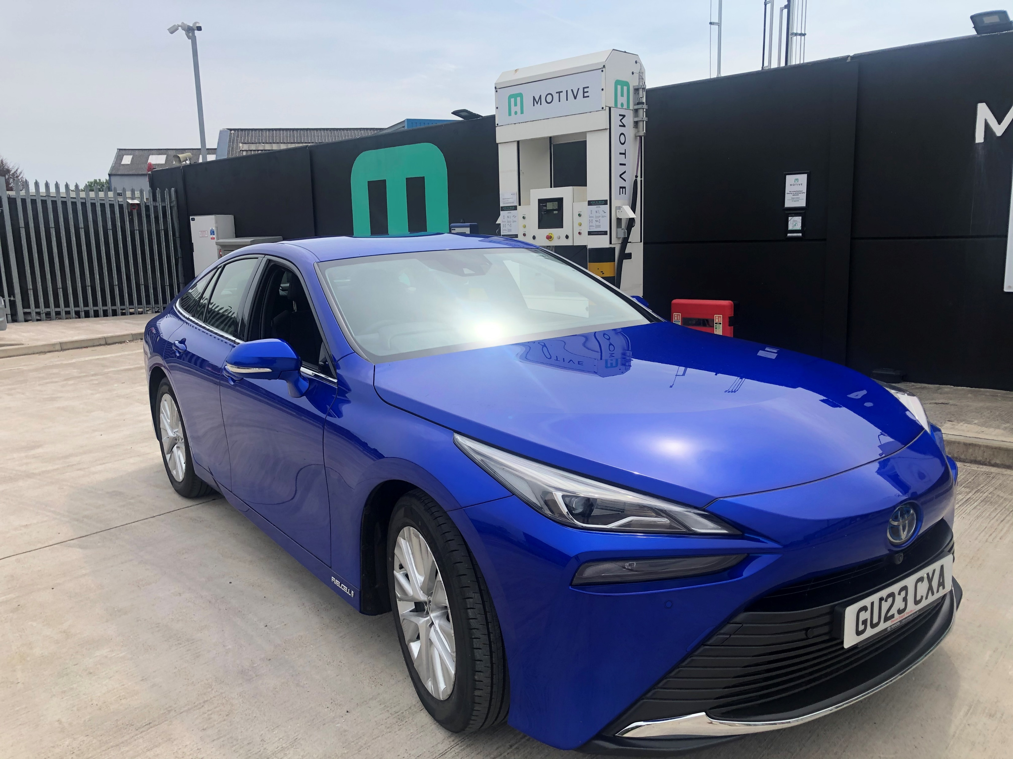
Why hydrogen? STORAGE
Green, Clean and Cheap
We need the supply chain
Green Hydrogen chain is not working
Let’s define the problems Answer is making profits

Slide 7
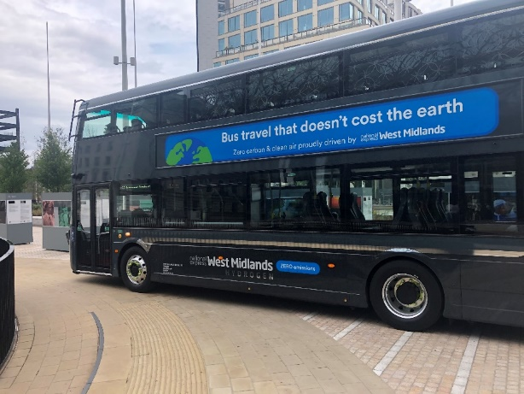
GOVERNMENT HYDROGEN TURF WARS
Fossil CO₂
TRANSPORT 32%
HEATING BUILDINGS 25%
GRID ELECTRICITY 21%
INDUSTRY DESNZ 14%
AGRICULTURE 8%
Ignore 10% imported

Slide 8
IT IS WORSE
Energy supplied TWh percentage
1 Electricity Grid 308 21%
2 Gas Grid 485 34%
3 Petroleum 638 45%
TOTAL 1431 100%

Slide 9
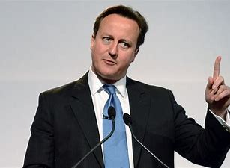
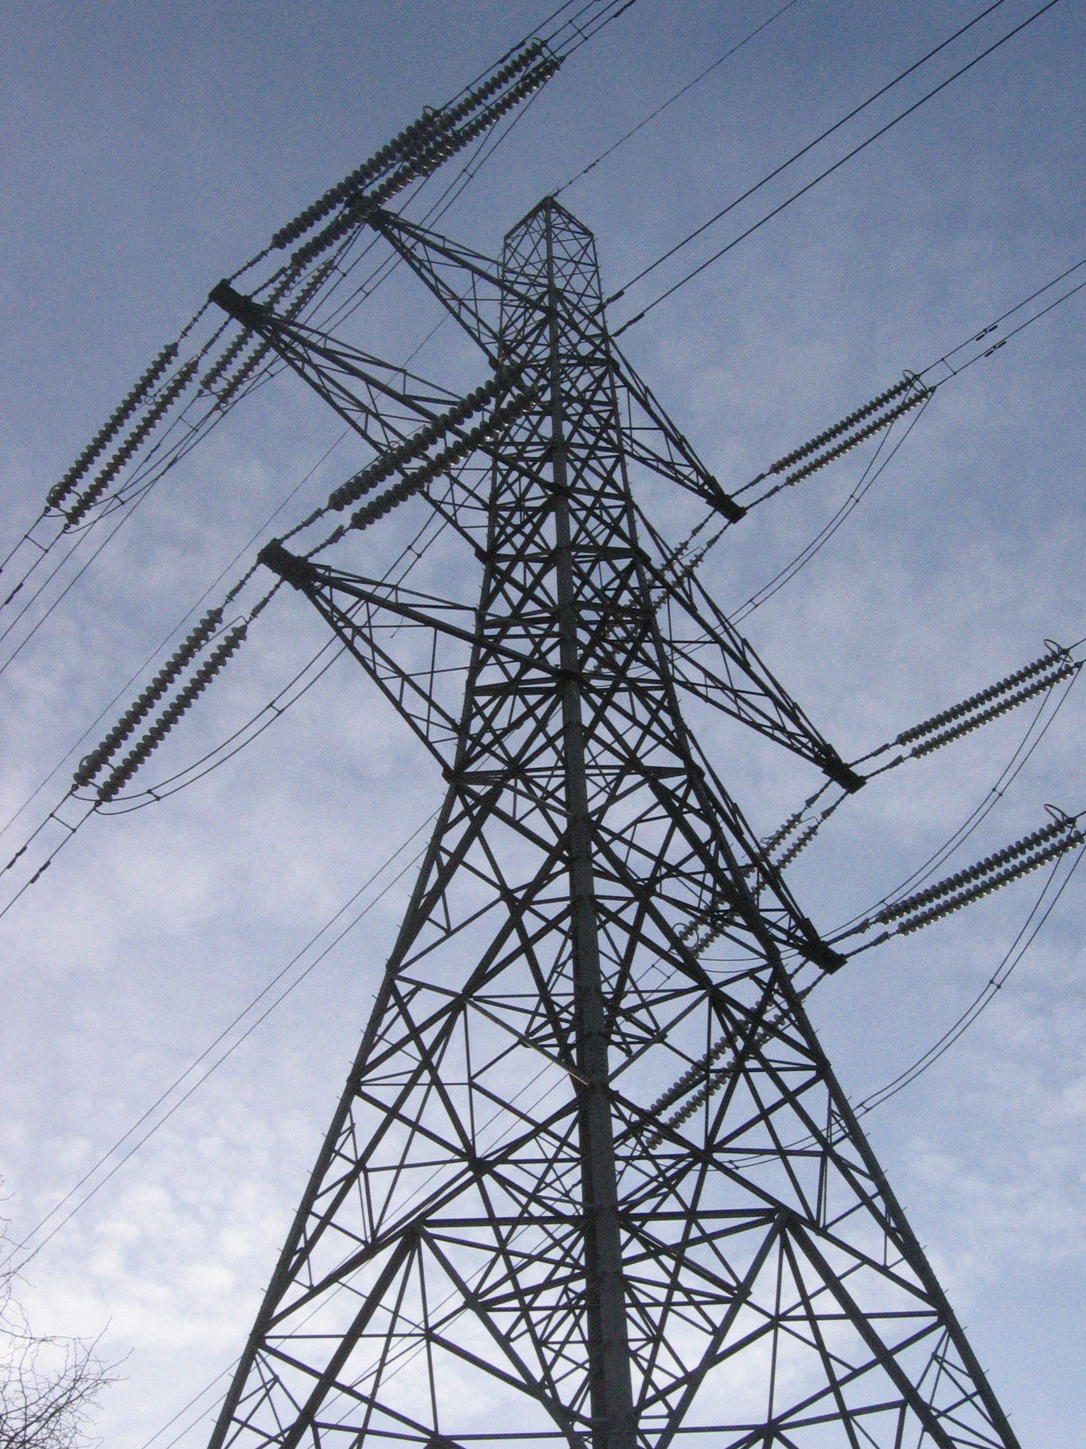
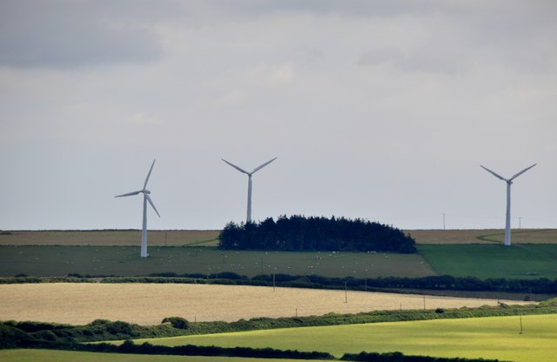
ANOTHER GOVERNMENT ISSUE

Slide 10
DAVID CAMERON FORGOT TO MENTION
WE HAVE ABOUT 22,000 PYLONS
He now needs 5 times that.

Slide 11
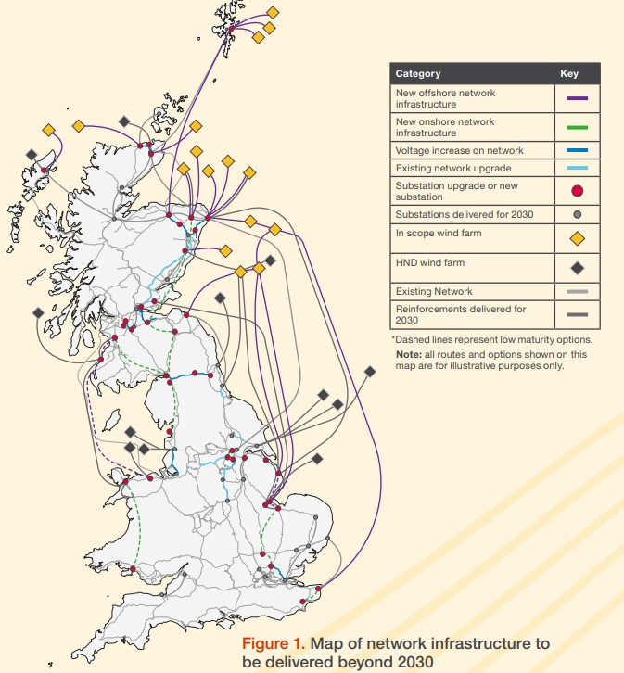
PLANNED GRID EXPANSION £58bn

Slide 12
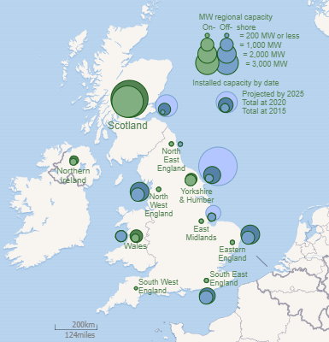
DAVID CAMERON LIVES HERE
NO WIND turbines
LITTLE SOLAR
NEED MORE ONSHORE, WIND + SOLAR eg 10MW

Slide 13
TRY REFUELLING YOUR HYDROGEN CAR OFFSHORE

Slide 14
We need 10,000 onshore turbines:
bigger wind/solar locations 10MW
Distributed green energy
100GW NEW LOCAL POWER

Slide 15
EXPERIMENTAL KEY PROBLEMS
1 Few Hydrogen Cars
2 Few Hydrogen stations
3 Not green Hydrogen
4 Too expensive £23/kg

Slide 16
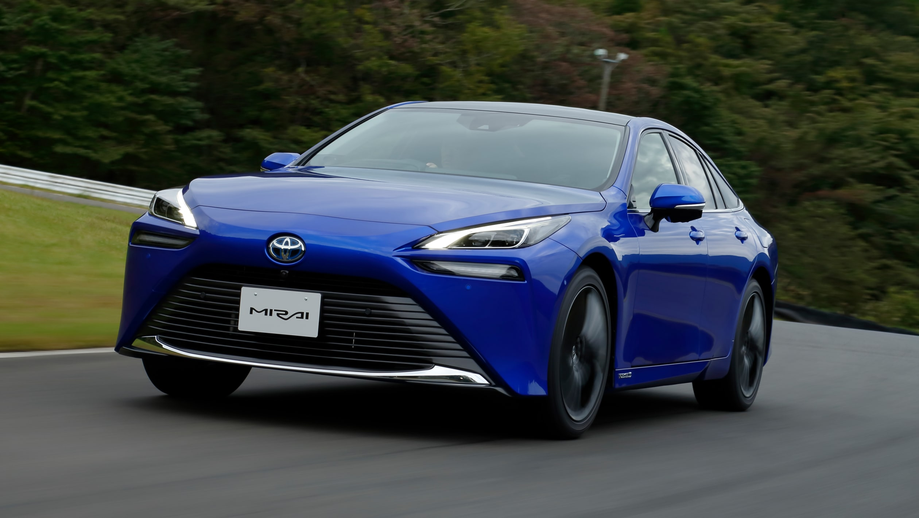
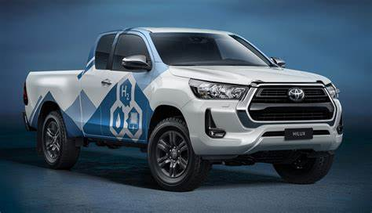
FEW HYDROGEN CARS
Mirai is great
£50k, 400 miles
New truck soon
Steven Eagells
go to Agent 2023

Slide 17
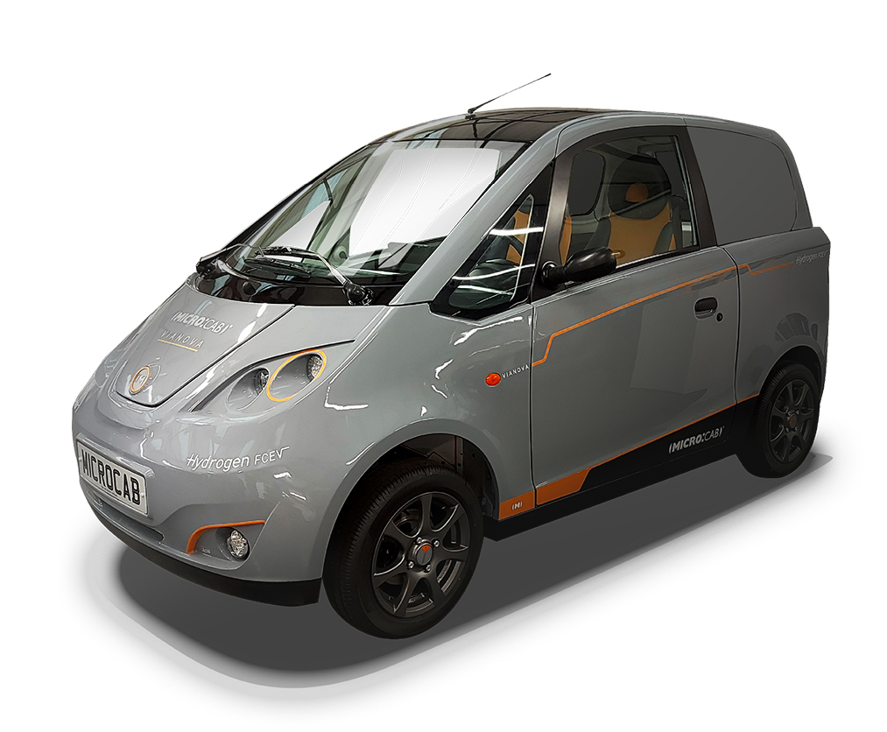
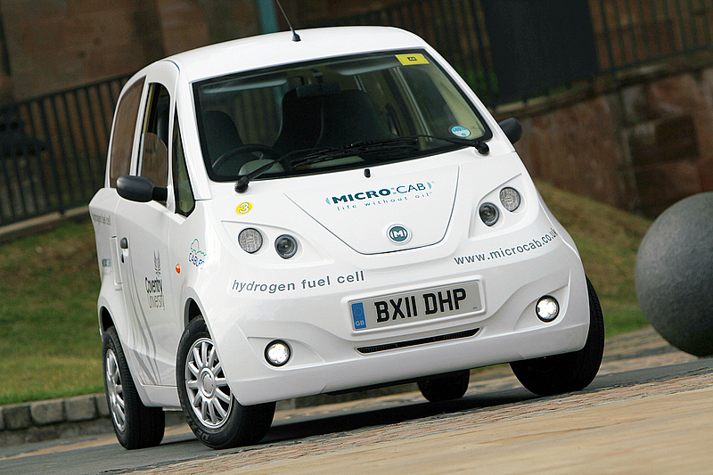
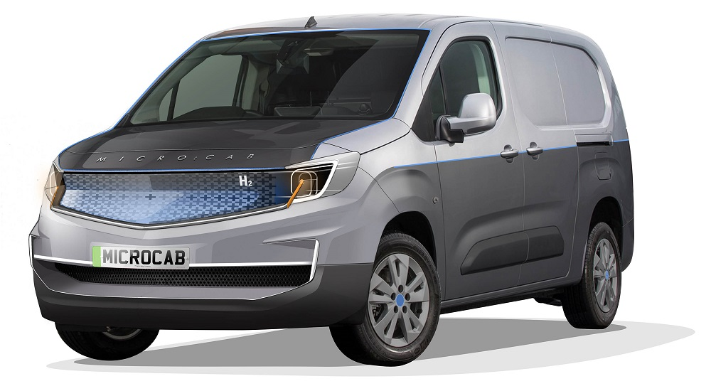
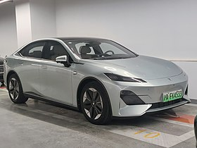
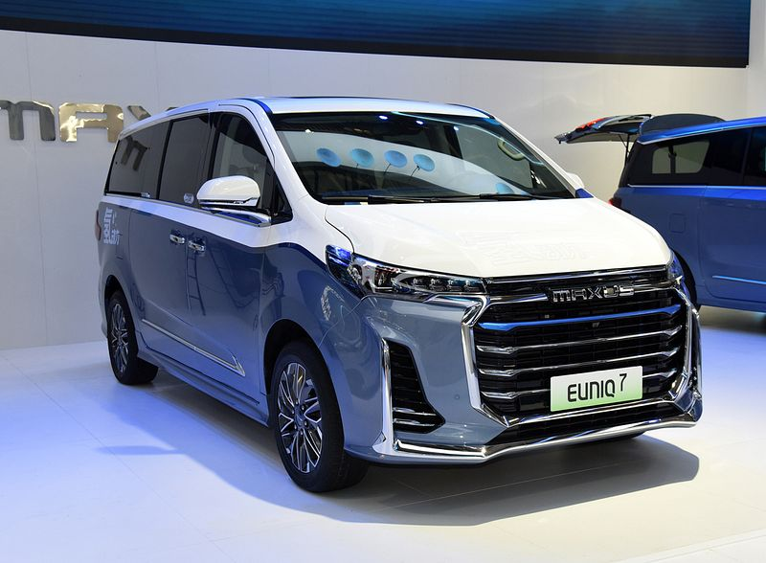
BIRMINGHAM makes HYDROGEN VEHICLES
Microcab is made at Tyseley
Changan, Solihull
SAIC Longbridge
Maxus MG

Slide 18
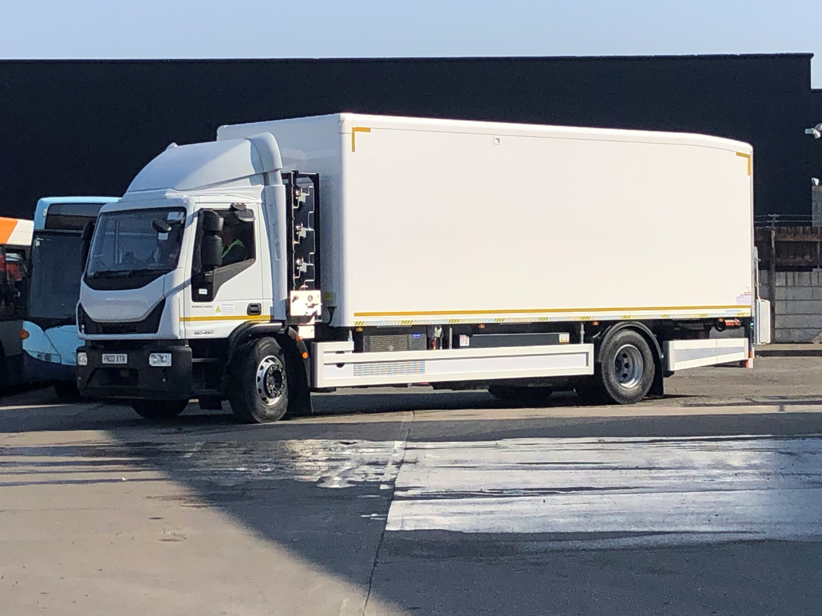
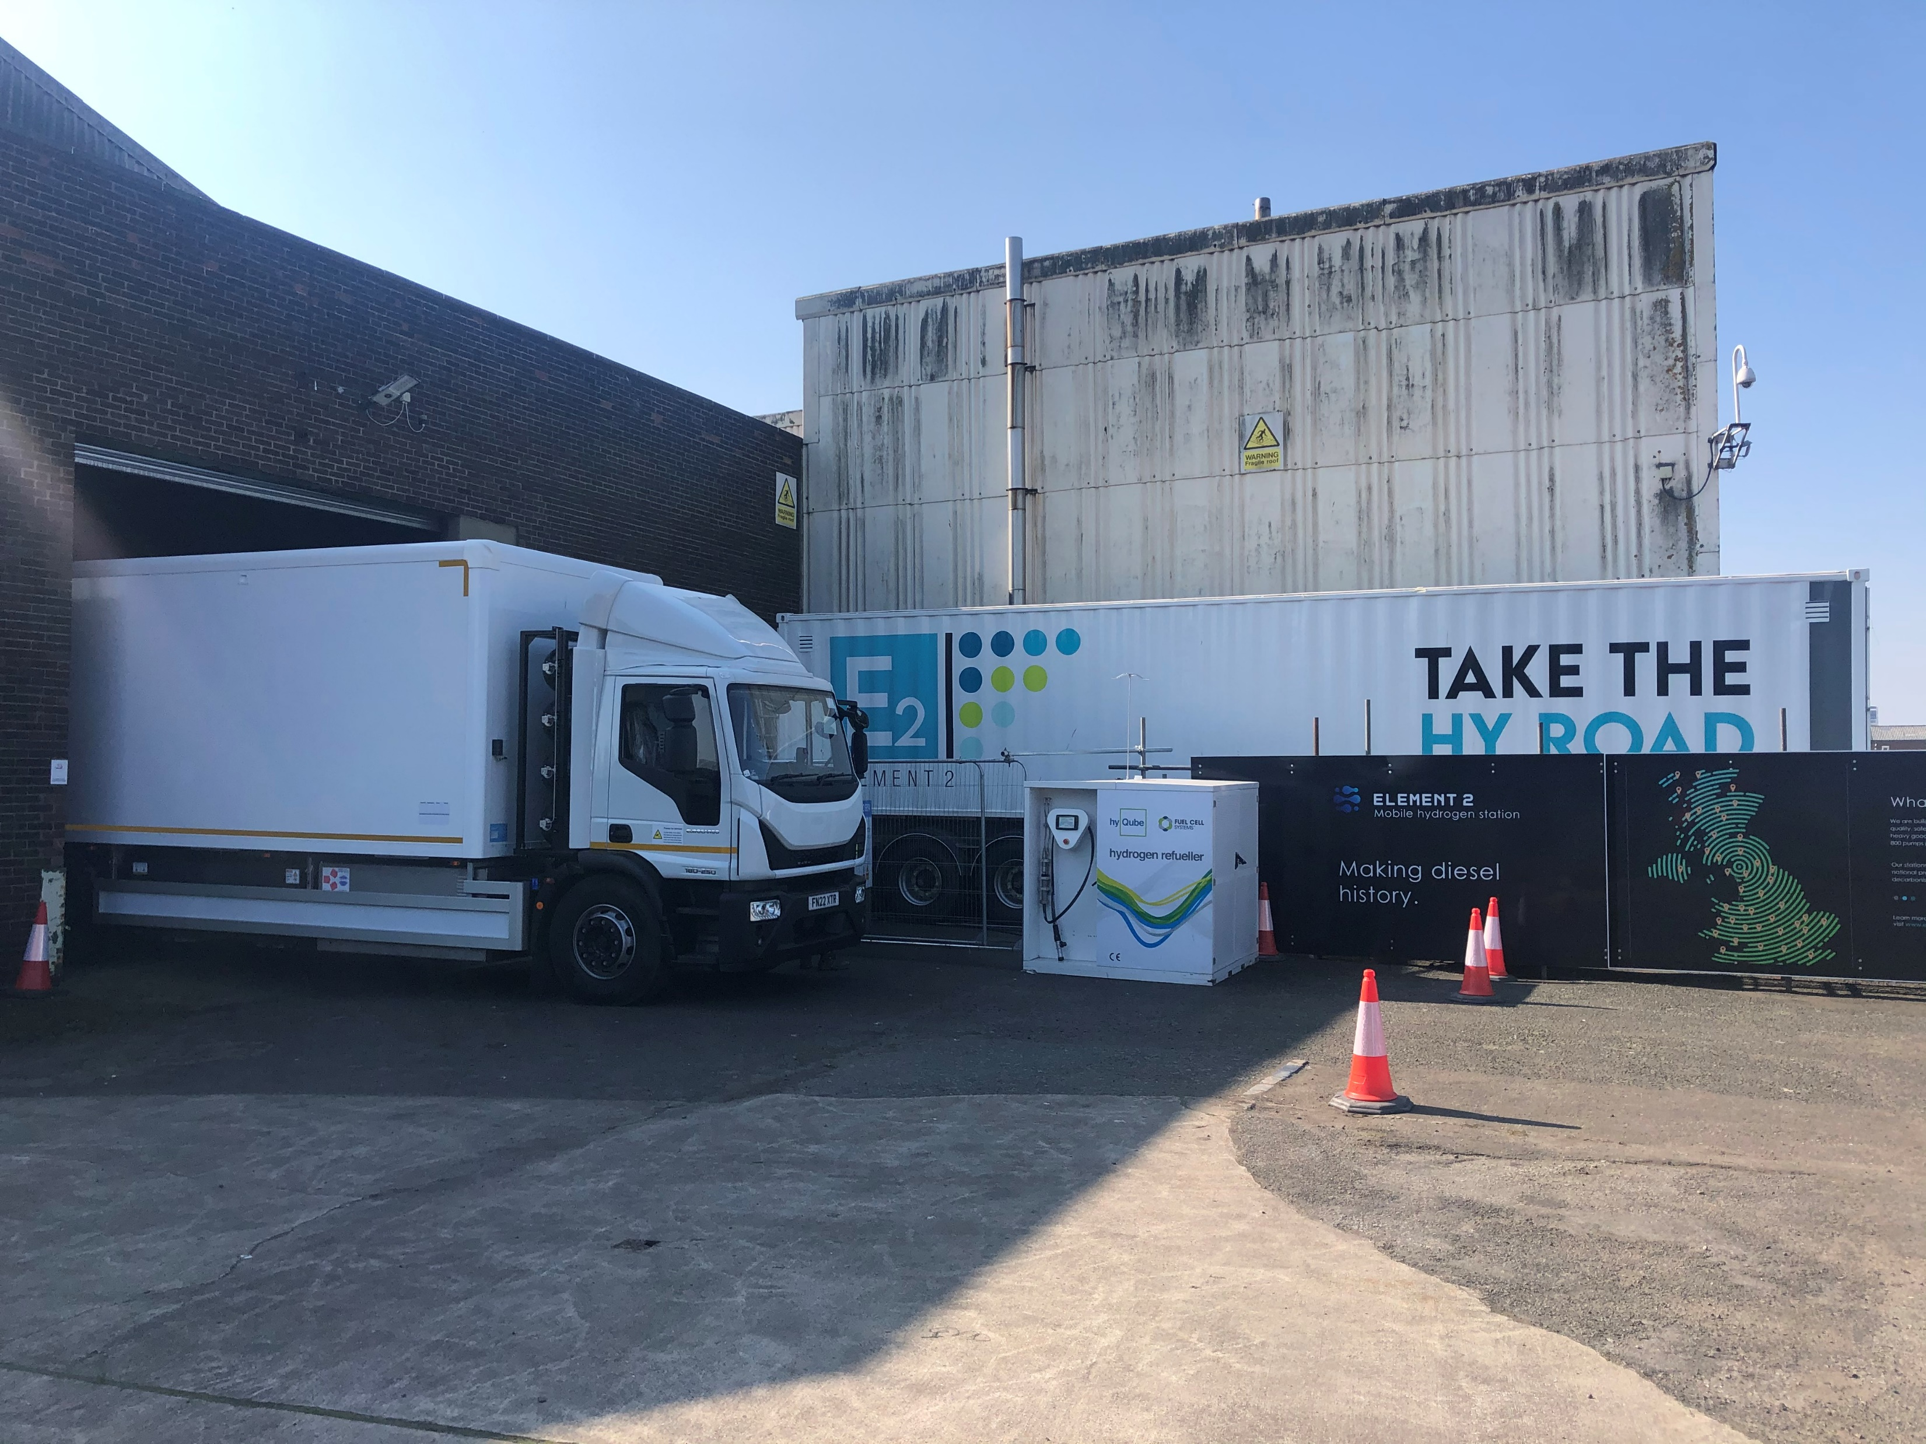
HYDROGEN BUSES & TRUCKS
ELECTRA-truck PROTOTYPE

Slide 19
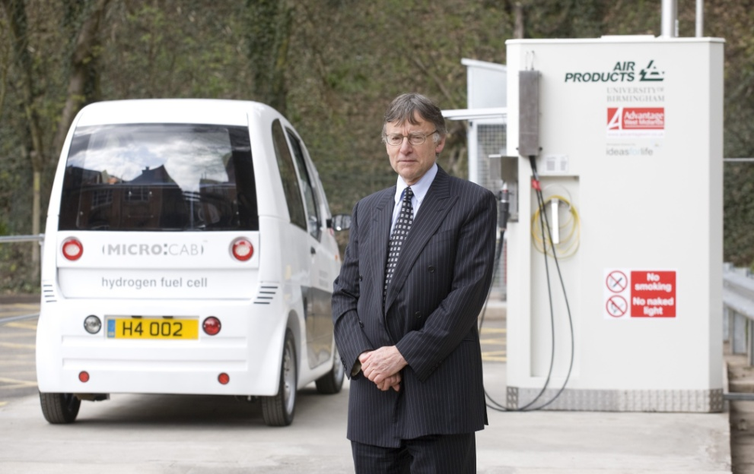
FEW HYDROGEN STATIONS
FIRST UK GREEN H₂ STATION 2008

Slide 20
NUMBER OF HYDROGEN STATIONS
number of UK hydrogen stations
number of German stations
30
20
10
0
predicted rise by 2030
150
100
50
0
develop
intro
growth
mature
1980 2000 2020 2040
year
1980 2000 2020 2040
year

Slide 21
NOT GREEN & TOO EXPENSIVE
Tyseley uses Grid Electricity £23/kg
Germany has 93 not green £11/kg
China has 350,
Not green £9/kg

Slide 22
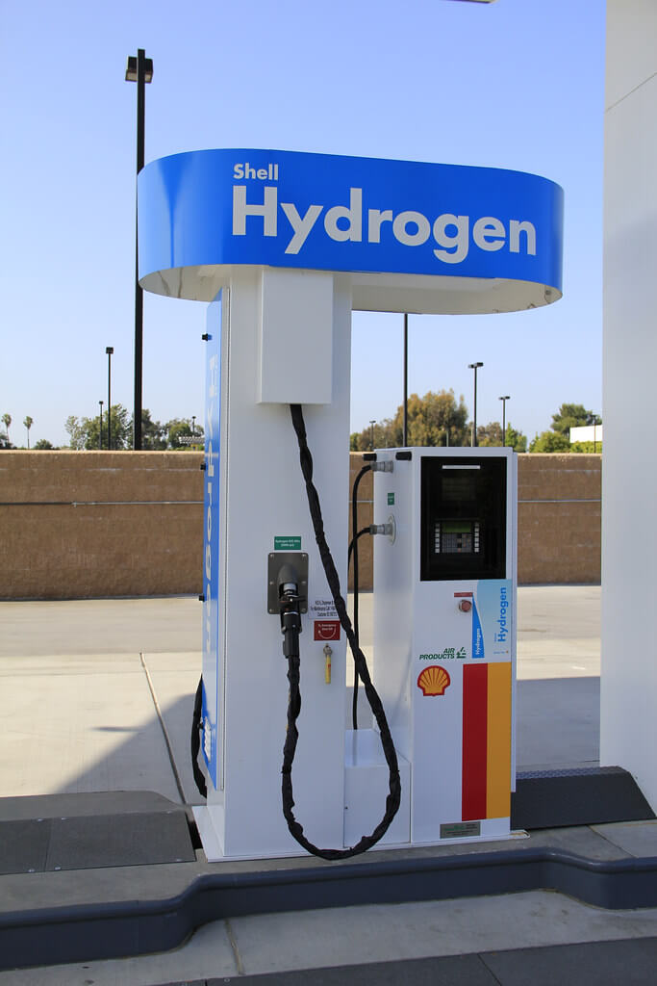
LEAGUE TABLE HYDROGEN STATIONS
China 250
Japan 161
Korea 141
Germany 93
USA 54
France 21
Switzland 13
Holland 11
Canada 9
Denmark 7
Austria 5
Belgium 5
Norway 5
UK 3-4
number

Slide 23
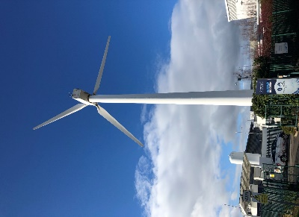
ONLY ONE UK H₂ STATION IS GREEN
Rotherham station built by ITM Power in 2015 has Wind Power feeding electrolyser to store & compress green hydrogen
0.3MW TOO SMALL,
NO SOLAR

Slide 24
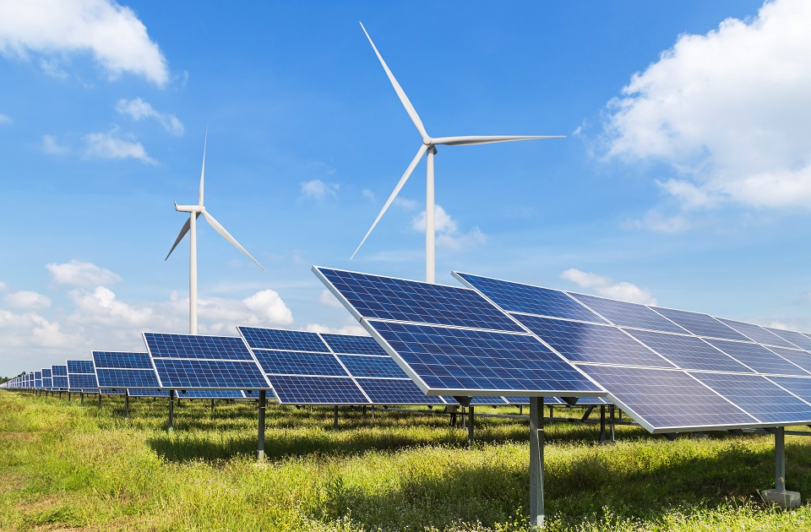
KEELE UNIVERSITY 2018
£8M grant
2MW wind
4.4MW solar
1MWh battery
3MW average

Slide 25
KEELE RESULT ON ONE DAY
MW
power demand
fed to grid
low value
4
2
0
solar power
0 6 12 18 24
hours

Slide 26
INSTALLING MORE SOLAR/WIND
12
9
6
3
0
green power
green hydrogen bridges the gaps
MW
power demand
0 6 12 18 24
hours

Slide 27
WIND WINS in WINTER

Slide 28
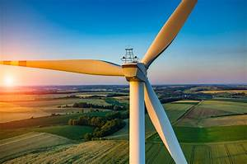
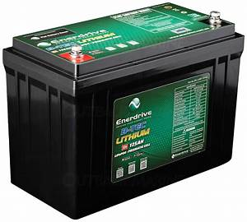
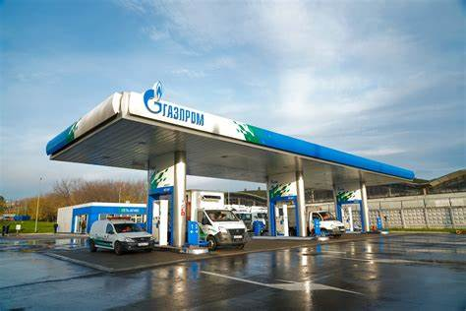
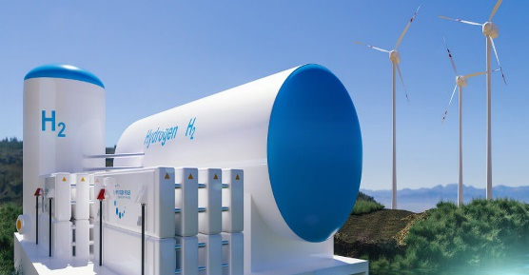
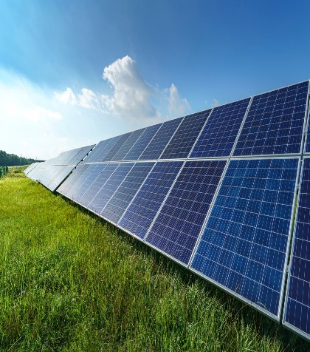
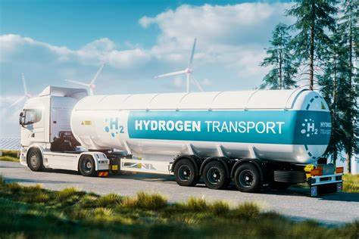
CONSIDER FULL GREEN SUPPLY CHAIN green electricity, buildings, vehicles, industries (+ GRID)

Slide 29
DO NOT BURN GREEN HYDROGEN
BEST TO USE FUEL CELLS IN CARS & BUILDINGS
COMBINED HEAT AND POWER

Slide 30
CONCLUSIONS
COMMUNITY Wind/Solar/HYDROGEN
Electrolysers + Storage cylinders
Feeding Buildings fuel cell CHP
Feeding Hydrogen vehicles
PAY BACK 4 years PROFITS over 20 years eg £100 million

