Slide 1
WELCOME
SOLAR/WIND MIDLANDS GREEN HYDROGEN WORKSHOP
Kevin Kendall
HydrogenUnited.org

Slide 2
MIDLANDS ENERGY CRISIS https://assets.publishing.service.gov.uk 2021 renewable energy in England regions
Yorks & Humber
East England
South East
South West
East Midlands
North West
North East
West Midlands
London
0 1 2 3 4 5 6 GW

Slide 3
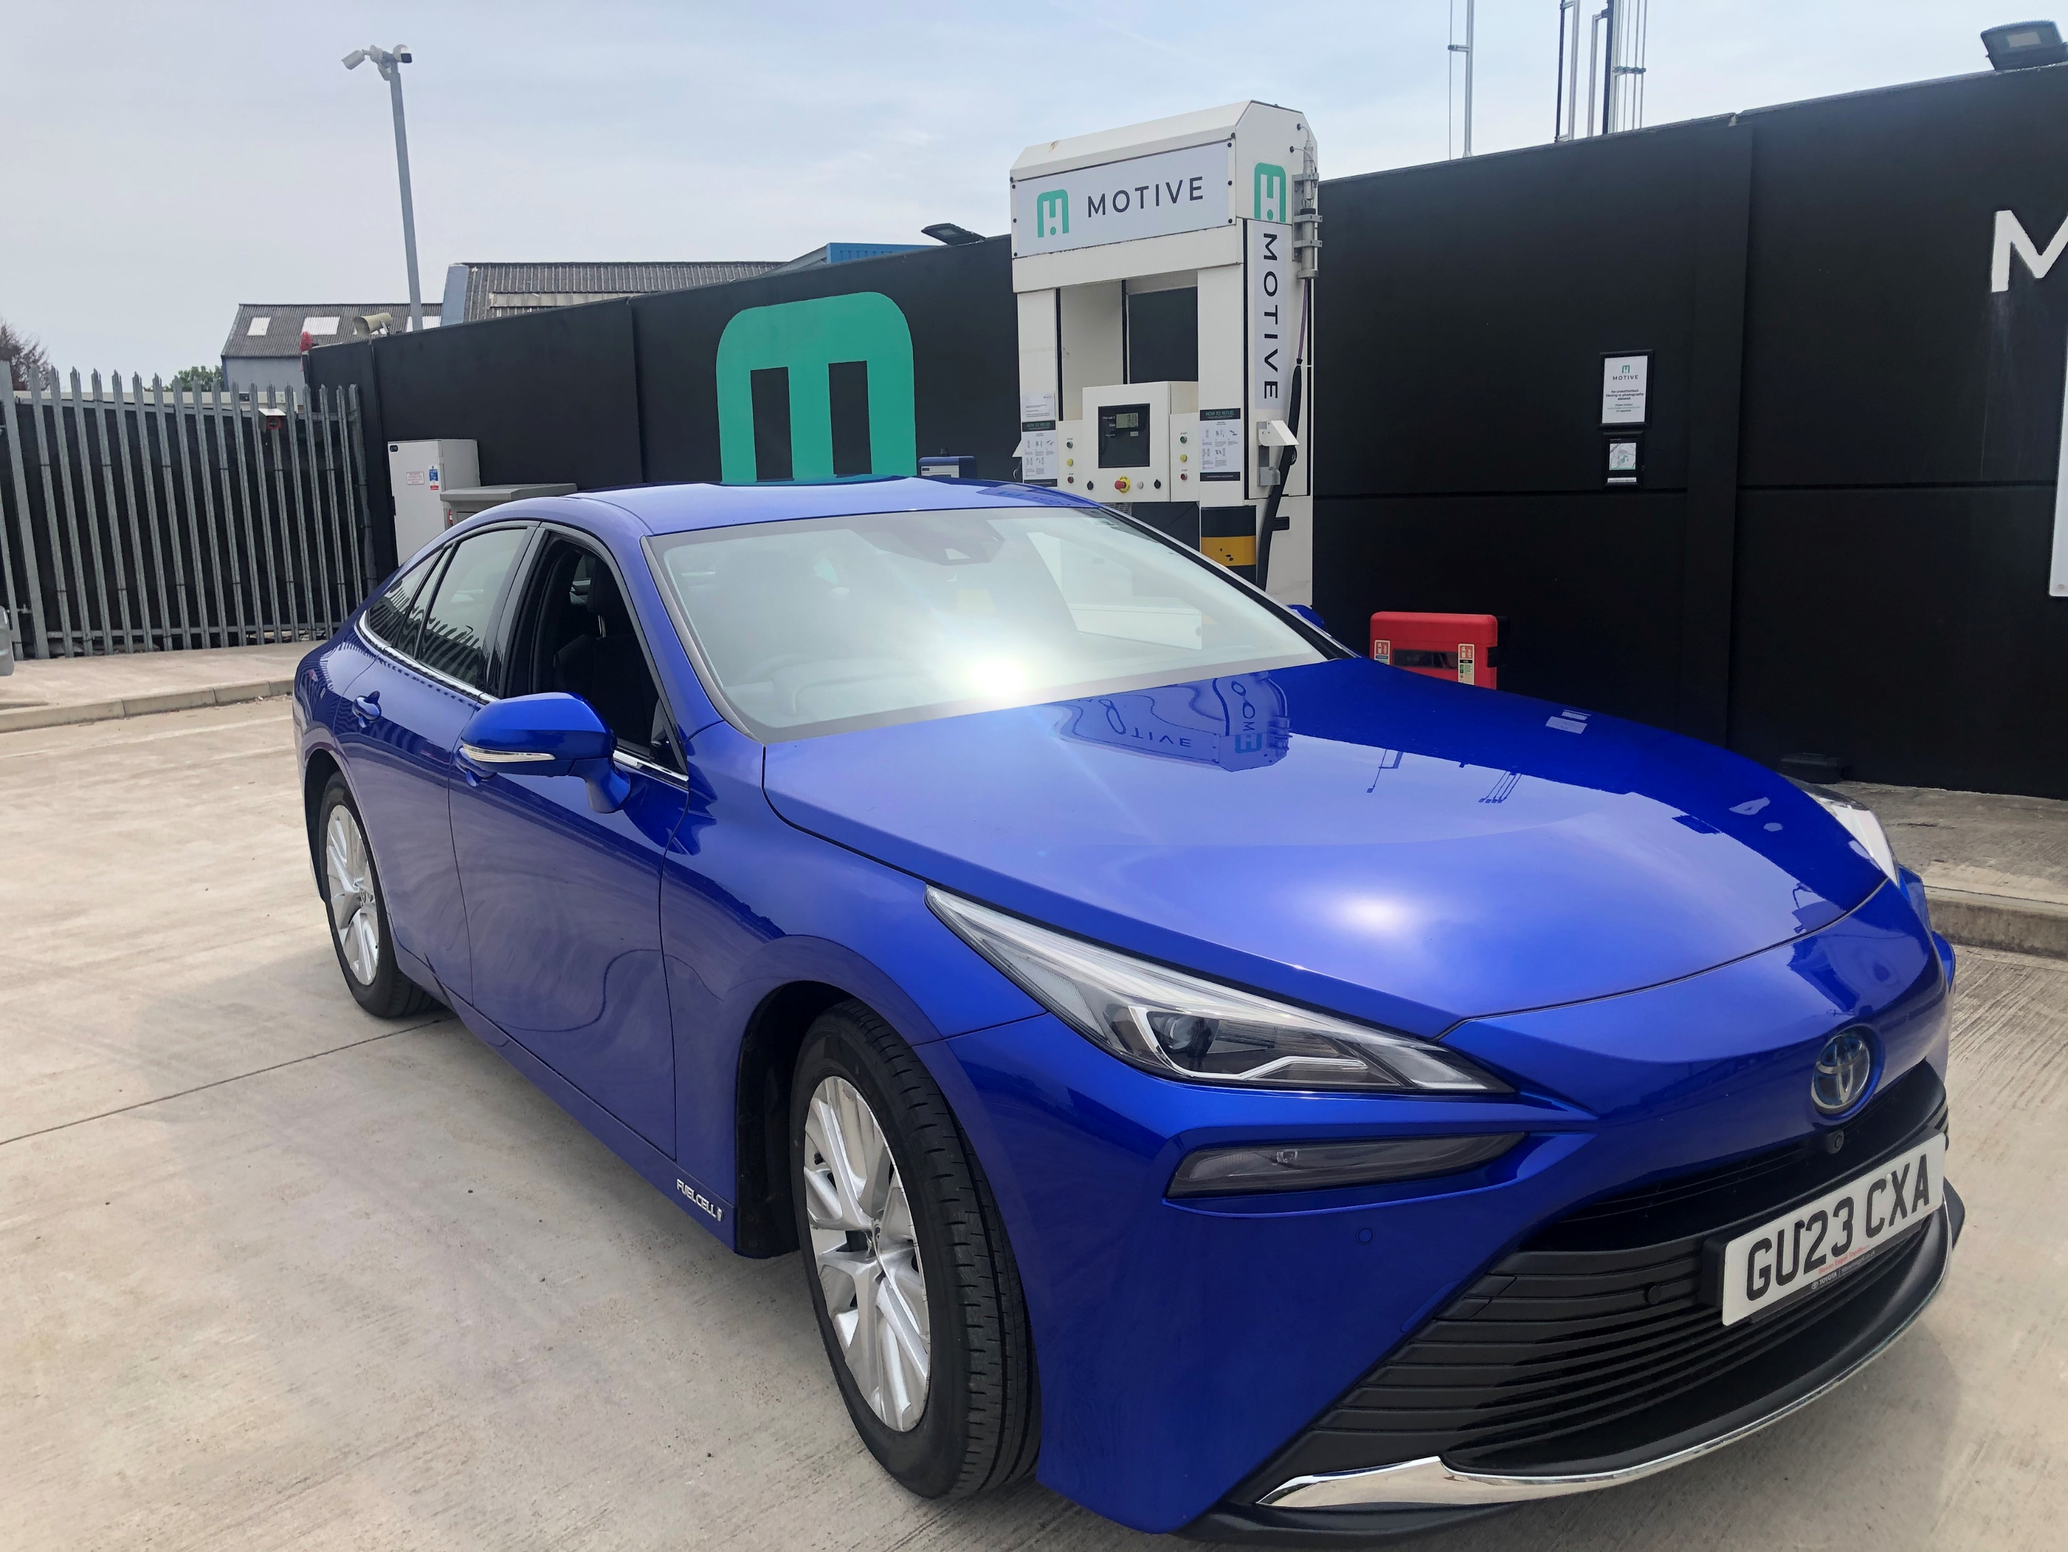
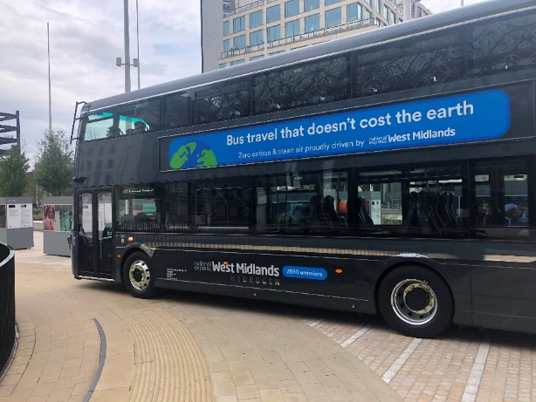
MIDLANDS HAS BIGGEST UK HYDROGEN STATION
MIDLANDS IS UK TOP FOR HYDROGEN BUSES
WEST MIDLANDS GOOD

Slide 4
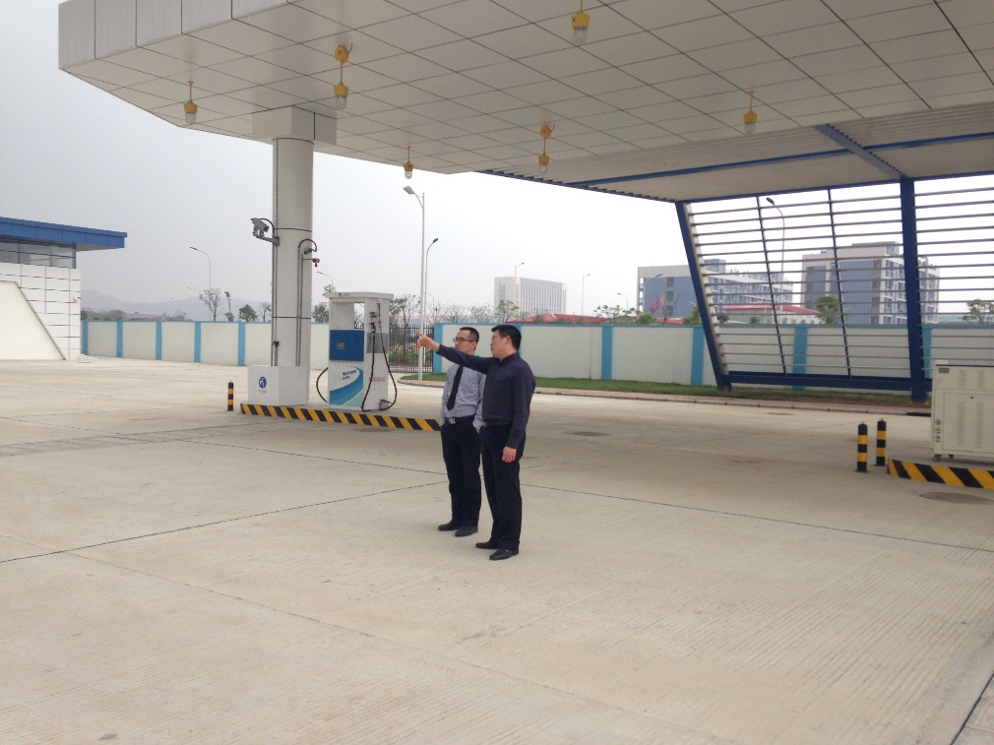
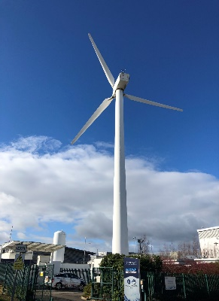
WEST MIDLANDS BAD
UK only has 4 stations operating: CHINA has 350
MIDLANDS hydrogen is not ECONOMIC nor GREEN

Slide 5
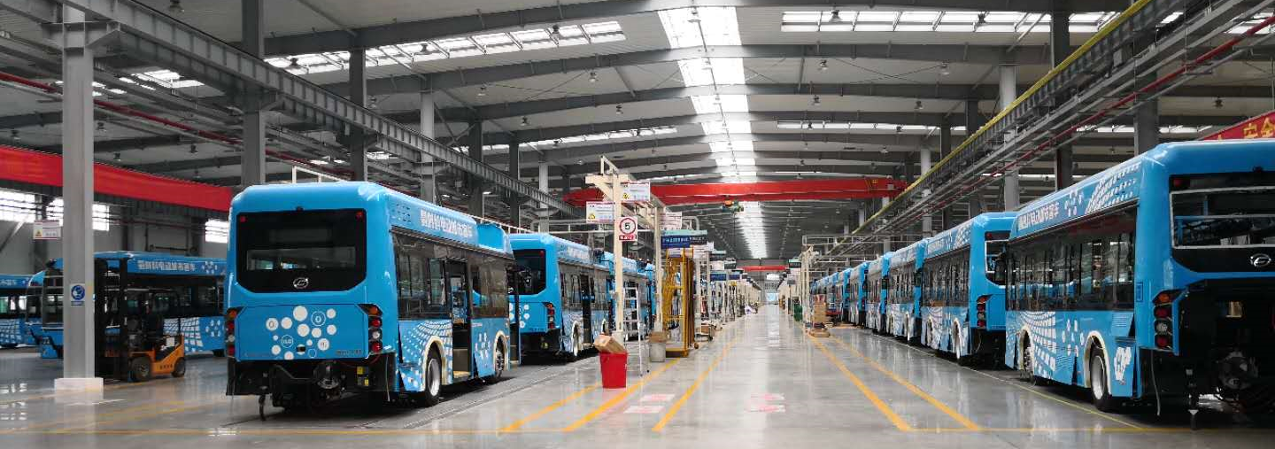
PROGRESS ON YUNFU INDUSTRY PARK
2017
BUS FACTORY
FUEL CELL LINE
LAB
2018

Slide 6

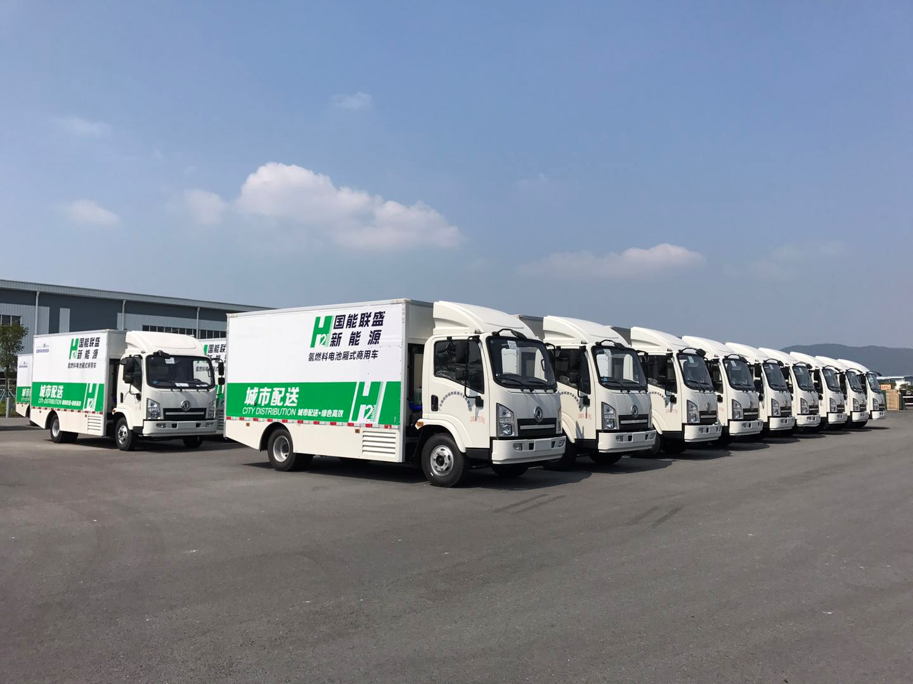
FUEL CELL DELIVERY TRUCKS
  BroadOcean is collaborating with Synergy to build 30kW Ballard trucks

Slide 7
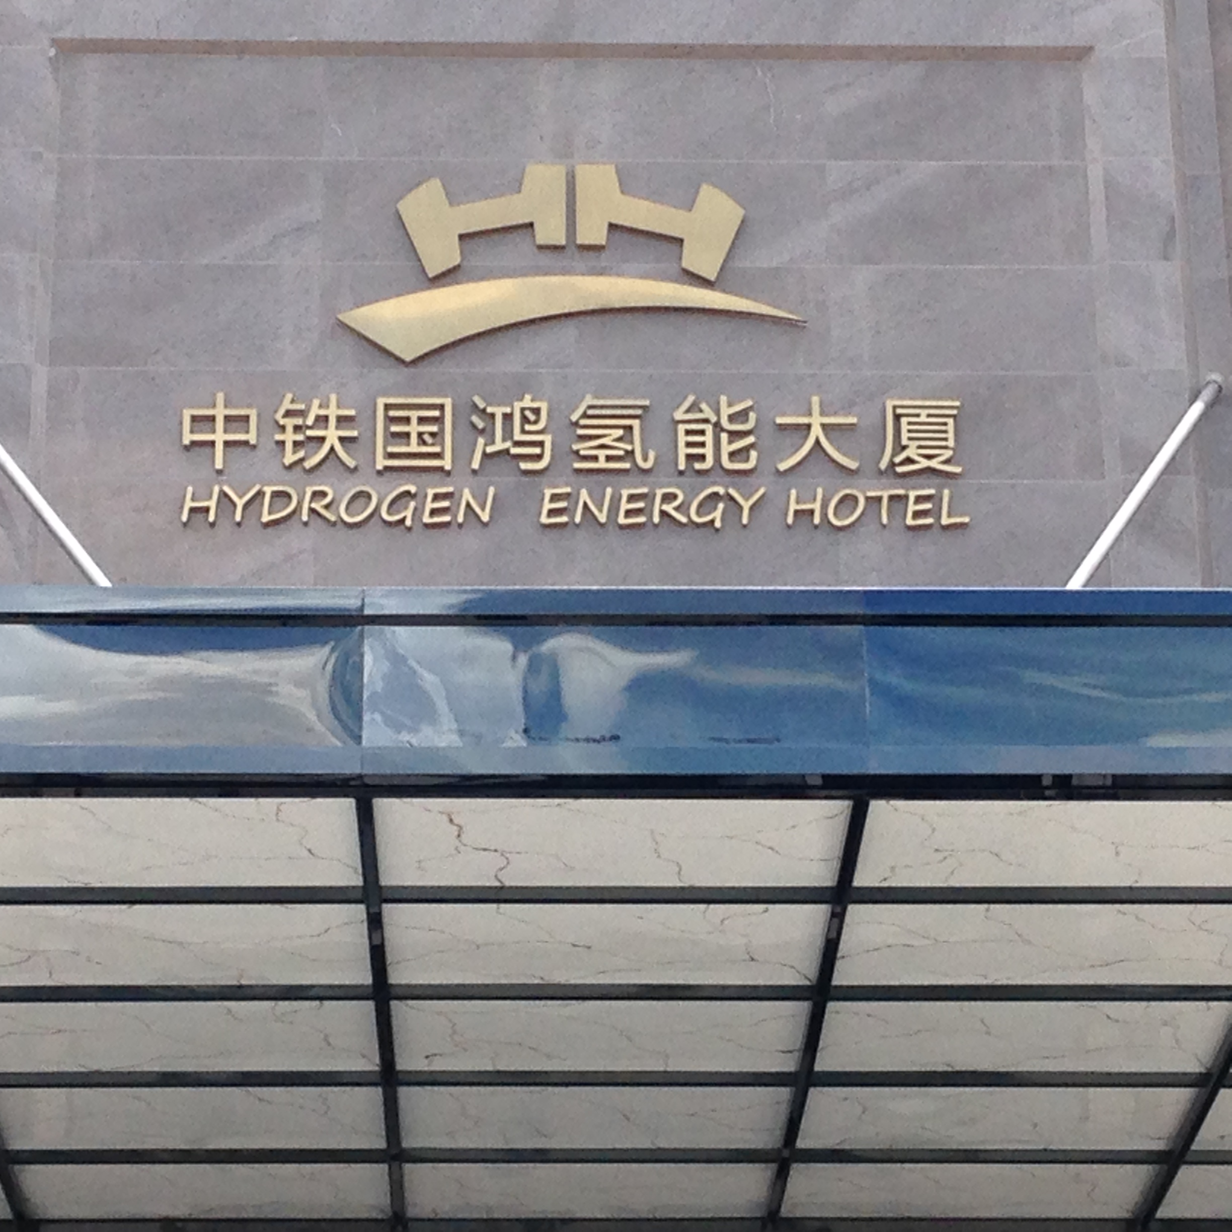
YUNFU industry park

Slide 8
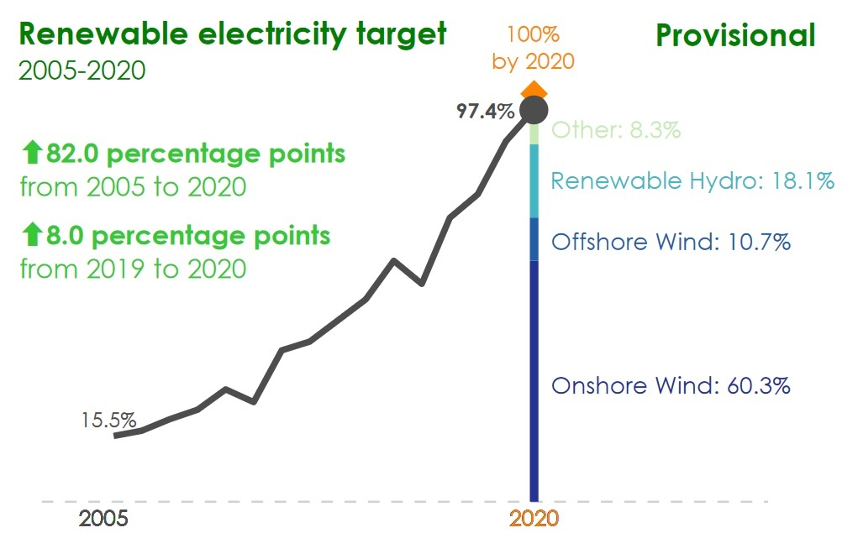
SCOTLAND IS MUCH GREENER THAN ENGLAND
SCOTLAND 100%
ENGLAND 43%
2005 2020

Slide 9
WE NEED TO FIX THESE PROBLEMS
THIS SESSION
Mark ORMEROD, Keele University going Green
Ali Murat SOYDAN, Solar/Wind in Europe (MK)
Kevin Kendall, Hydrogen for Vehicles & Buildings

Slide 11
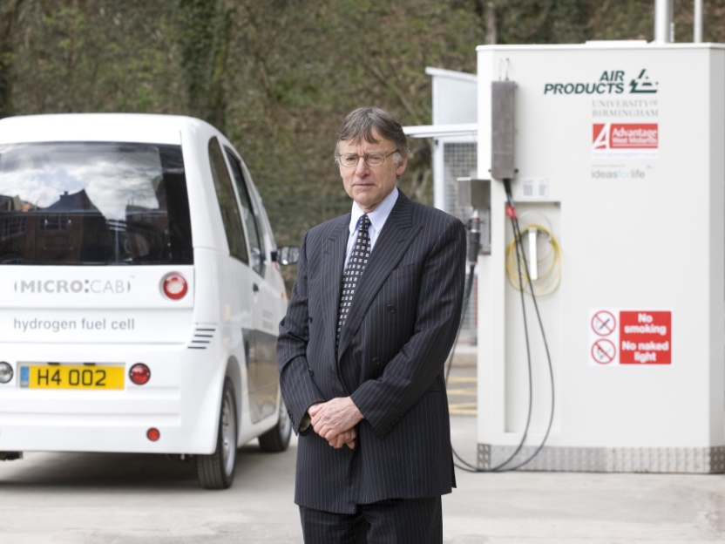
31st Anniversary conference
FIRST UK GREEN HYDROGEN STATION 2008
K Kendall, Economic Green Hydrogen for UK Refueling Stations and Buildings, Renewable Sustainable Energy ,2023

