Slide 2
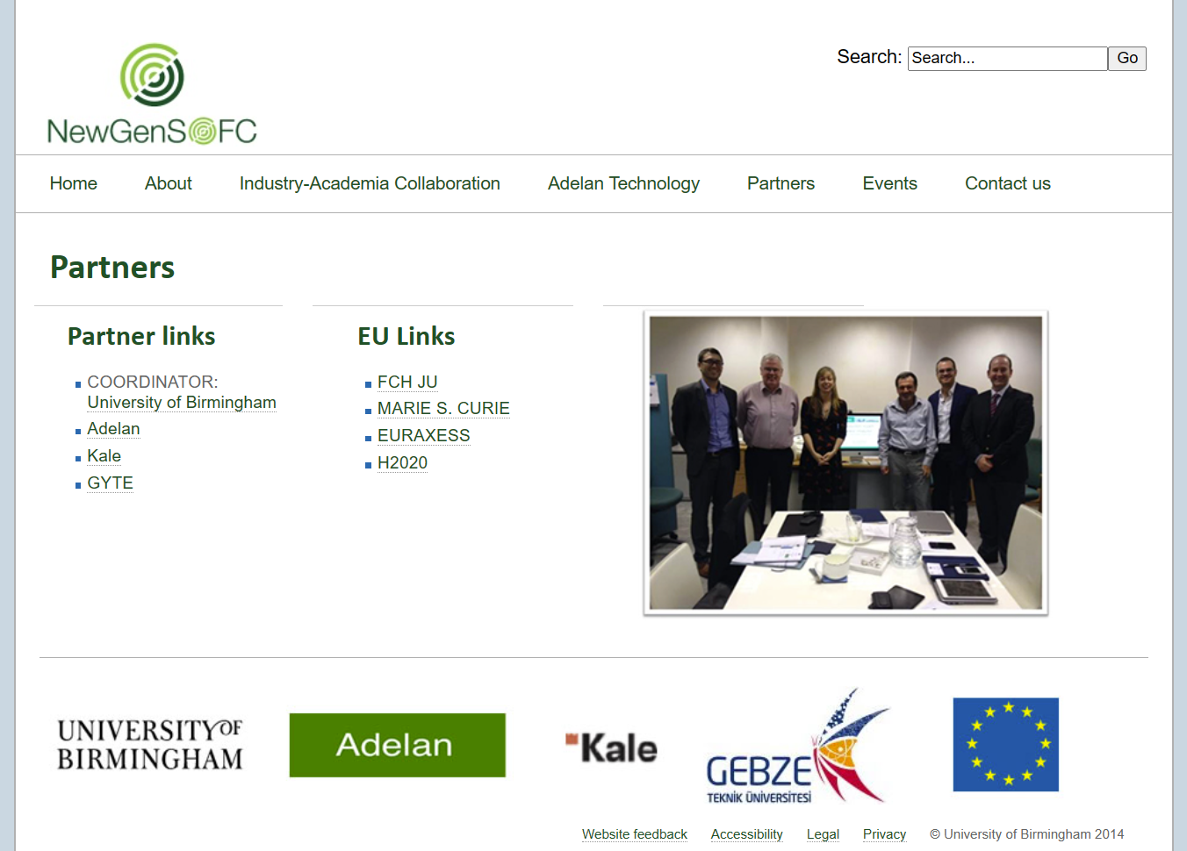

Slide 3
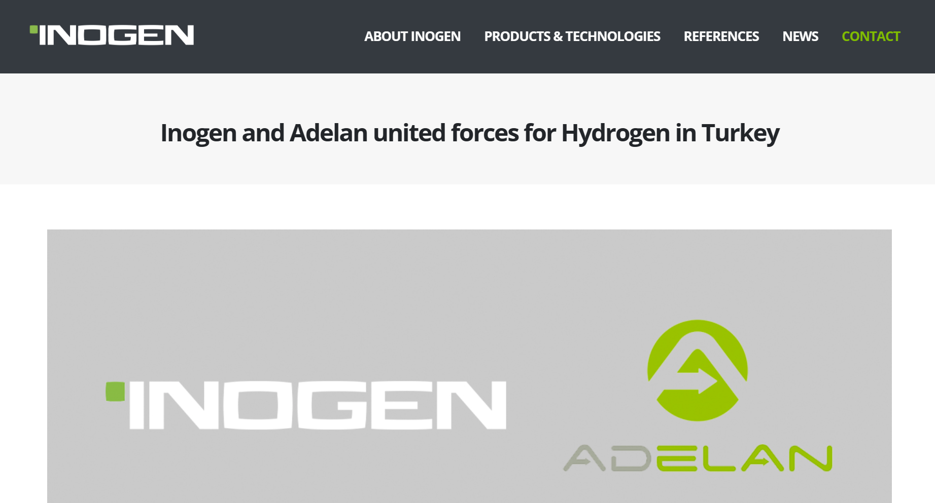
Inogen extends on going collaboration activities with UK fuel cell company Adelan. Together with Adelan, Inogen will investigate manufacturing and applying fuel cell systems in Turkey.

Slide 4
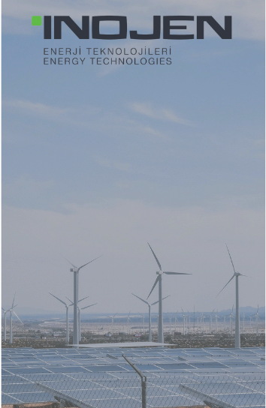
As one of Turkey's largest EPC companies, we install the most efficient systems in the shortest time, especially in ground-mounted solar power plants.
Completed SPPs over 3 GW
Effective working periods
Short payback periods
Improvement in cashflow
Knowledge Integrator

Slide 5
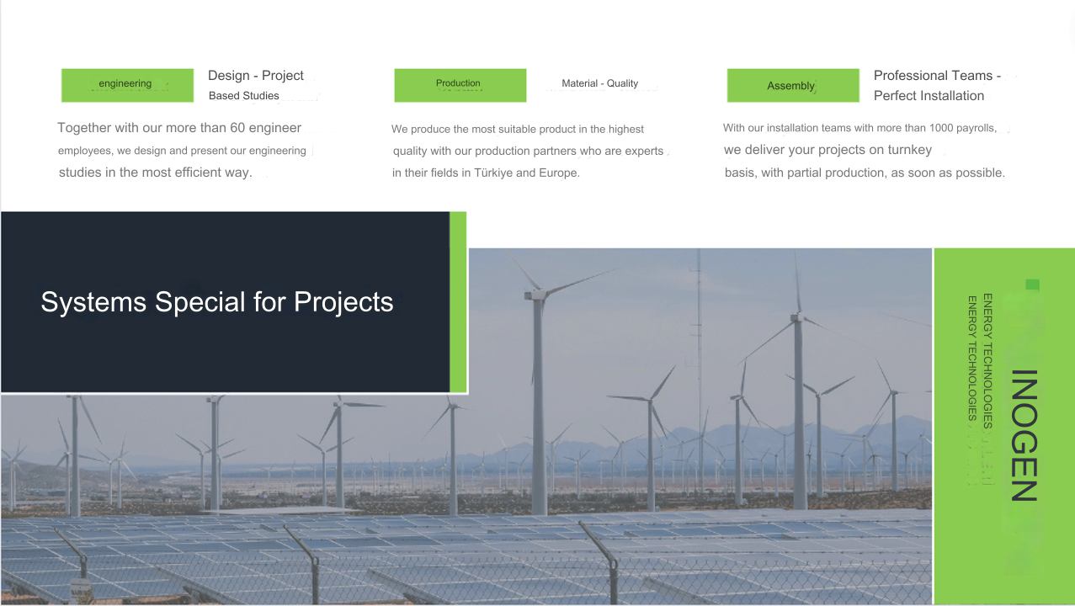

Slide 6
The largest solar power plant in Europe and in Turkey: KARAPINAR – GES
Konya Karapinar SPP is a power plant to be established on approximately 20 million square meters in the Karapinar district of Konya. After completion, this power plant prevents 1.5 million tons of fossil waste and carbon emissions annually and also meets the annual energy needs of 2 million people.
Although its installed power is 1347 MW, in this project, a more environmental energy source will be obtained by the use of renewable energy sources, on the other hand, dependence on external dependence will be reduced.
Knowledge Integrator

Slide 7
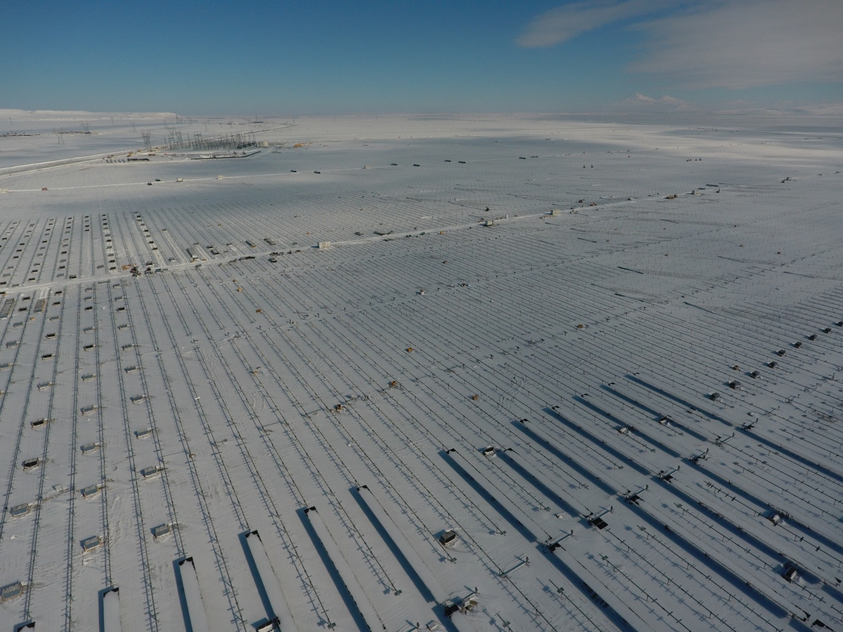
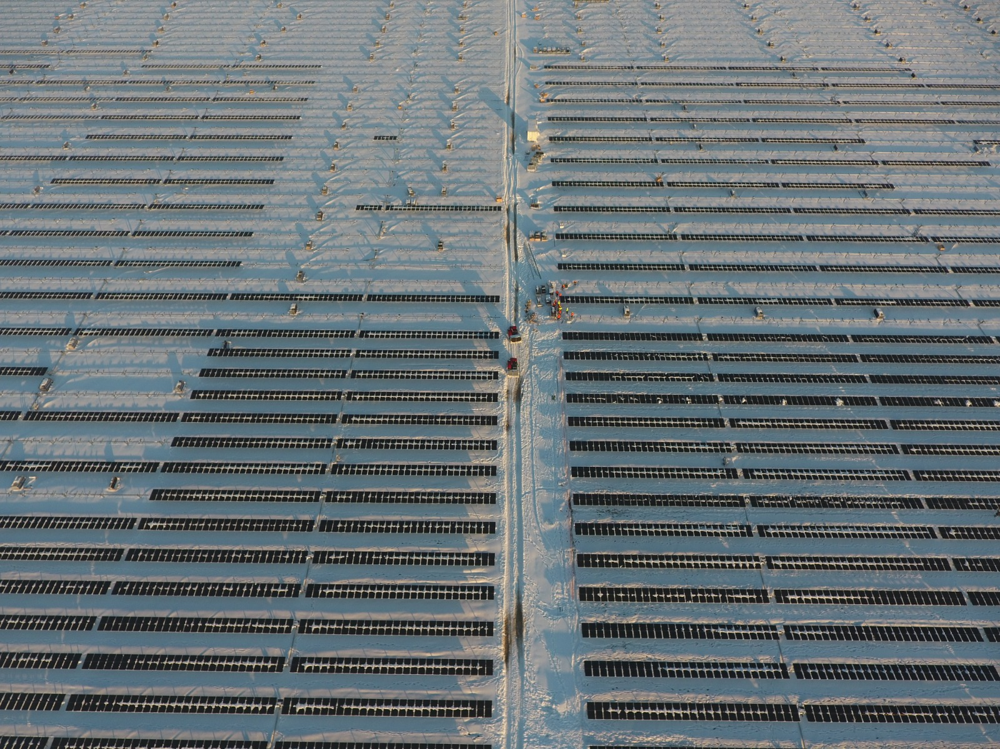
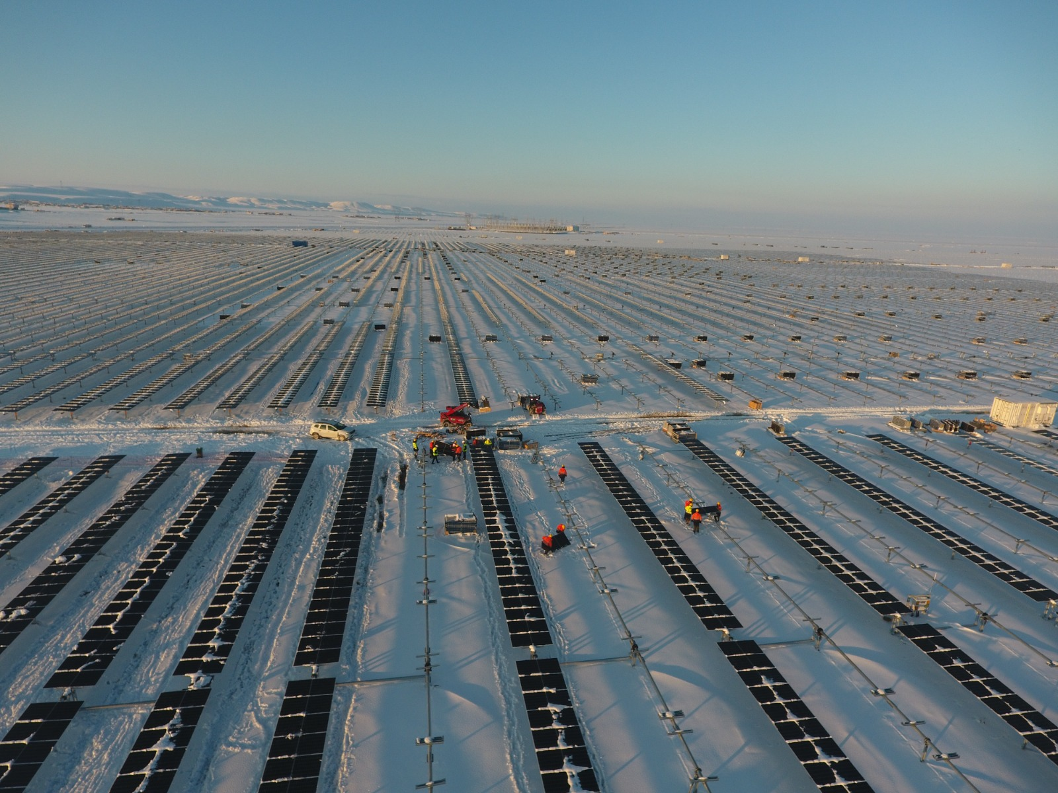
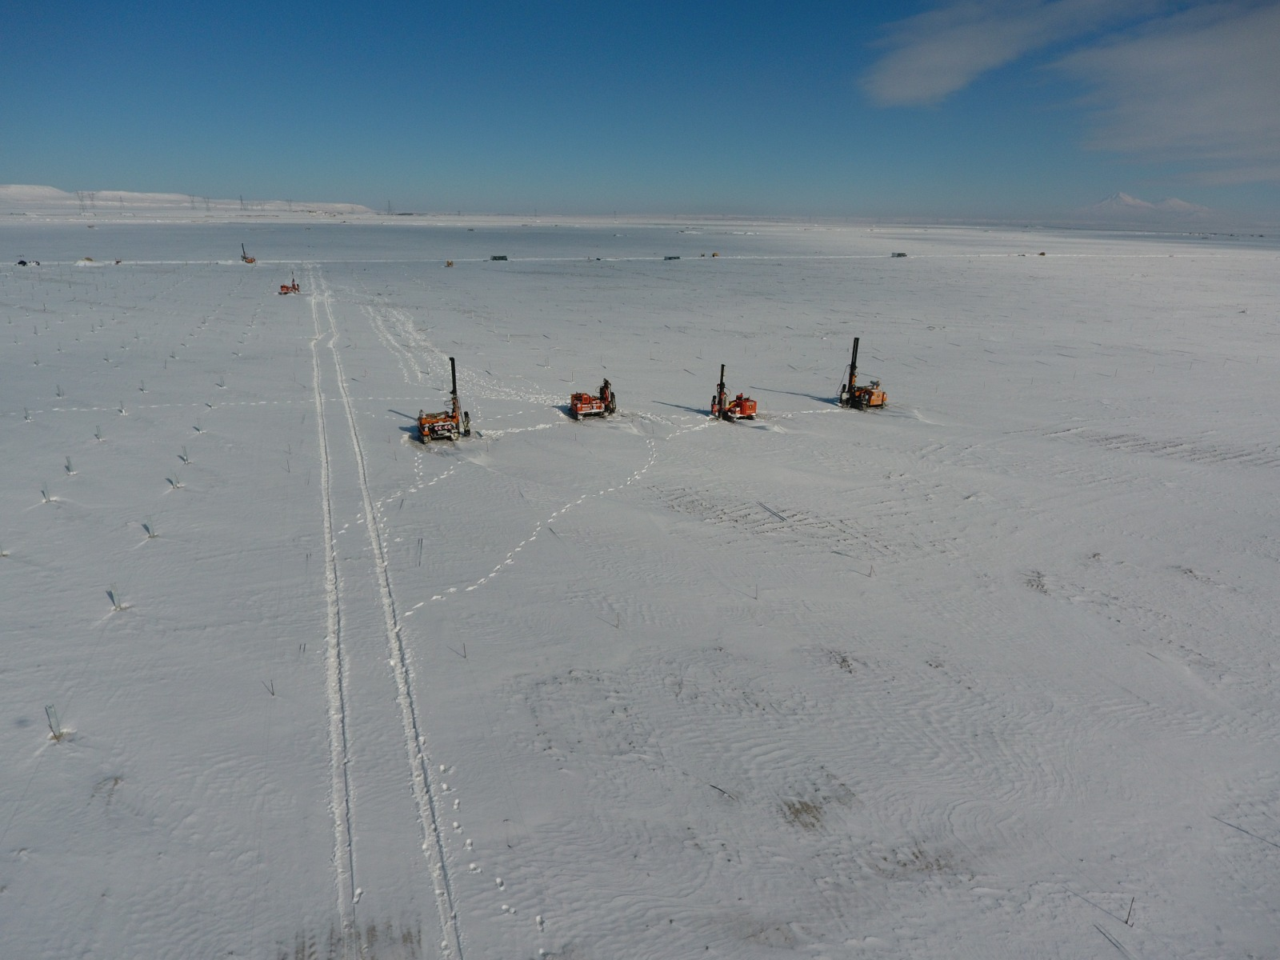
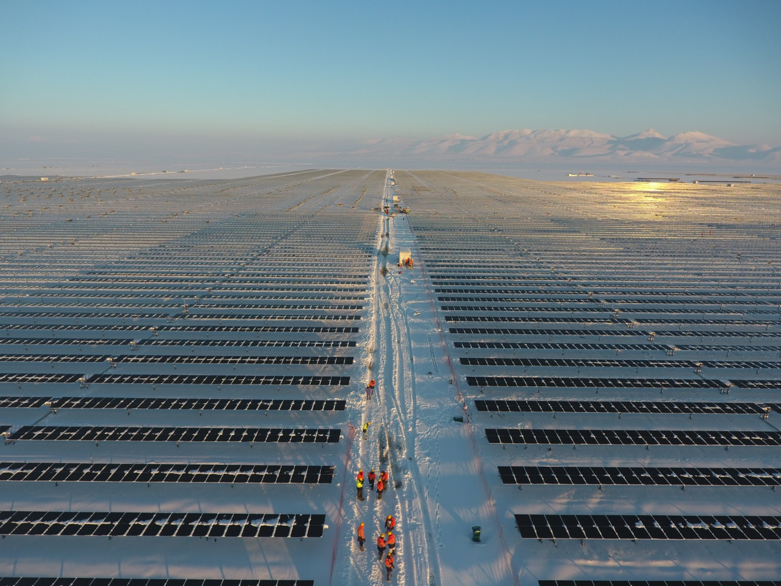
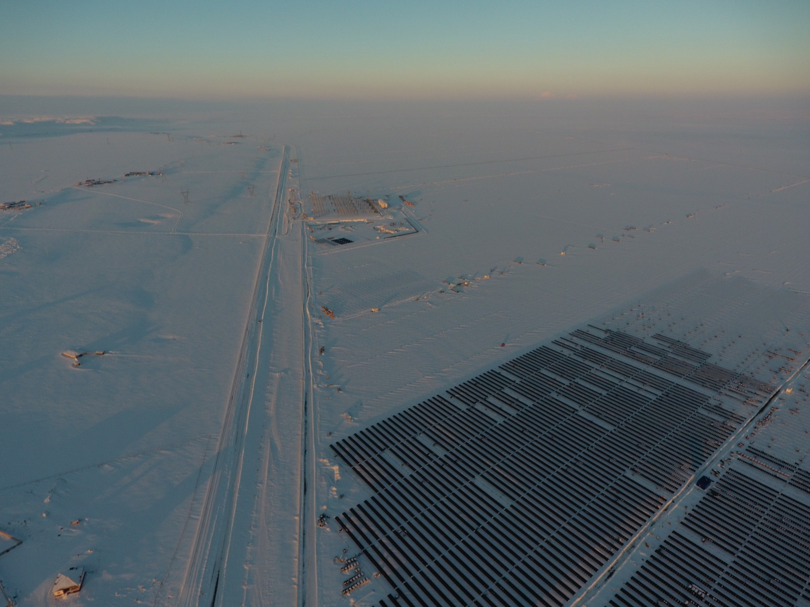
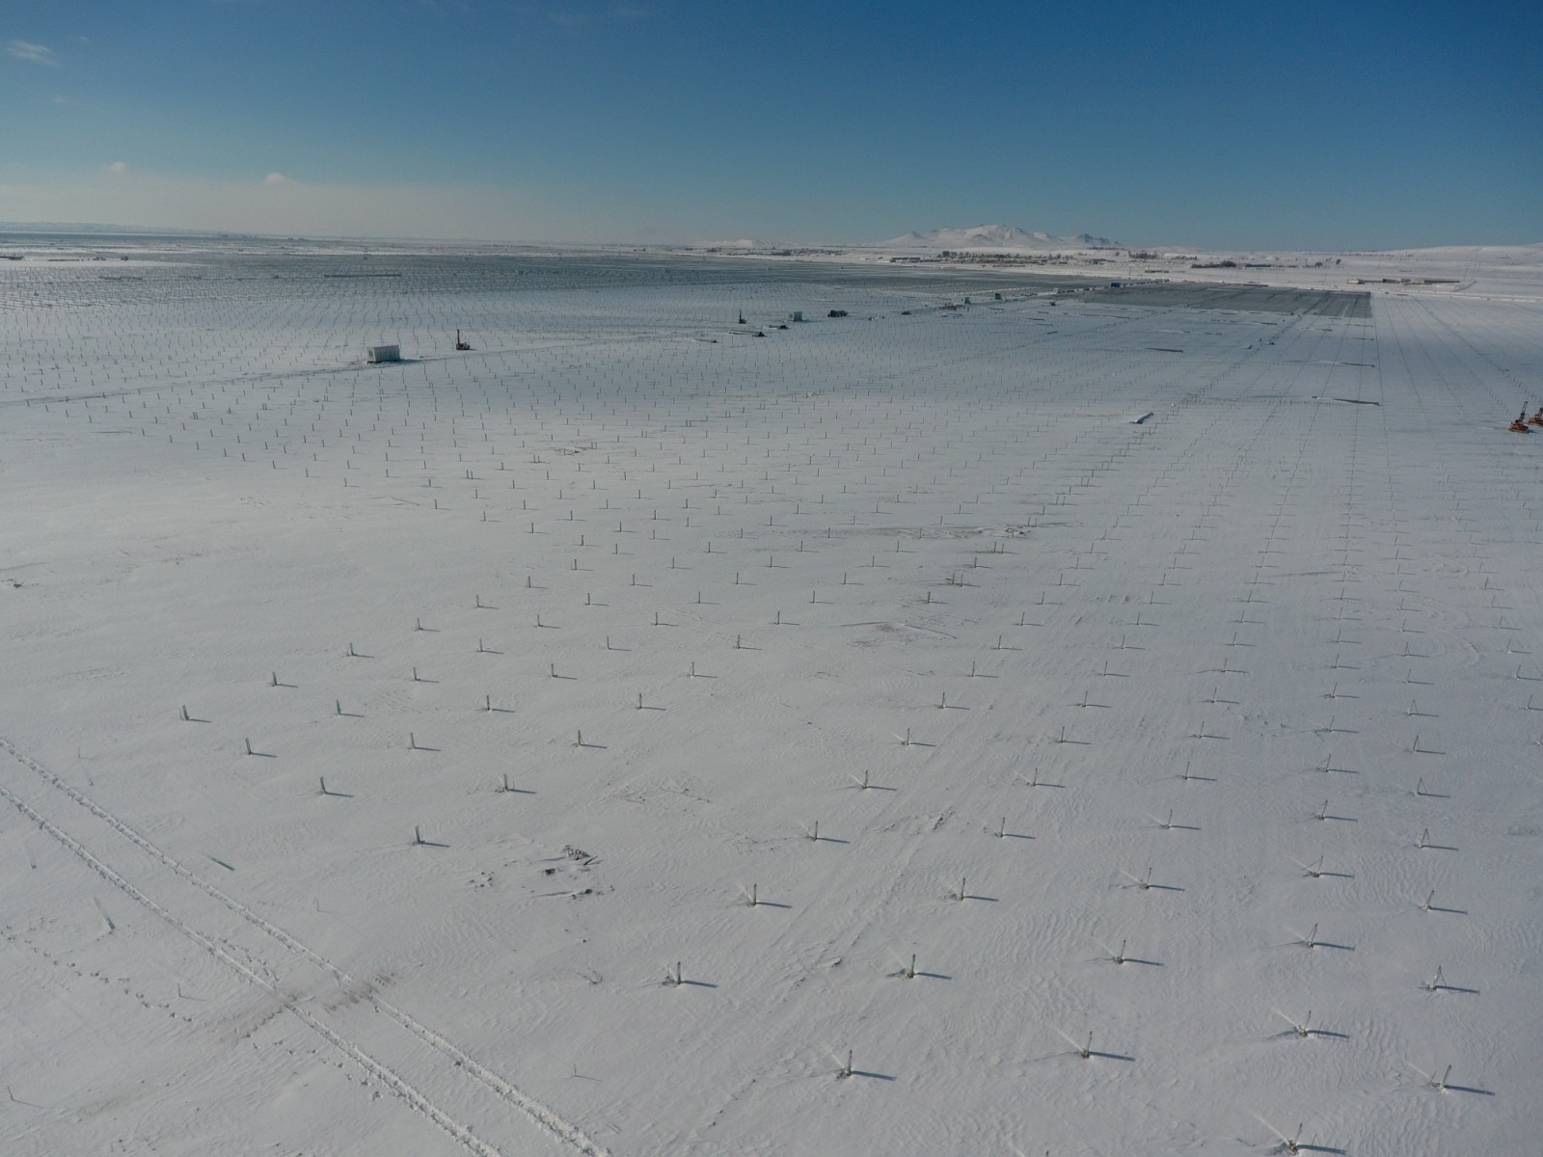
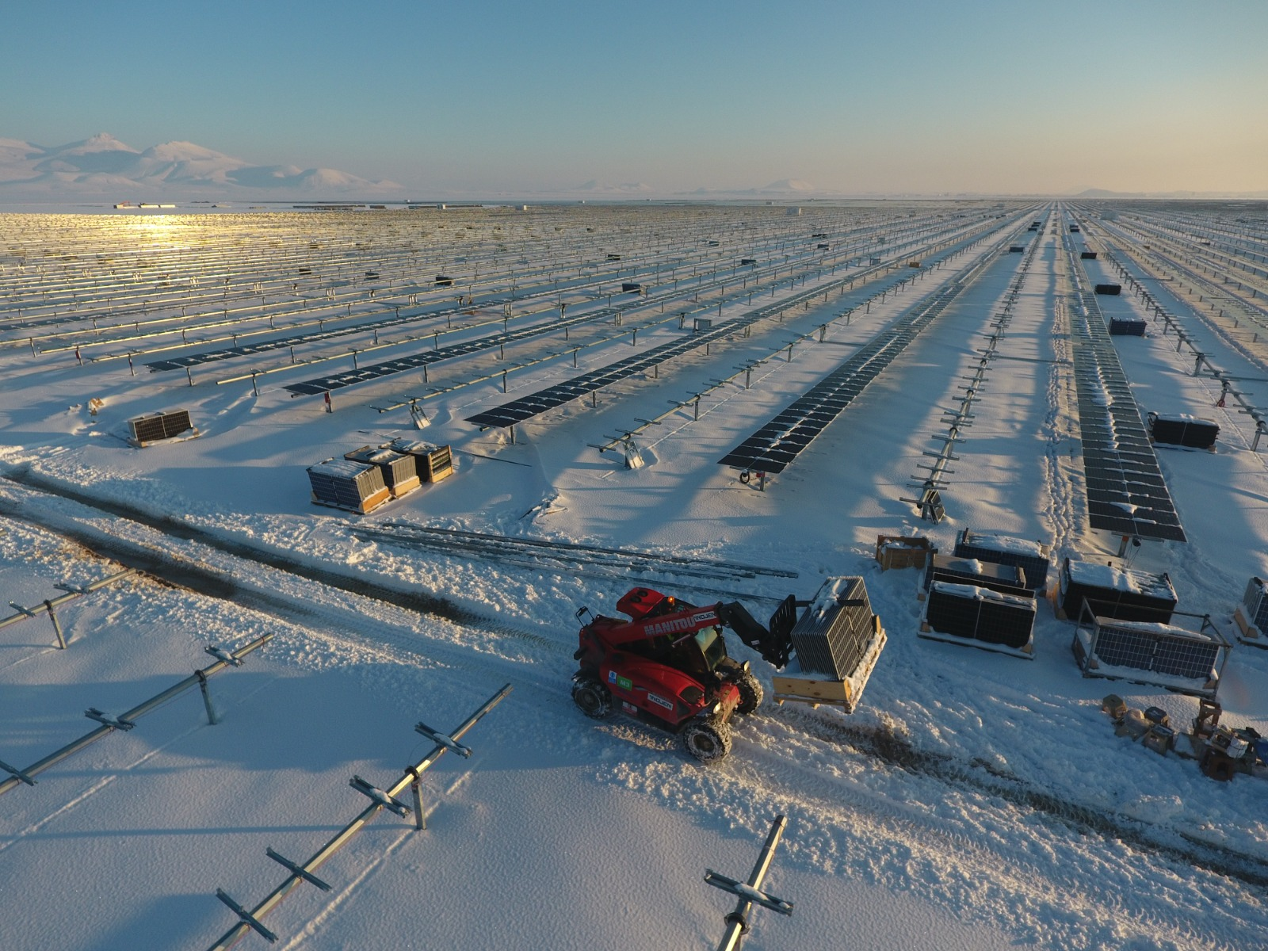
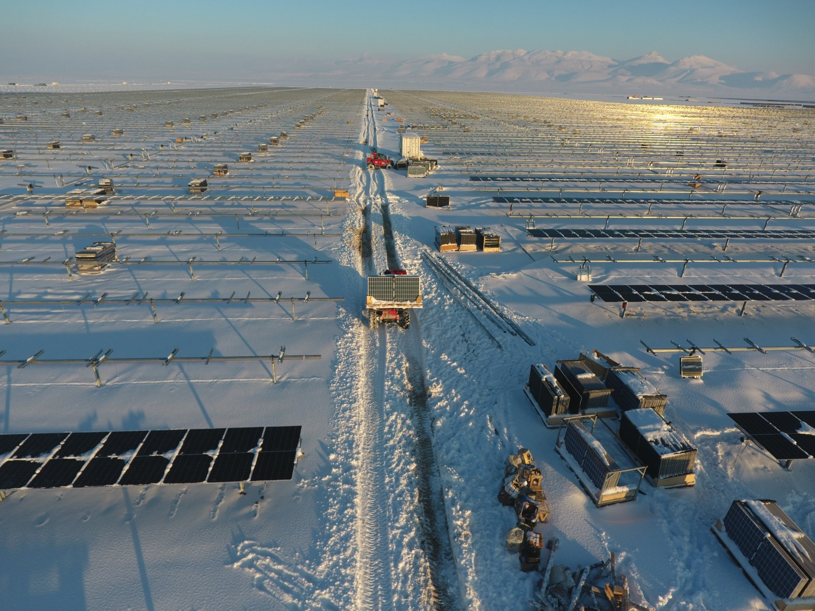
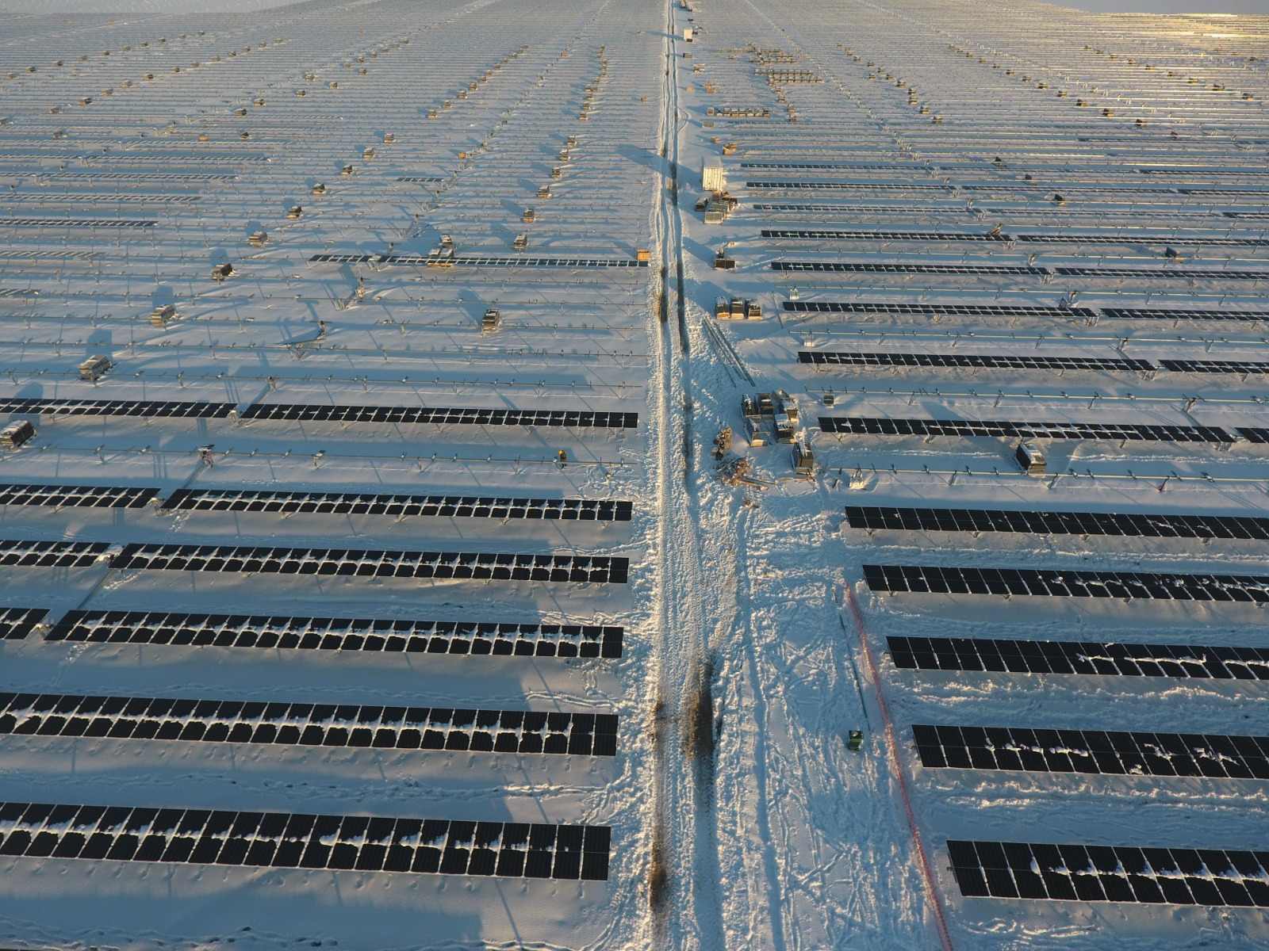
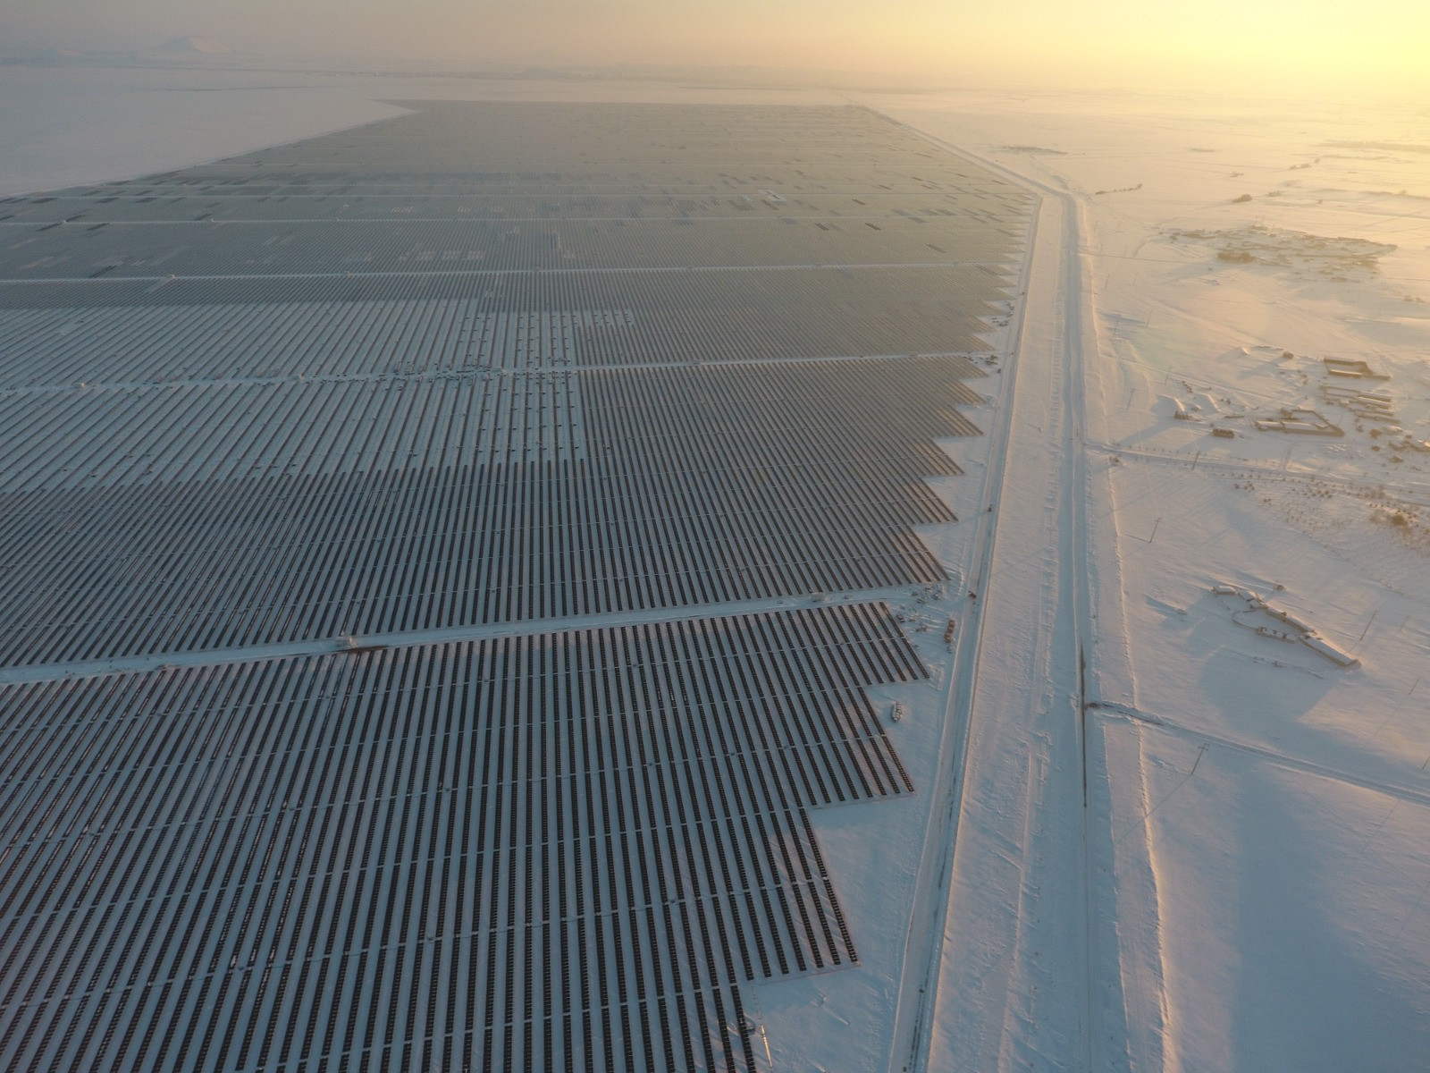
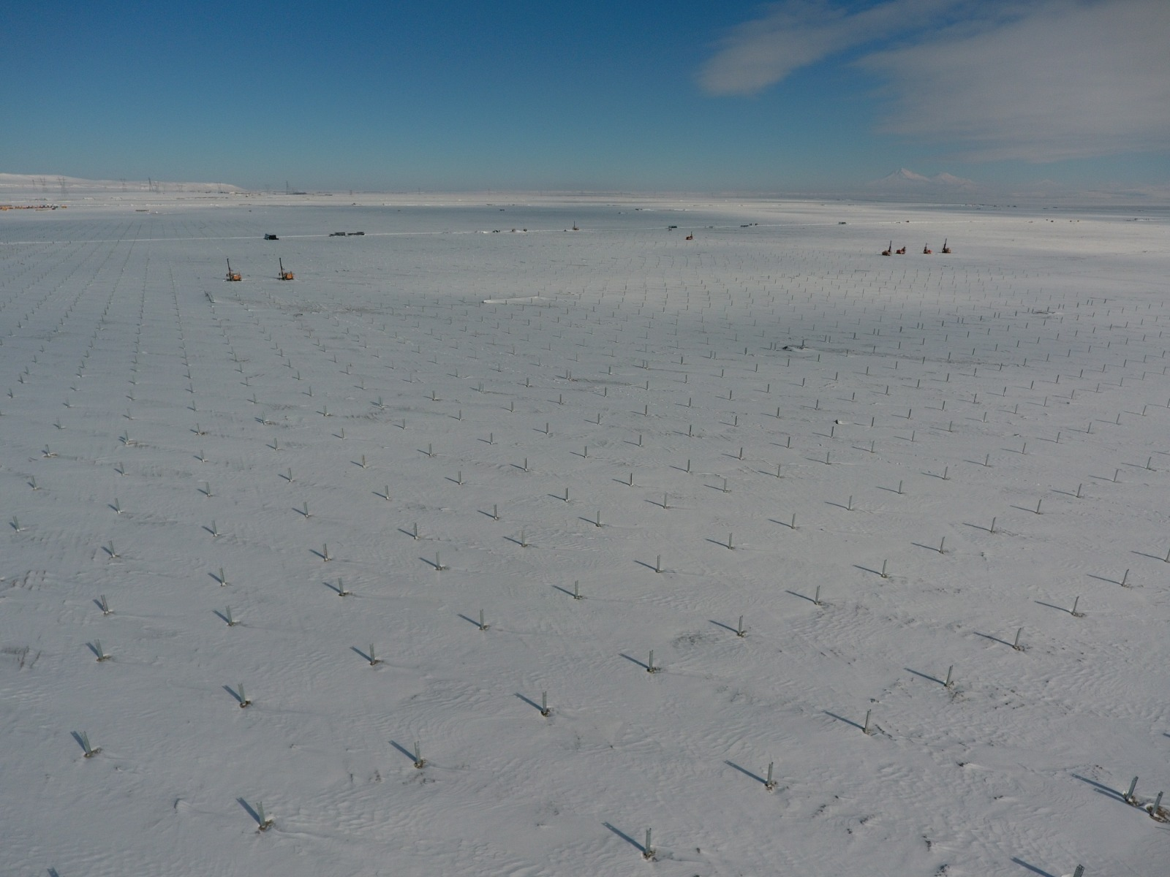
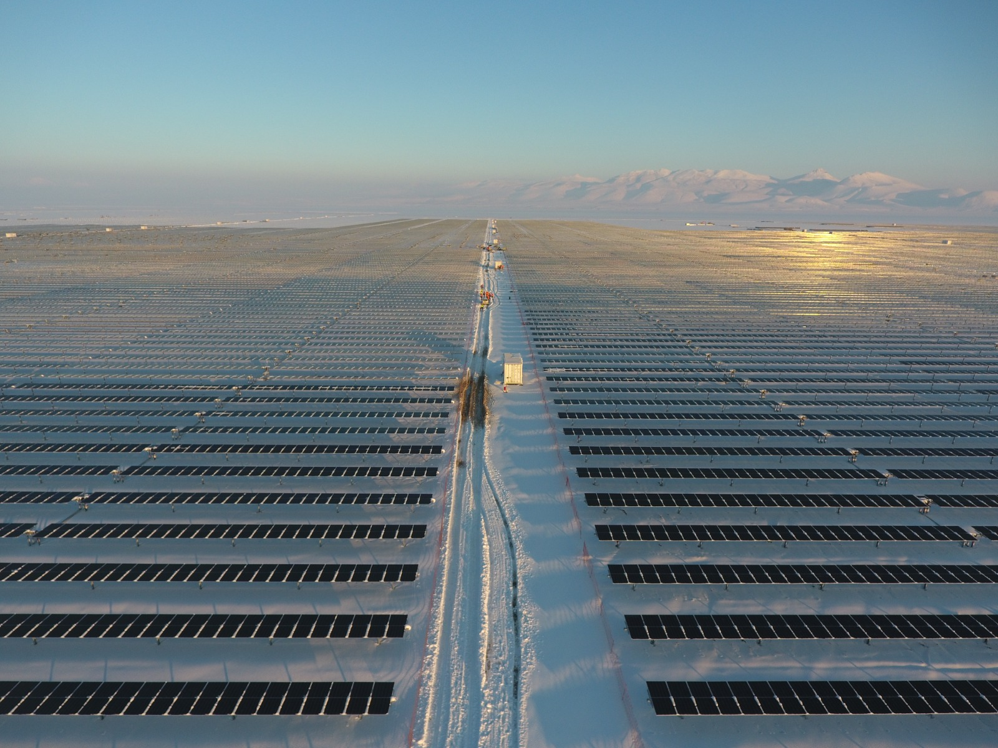
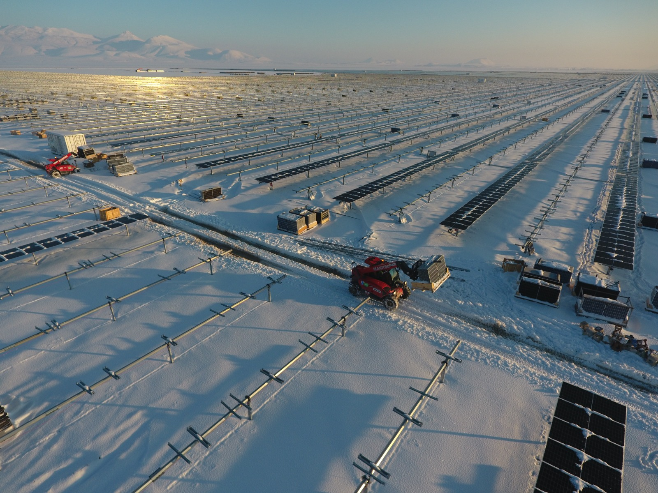
Knowledge Integrator

Slide 8
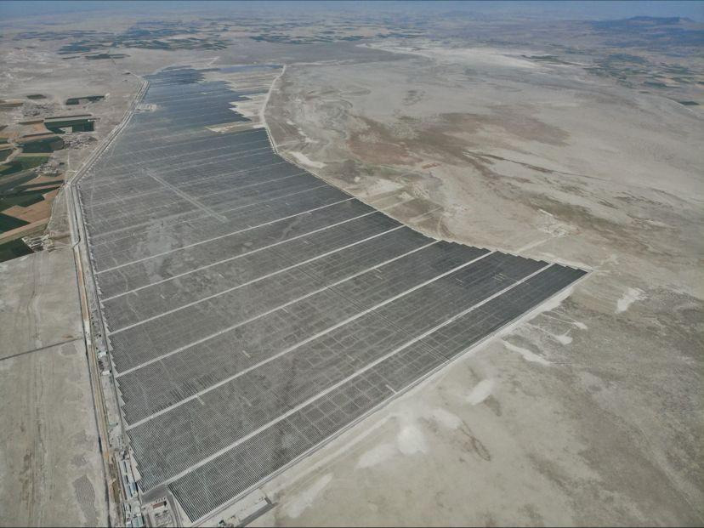
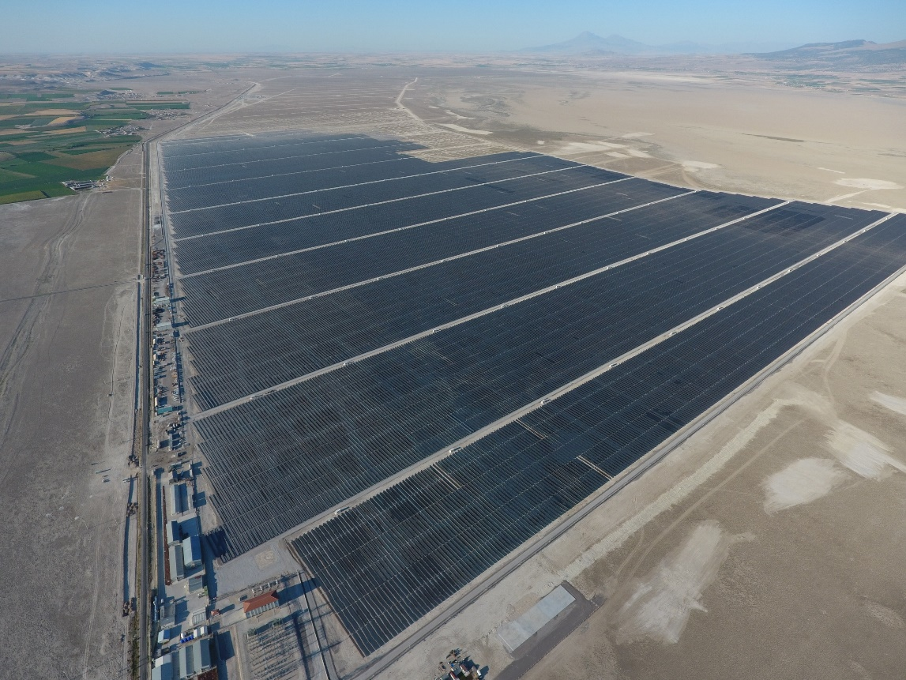
Knowledge Integrator

Slide 9
Knowledge Integrator
Turley’s First Hybrid Project – 50 MWp
50 MW Installed Power
The first hybrids project comissioned in Turkey
Combined use of solar and wind energy

Slide 10
The Ideal Design
30 MW Installed Power
1100 Tons of Steel infrastructure
20 days of total production time
Knowledge Integrator

Slide 11
UŞAK – 82 MW IN 70 DAYS
WHAT IS ‘INSTALLATION AT EFFECTIVE SPEED’?
Correct project design
Correct supply chain
Fast production
Effective installation
Successful commissioning

Slide 12
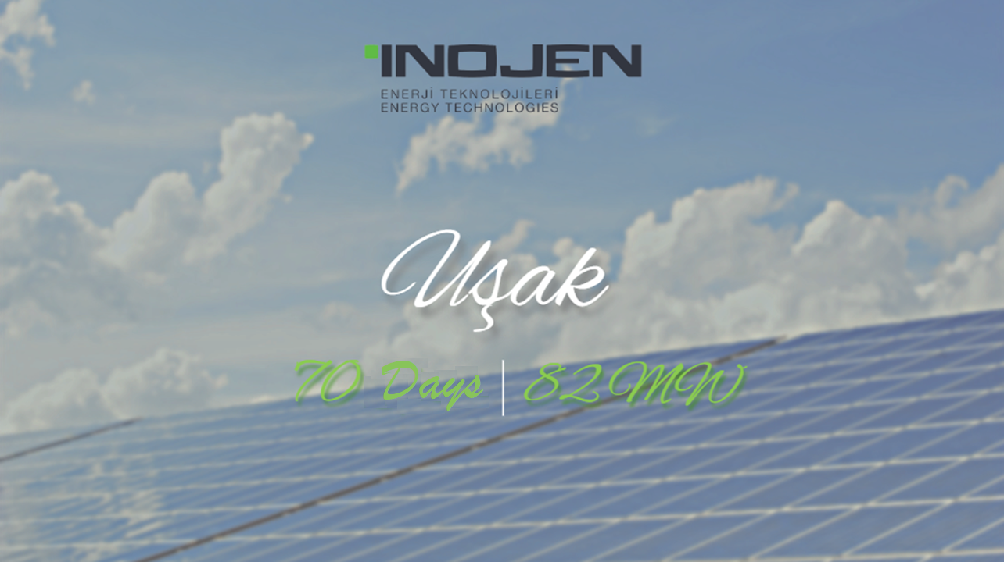

Slide 13
UŞAK – 82 MW IN 70 DAYS
UŞAK – 70 GÜNDE 82 MW
HOW TO INSTALL AT EFFECTIVE SPEED?
Correct project design
Determination of all phases
Rational business plan
Preparation of technical projects
Starting at the right time

Slide 14
UŞAK – 82 MW IN 70 DAYS
UŞAK – 70 GÜNDE 82 MW
HOW TO INSTALL AT EFFECTIVE SPEED?
Correct supply chain
Determining material
Stock management
Sustainability
On-time deliveries

Slide 15
UŞAK – 82 MW IN 70 DAYS
UŞAK – 70 GÜNDE 82 MW
HOW TO INSTALL AT EFFECTIVE SPEED?
Fast production
Sufficient production capacity
Seamless mass production
Simplified materials

Slide 16
UŞAK – 70 GÜNDE 82 MW
UŞAK – 82 MW IN 70 DAYS
HOW TO INSTALL AT EFFECTIVE SPEED?
Effective installation
Active time
Getting to know the work and the product
Fastest method

Slide 17
UŞAK – 82 MW IN 70 DAYS
UŞAK – 70 GÜNDE 82 MW
HOW TO INSTALL AT EFFECTIVE SPEED?
Successful commissioning
Non-missing/Complete material
A complete assembly
Quality control

Slide 18
UŞAK – 70 GÜNDE 82 MW
UŞAK – 82 MW IN 70 DAYS
HOW TO INSTALL AT EFFECTIVE SPEED?
Correct and skilled team
Correct and sufficient equipment
Accurate and experienced administrative staff

Slide 19
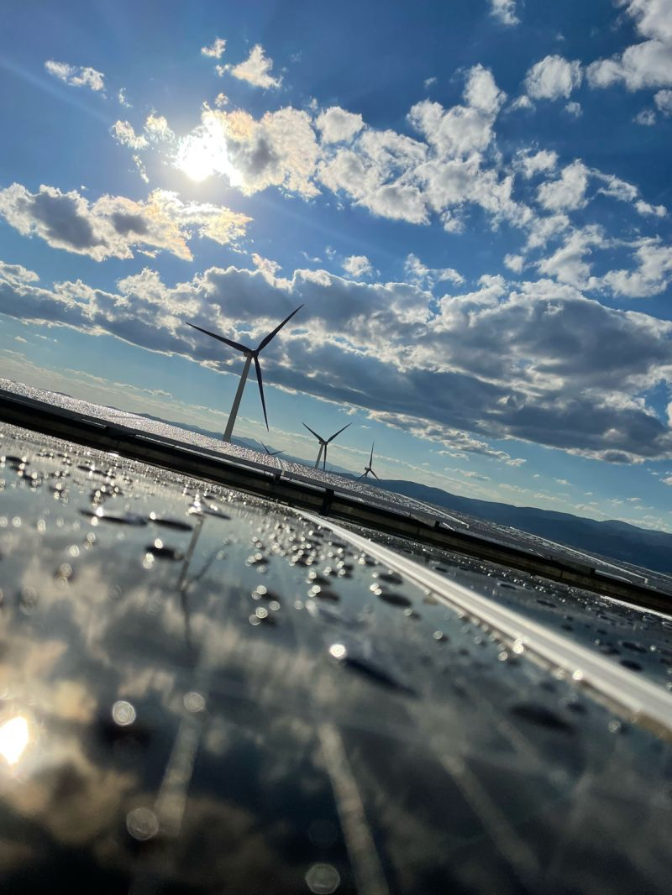
UŞAK – 82 MW IN 70 DAYS
UŞAK – 70 GÜNDE 82 MW
Knowledge Integrator
OUR SUCCESS STORY
IN EFFECTIVE COMMISSIONING

Slide 20
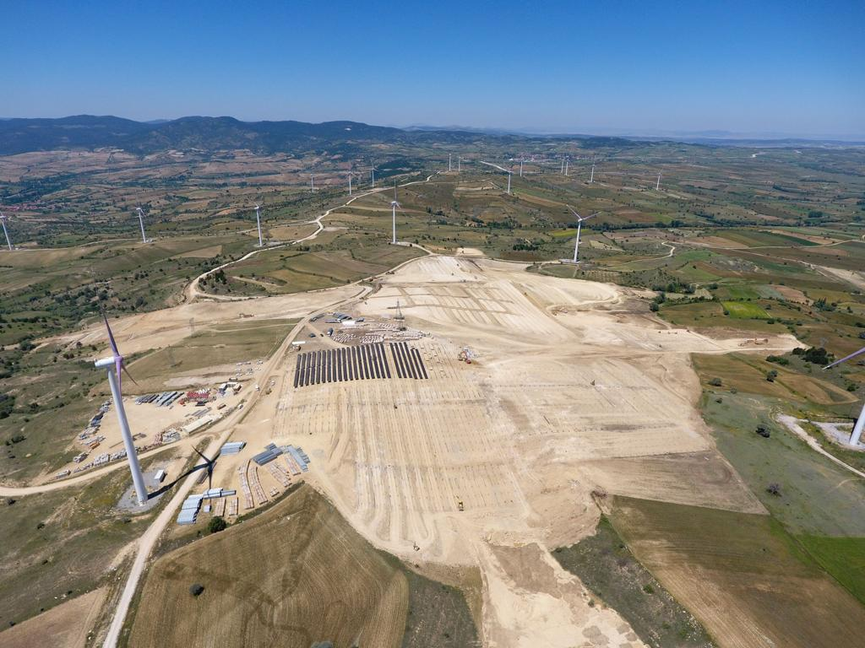
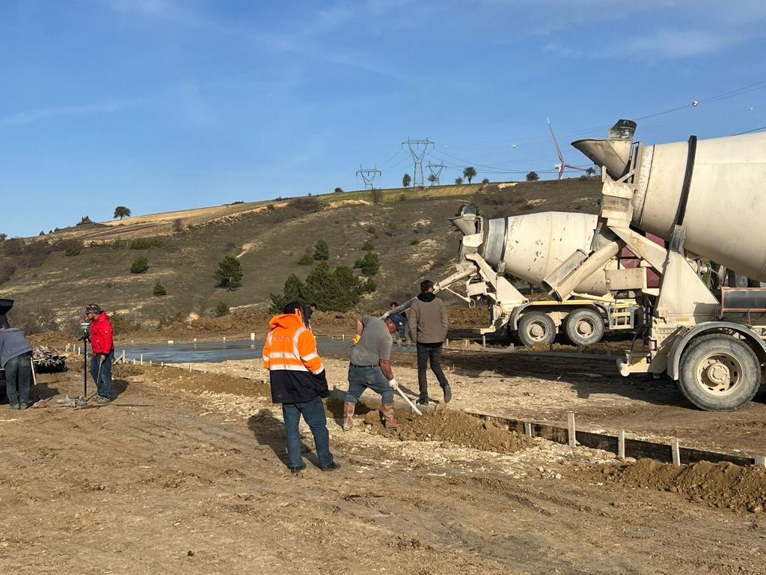
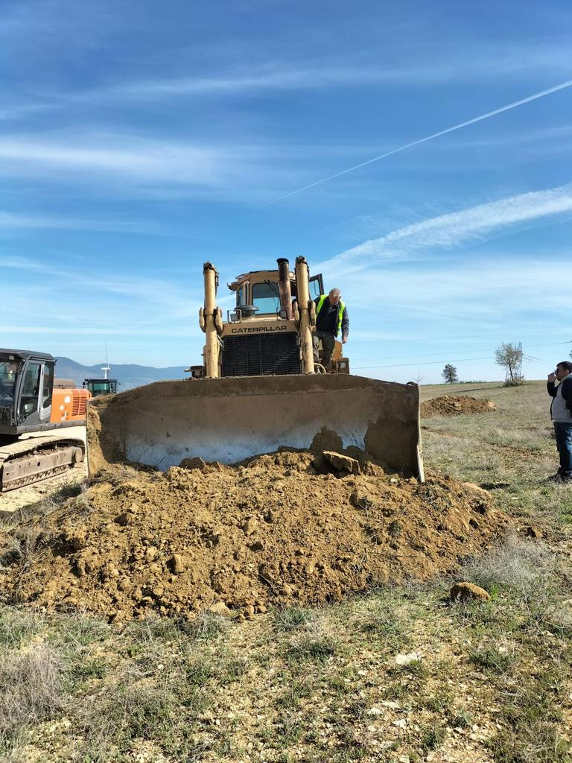
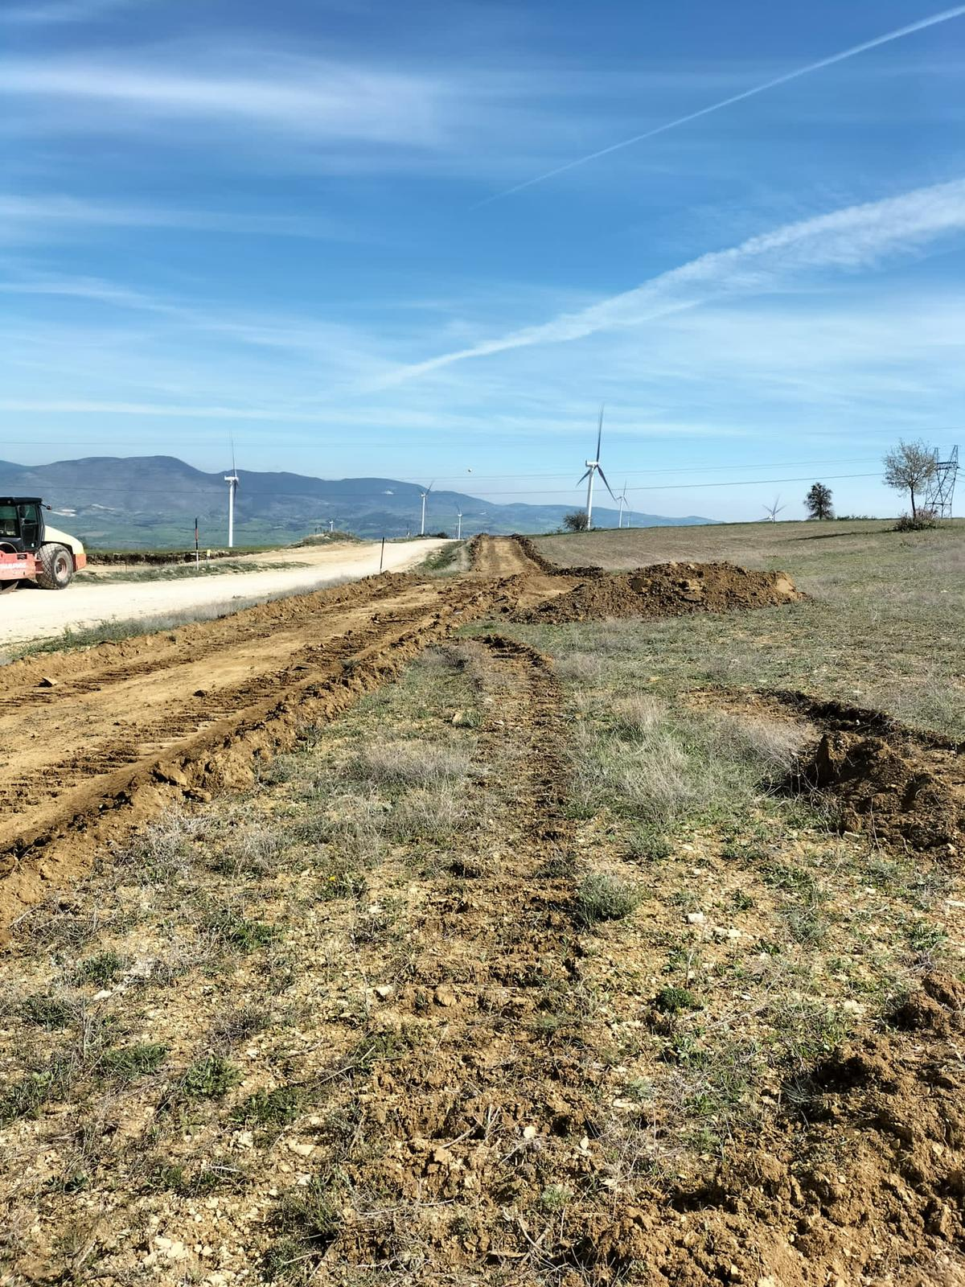
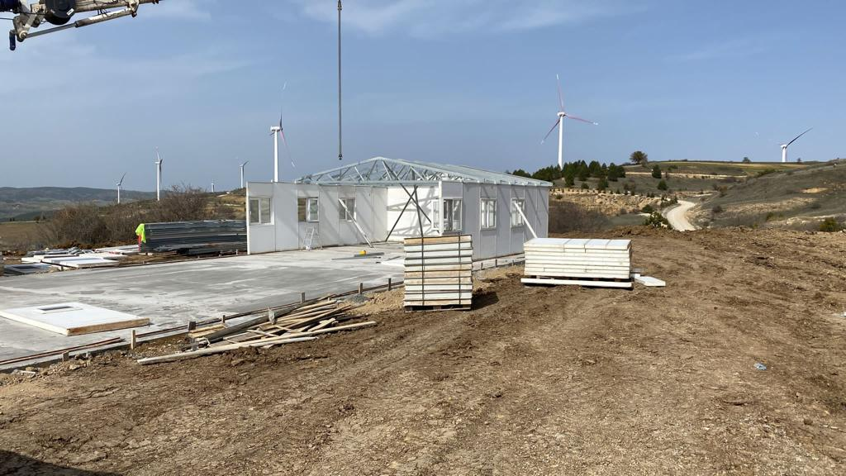
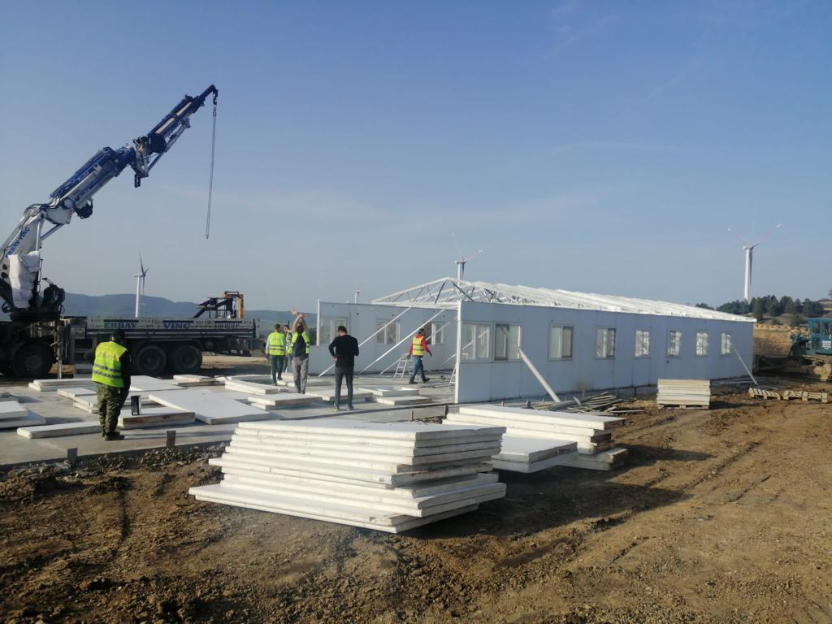
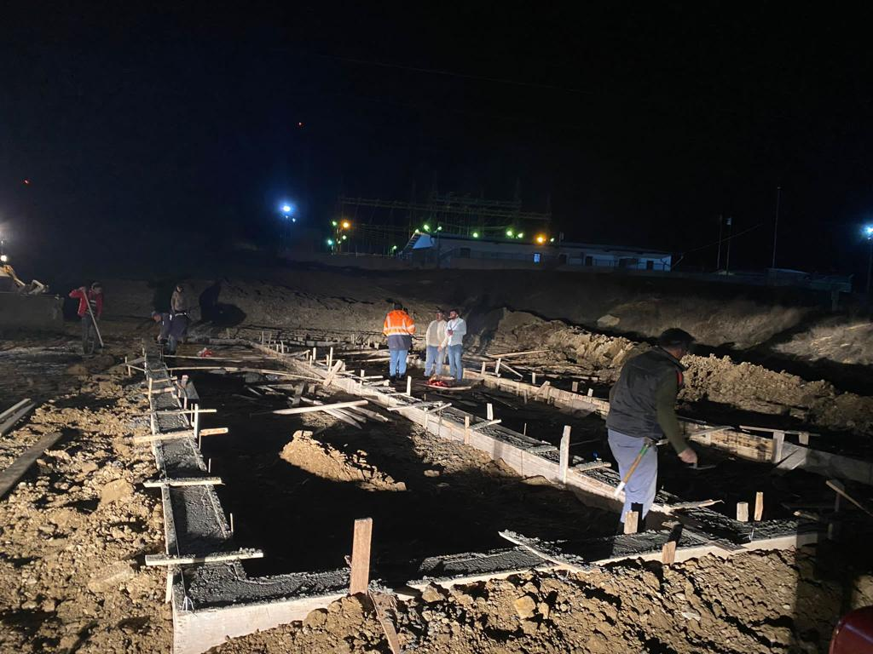
Knowledge Integrator

Slide 21
Knowledge Integrator

Slide 22
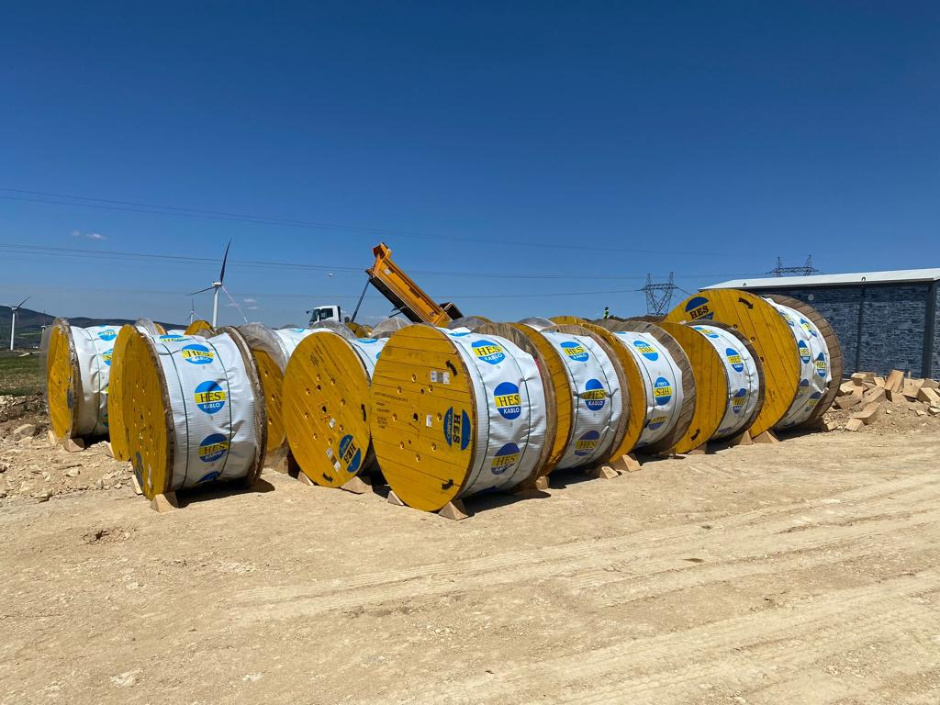
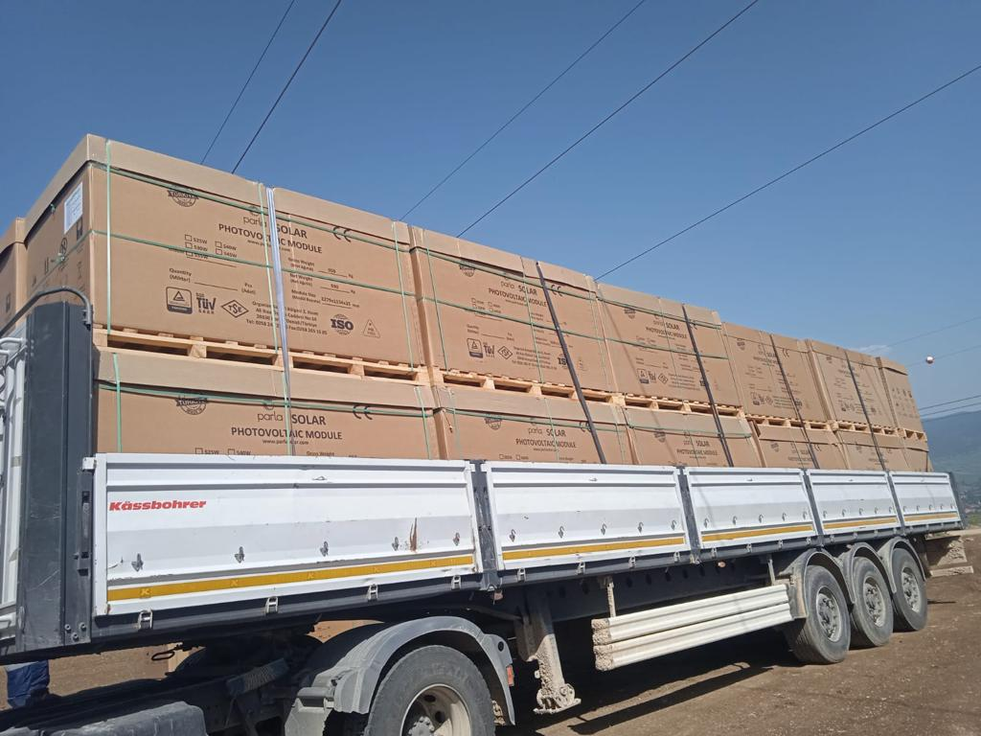
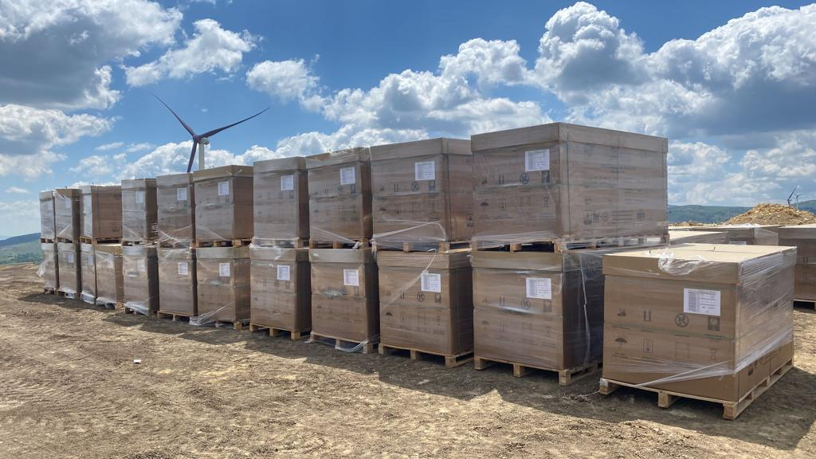
Knowledge Integrator

Slide 23
Knowledge Integrator

Slide 24
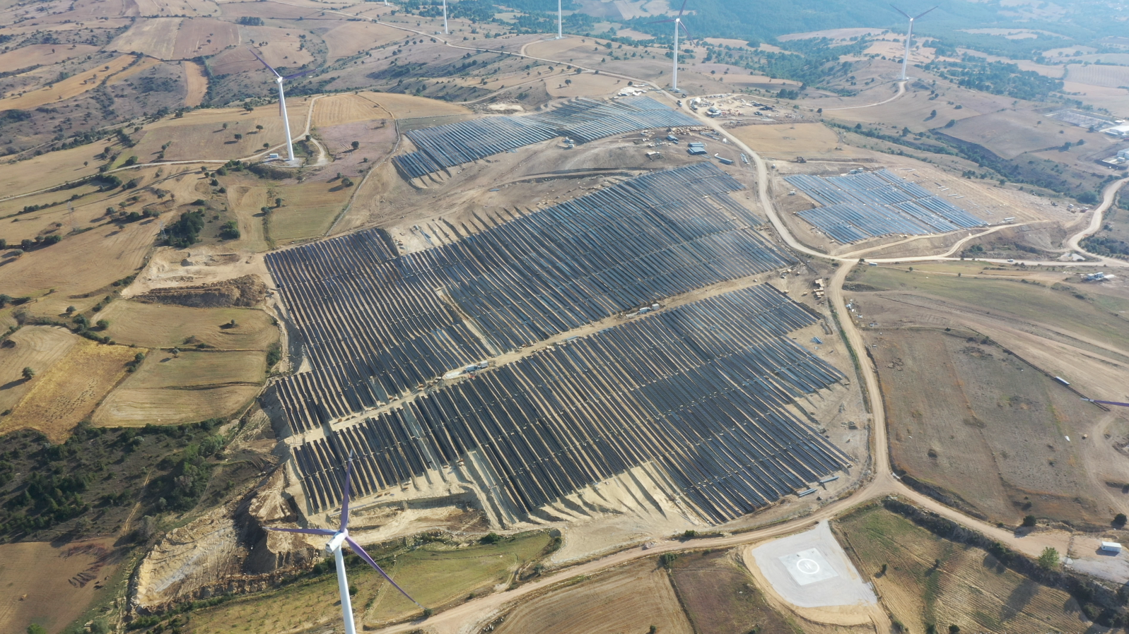
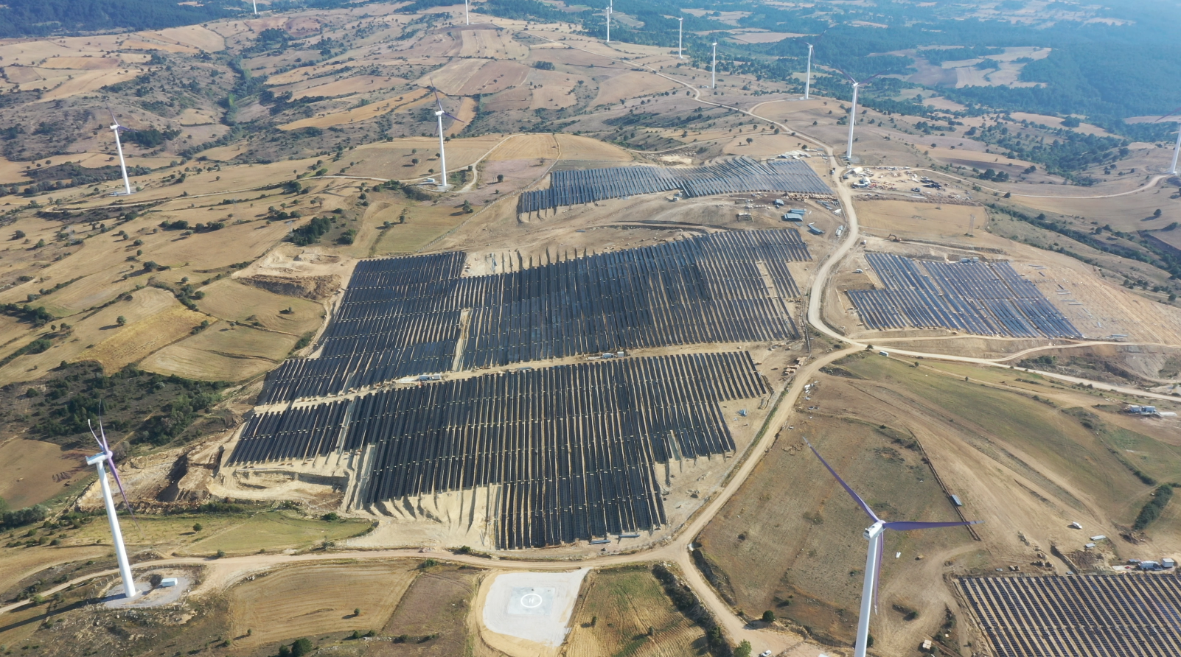
Knowledge Integrator

Slide 25
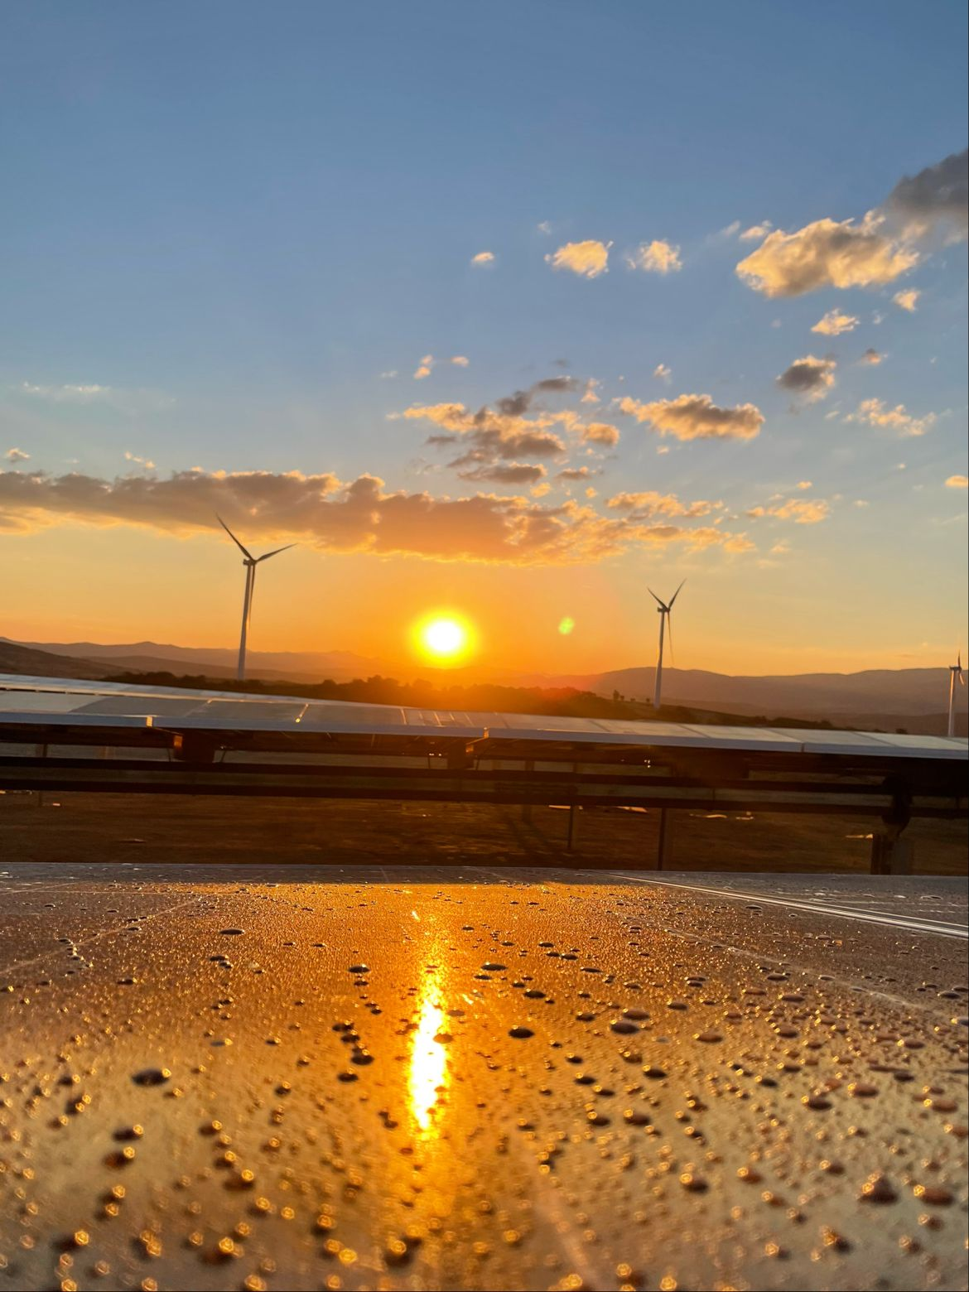
Knowledge Integrator

Slide 26
Assoc. Prof. Dr. Ali Murat SOYDAN

