Slide 1
Training Solutions for Hydrogen Smallbore Systems
Mitchell Brunt – Project Sales Manager
Swagelok Manchester

Slide 2
Swagelok Manchester
Swagelok, a $3bn Fluid system components supplier with a global network of Sales and Service Centres
Swagelok Manchester, very active locally with hydrogen solutions
Active member of Associations and trade bodies – BCGA, UKHEA, IGEM, East Midlands Hydrogen Consortium, NW Hydrogen Alliance, Hydrogen UK.
Swagelok products used on the UK’s first hydrogen train, plane, double decker bus, and hydrogen into natural gas blending project.
Collaboration with a major gas cylinder manufacturer to deliver high profile hydrogen storage systems on FCEV projects.
Active participation in projects relating to HAR1,HyNet, and HyNTS Future Grid

Slide 3
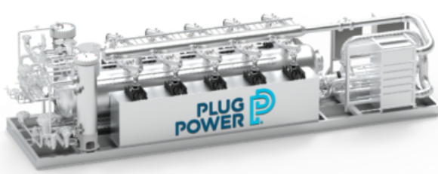
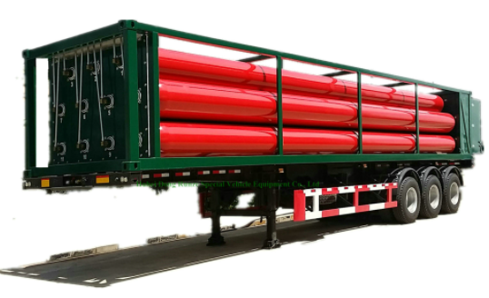
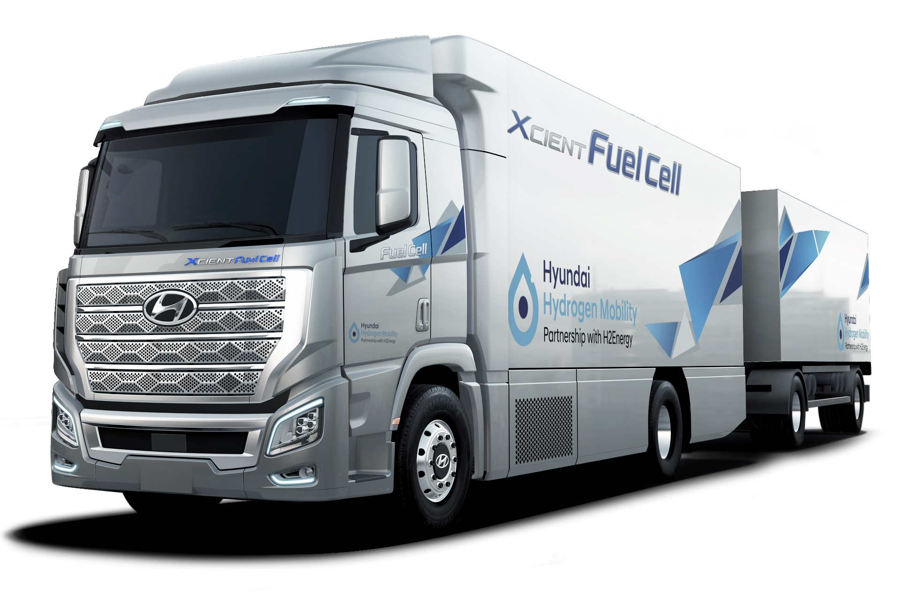
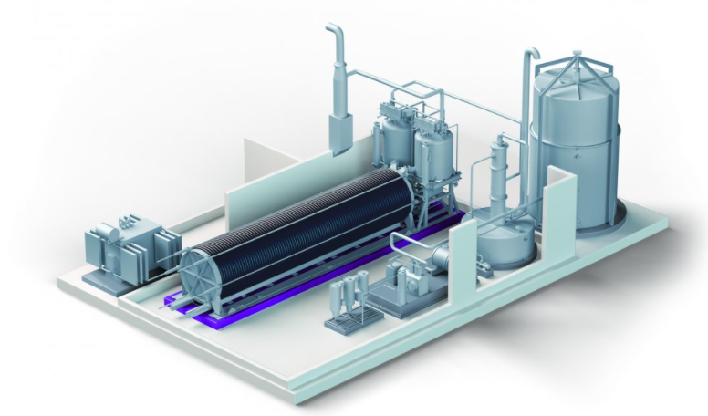
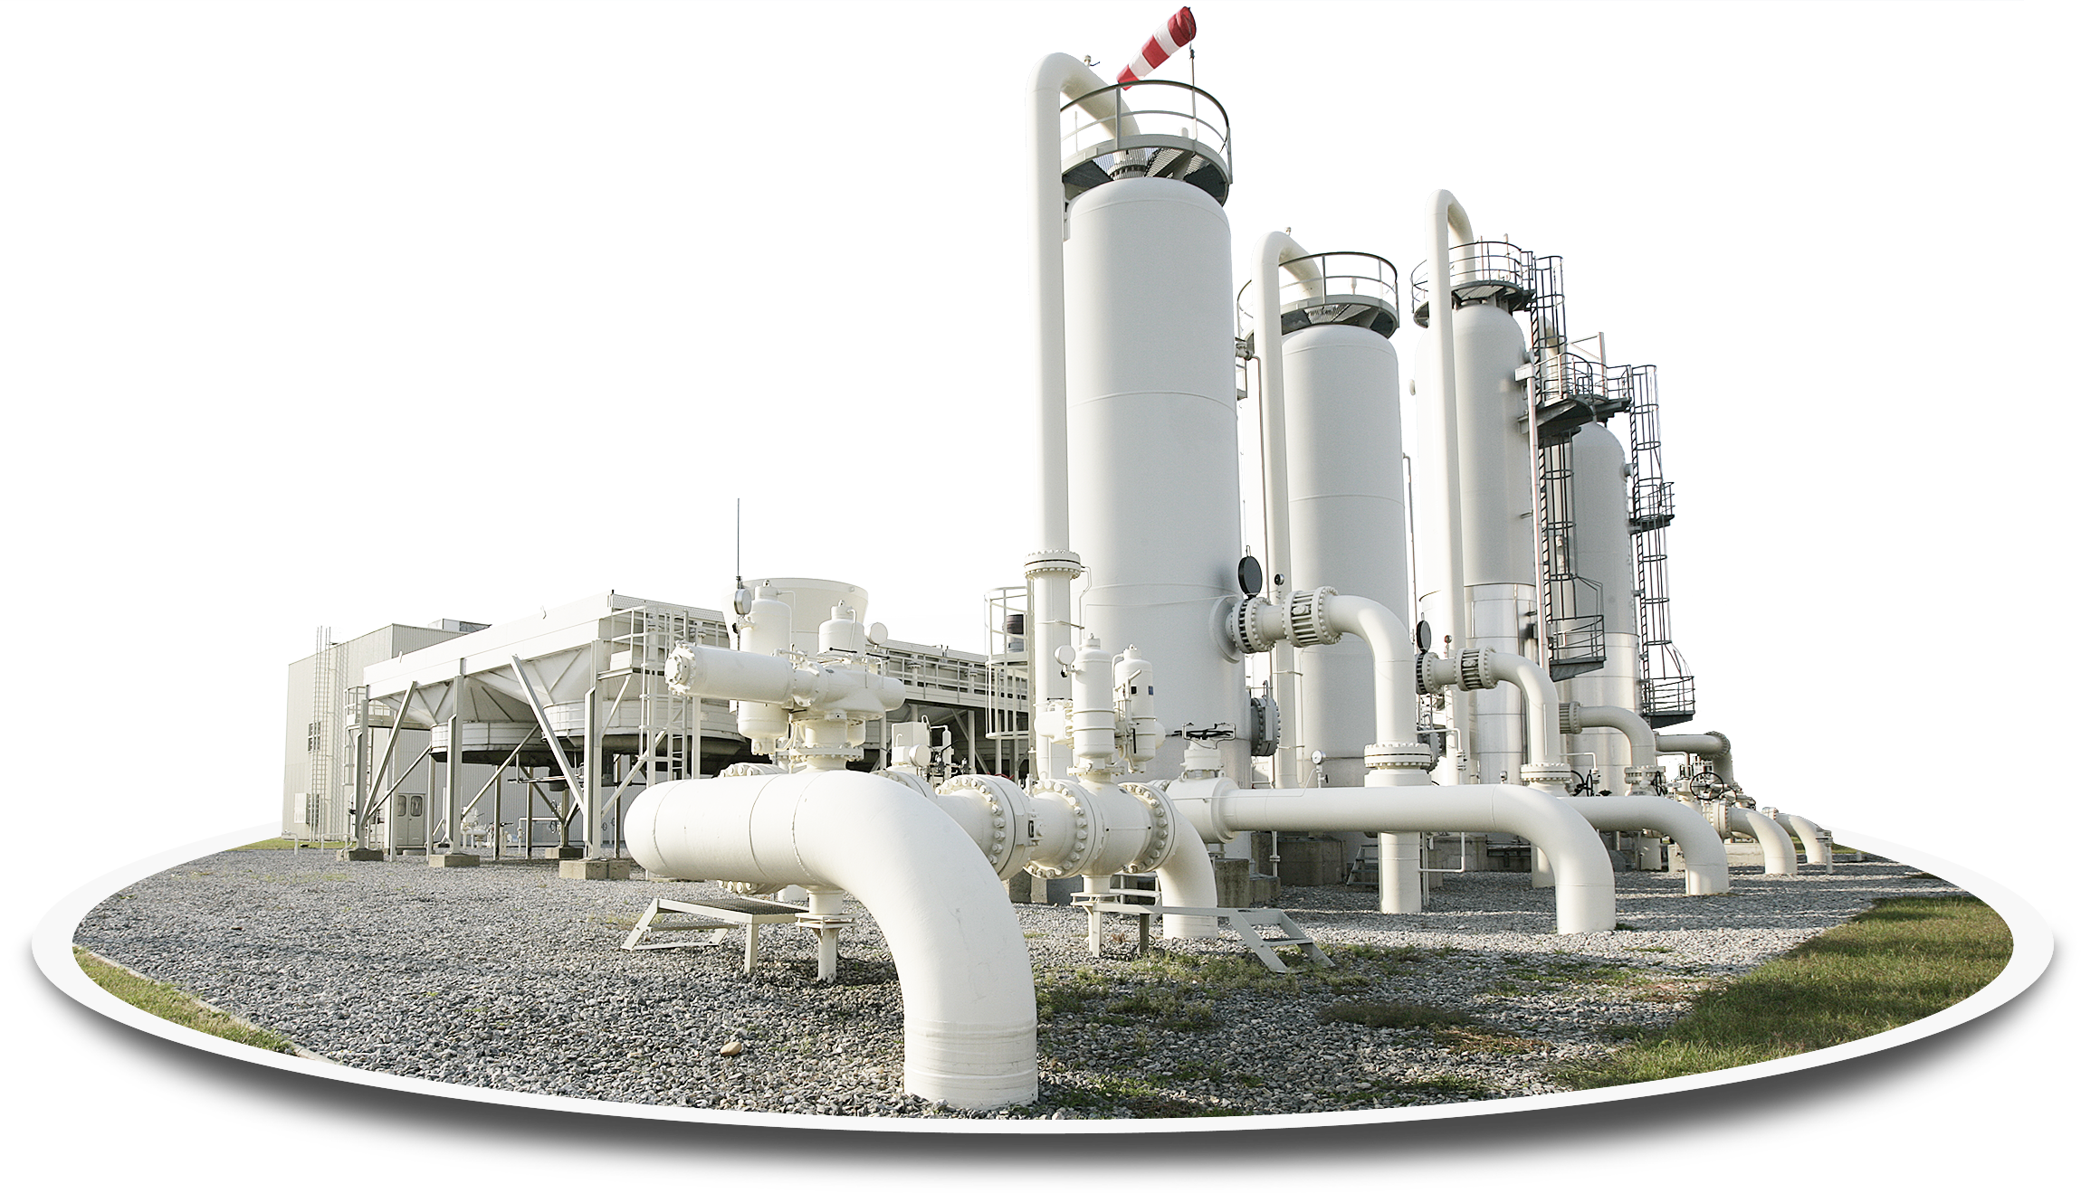
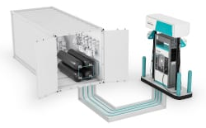
Hydrogen System Focus – Small Bore Tubing Systems
Hydrogen
Electrolysis
Infrastructure
Virtual Pipeline & Refuelling Stations
Heavy-duty Vehicles
3
Notes:
Define small bore – 2” and under tubing systems

Slide 4
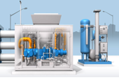
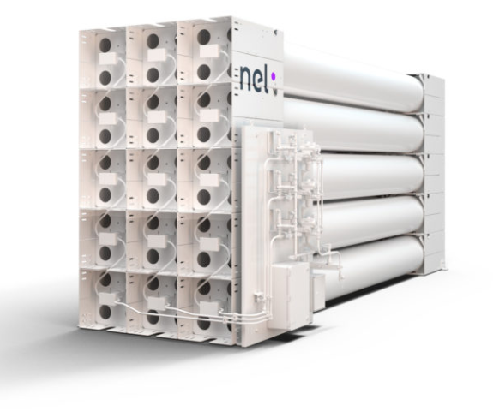
Hydrogen Application Pressures
Low Pressure Applications
High Pressure Applications
Production
Infrastructure
Storage
HRS
Virtual pipeline
On-Vehicle
Pressures up to 40 bar
Pressures up to 85 bar
Pressures typically 350 bar up to 1000 bar
Pressures typically 350 bar or 700 bar
Pressures typically 350 bar up to 1000 bar
Challenges:
Vibration
Pressures typically 350 bar or 700 bar
Challenges:
Vibration
Certification
Increase in importance in design choices
Notes:
Production – Electrolysers and gasification - traditional alkaline / PEM + new technologies
Infrastructure – Pipelines - Transmission and distribution / Hydrogen blending / repurposing / instrumentation hook-ups on larger lines
Storage – Used anywhere to store hydrogen that cannot take hydrogen directly from a pipeline . Also used to ‘ store energy ‘ by converting spare electricity into Hydrogen that can be converted back when needed. Generally filled on site. PED.
HRS- Refuelling stations are predominantly small bore sizes at points of delivery (16/20mm)
Virtual pipelines – A mobile storage solution that arrives at site containing Hydrogen. Different design standards needed TPED / ADR etc
On vehicle – Focus on heavy vehicles where the fuel is part of the drive train , Carrying at high pressure but used in fuel cells at low pressures <10 bar

Slide 5
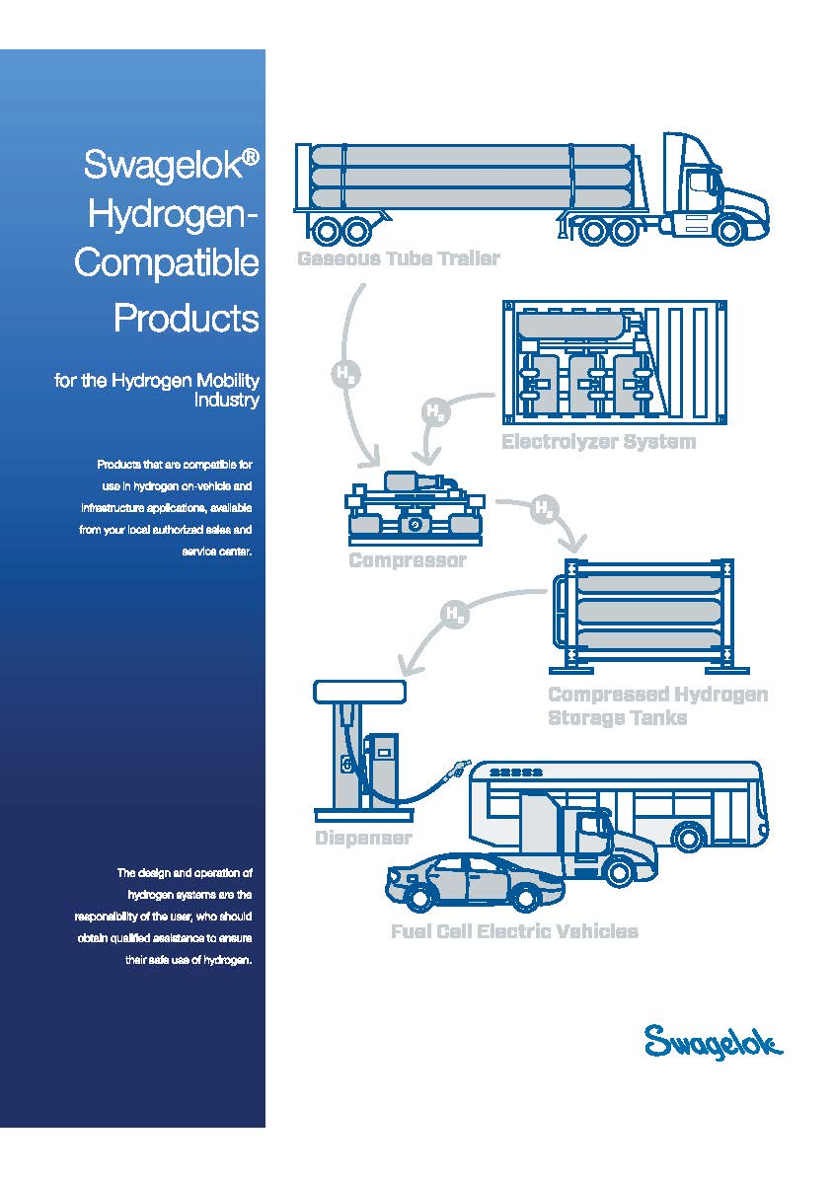
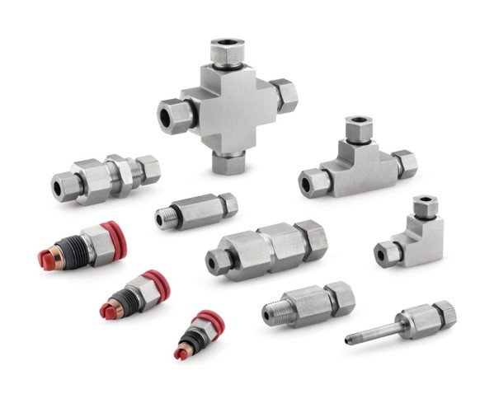
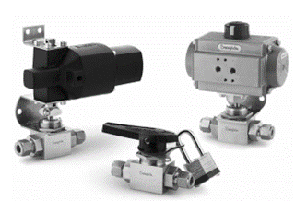
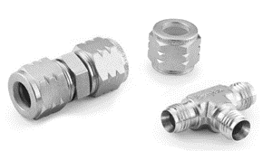
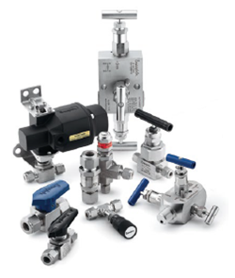
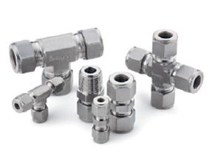
Product offering

Slide 6
Is there enough hydrogen SYSTEM expertise ?
Design Considerations:
Welds - hot work/permits/time/maintainability
Tubing and tube fitting solutions
Tube bending advantages
Threads to be avoided/careful attention
Material choices - metals & non metals
Notes:
Design – Tubing solutions / design out threads / welds don’t allow maintenance / material choices important
Install – a lot of traditional technologies were developed to seal liquids / gas systems are already taxing / small molecule gases need care and attention
Test - hydrotests wont find hydrogen leaks , neither will leak detectors be reliable

Slide 7
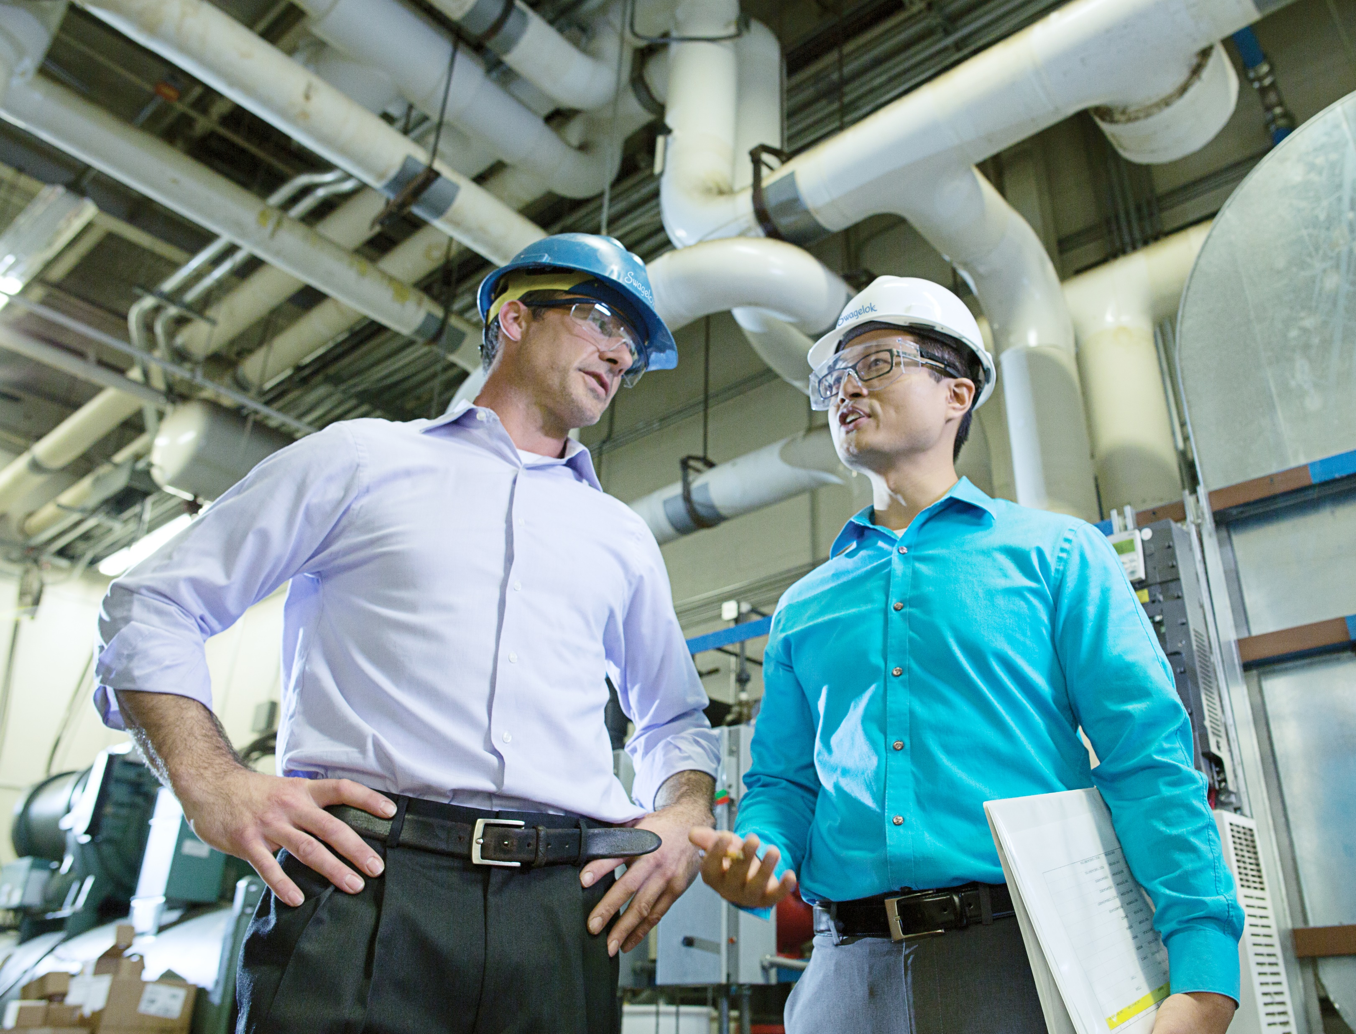
Is there enough hydrogen SYSTEM expertise ?
Installation Practices:
Advantages of tube bending
Installation of threads
Different technologies – different procedures
Inspection
Notes:
Design – Tubing solutions / design out threads / welds don’t allow maintenance / material choices important
Install – a lot of traditional technologies were developed to seal liquids / gas systems are already taxing / small molecule gases need care and attention
Test - hydrotests wont find hydrogen leaks , neither will leak detectors be reliable

Slide 8
Is there enough hydrogen SYSTEM expertise ?
Testing & Commissioning:
Hydrostatic testing – high pressure traditional method
Nitrogen testing – molecule size difference
Traditional leak detection fluids don’t show small leaks
Helium / Hydrogen testing
Leak detection equipment
Snoop
Bubble
Test
Ultra-Sonic
Pressure
Decay
Helium
Mass
Spectrometer
Notes:
Design – Tubing solutions / design out threads / welds don’t allow maintenance / material choices important
Install – a lot of traditional technologies were developed to seal liquids / gas systems are already taxing / small molecule gases need care and attention
Test - hydrotests wont find hydrogen leaks , neither will leak detectors be reliable

Slide 9
Launch of Swagelok training program 2024

Slide 10
Focus for Swagelok Training
Design
Materials
Installation
Inspection
Multiple Joint types
Leak testing a system
Knowledge and Practical Testing

Slide 11
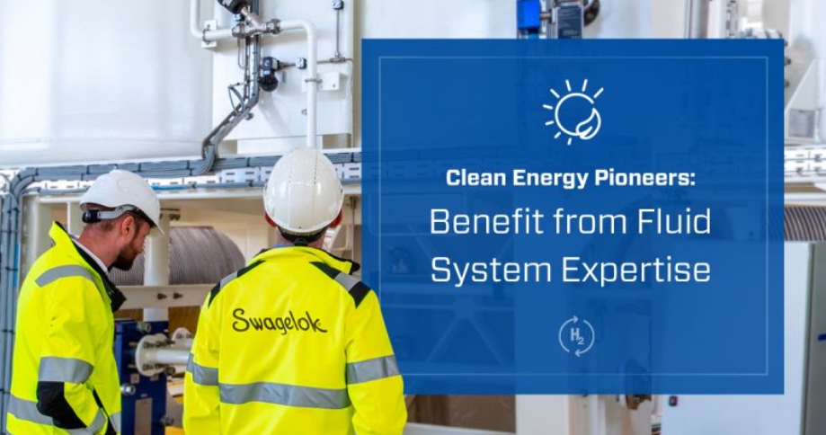
Advantages to Education/Training
Dismiss myths about Hydrogen
Adapt skillsets to include Hydrogen knowledge
Improve system design
Adoption of best practise in installation
Leak free systems
More productive site test activities

Slide 12
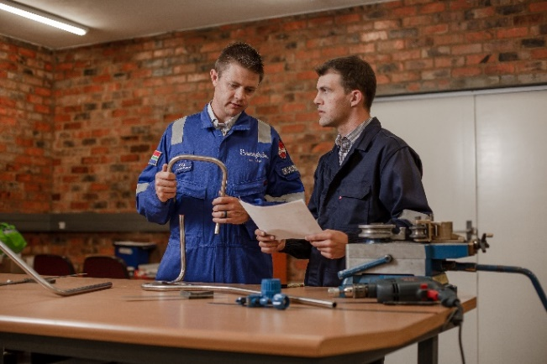
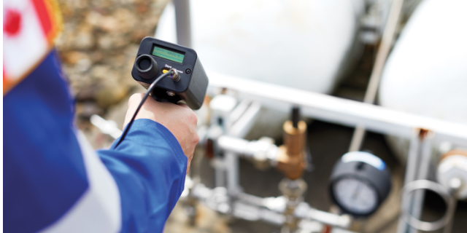
On Site Services - Support for increased safety
Global Field Engineer Support
Identify training needs
Monitor training effectiveness
Check site installations for best practise

Slide 13
Questions?

