Slide 1
SOLAR/WIND HYDROGEN VEHICLE SITE POTENTIAL Dr Sharon George, Keele University

Slide 2
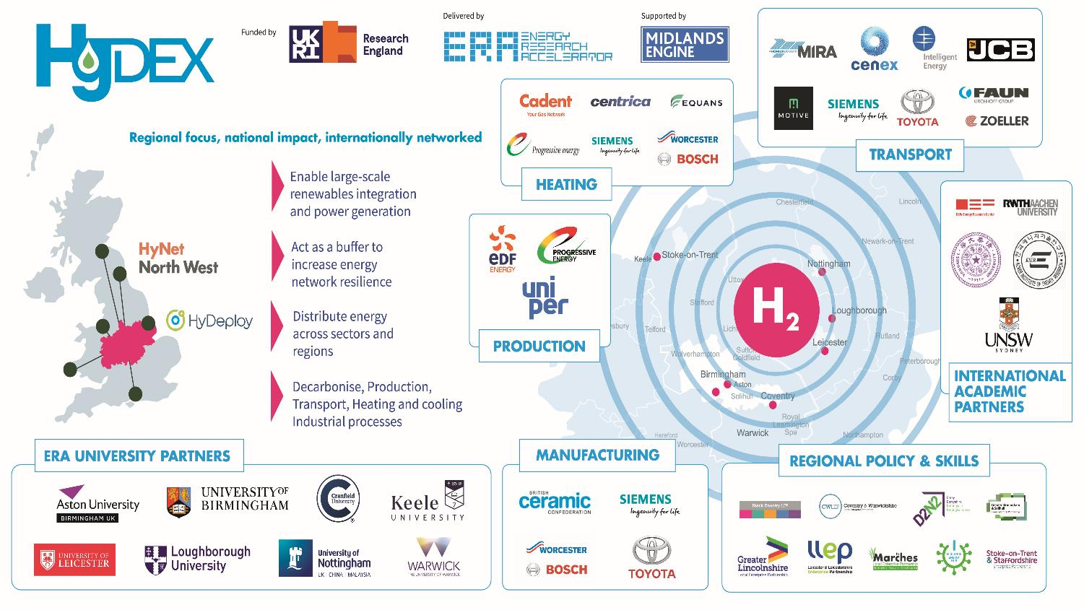
Access to large scale demonstrator and test facilities
Support for technology development and R&D
Support for IP development and commercialisation
Development of hydrogen skills and expertise in businesses
Civic engagement and policy activities to build understanding
Development of access to international markets and inward investment

Slide 3
Is it expensive?
Hydrogen production | Cost of hydrogen | FACTORS AFFECTING
Steam methane reforming (SMR) | between 1.0 and 1.8 €/kg | Natural gas price and availability
Carbon Sequestration and storage (CCS) | Between 2.0 and 2.4 €/kg | Stable geology and cost of transport
Electrolysis | 1.5 €/kg | Without price of equipment, assuming low price of electricity
Combination of solar and onshore wind renewable source is favourable for renewable production of H₂
See: Janssen, J. L.L.C.C., Weeda, m., Detz, R.J., van der Zwaan, B., (2022) Country-specific cost projections for renewable hydrogen production through off-grid electricity systems, Applied Energy, Volume 309, 118398,
https://doi.org/10.1016/j.apenergy.2021.118398.

Slide 4
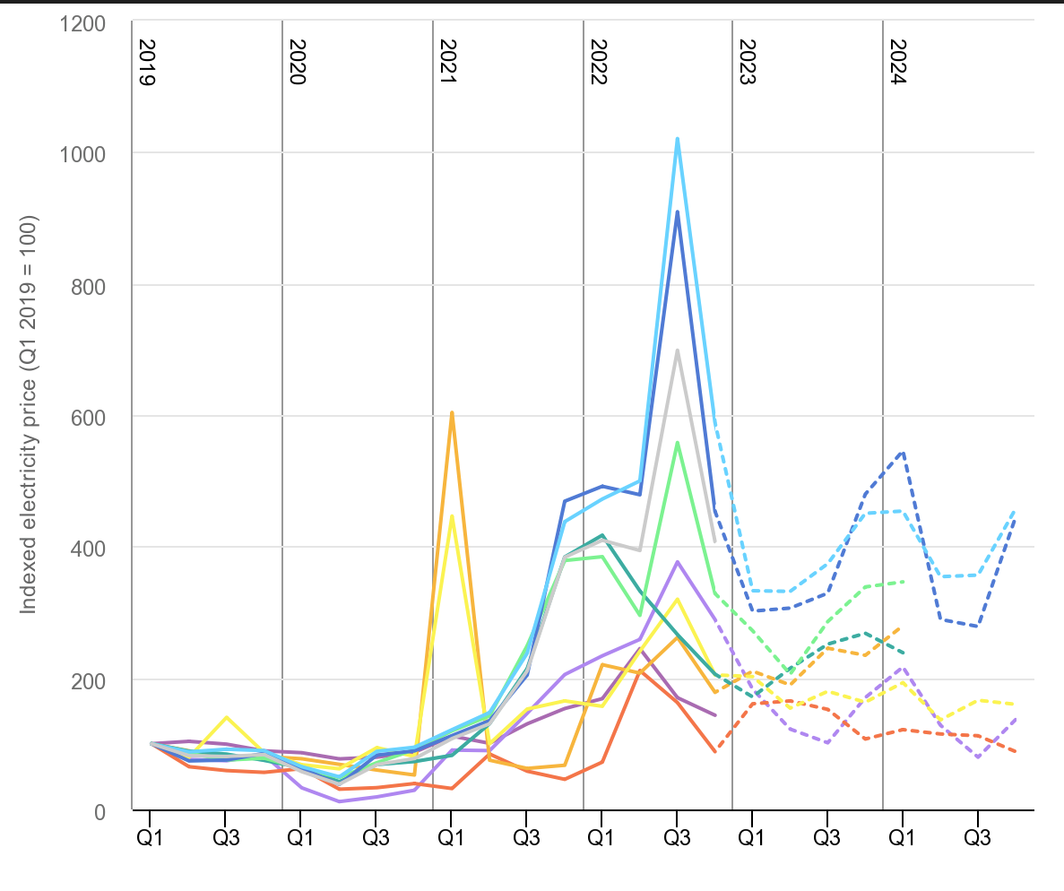
Is it expensive?
Influenced by:
Cost of production
Price of electrolyser and system (approx. £1k per kw)
Price of energy
Market capacity
Availability of equipment and resource
Stability of supply (energy security)
IEA, Indexed quarterly average wholesale prices for selected regions, 2019-2024, IEA, Paris https://www.iea.org/data-and-statistics/charts/indexed-quarterly-average-wholesale-prices-for-selected-regions-2019-2024

Slide 5
Colours of Hydrogen
GOLD
Hydrogen from geological sources
GREEN
Electrolysis from renewable technology
BLUE
Steam reforming of natural gas
With Carbon storage and sequestration
GREY
Steam reforming of natural gas without Carbon storage and sequestration
BLACK/BROWN
Production from coal
PINK
Electrolysis from nuclear energy
TURQUOISE
Methane pyrolysis producing
hydrogen and solid carbon
YELLOW
Electrolysis using solar
WHITE
Methane pyrolysis with solid carbon
byproduct, or naturally occurring hydrogen

Slide 6
How we are using hydrogen
Stationary uses: Heating
Fuel cell operations and direct combustion
HyDeploy has demonstrated up to 20% mix into current gas grid with no impact on domestic boilers
Hydrogen boilers and burners available and trials ongoing for manufacture
2035 sale of natural gas domestic boilers will be phased out
Mobile uses: Transport
Use in vehicles including buses, HGVs and cars
Use in agricultural machinery, fleet vehicles, refuse collection vehicles
Developments in shipping and aviation
Fuel cell operations and direct combustion
Back up energy: Storage
Can be used in connection with renewable energy storage to store overproduction for use when needed or to provide energy security to prevent cut-outs
Ammonia development is accelerating (easier to transport)

Slide 7
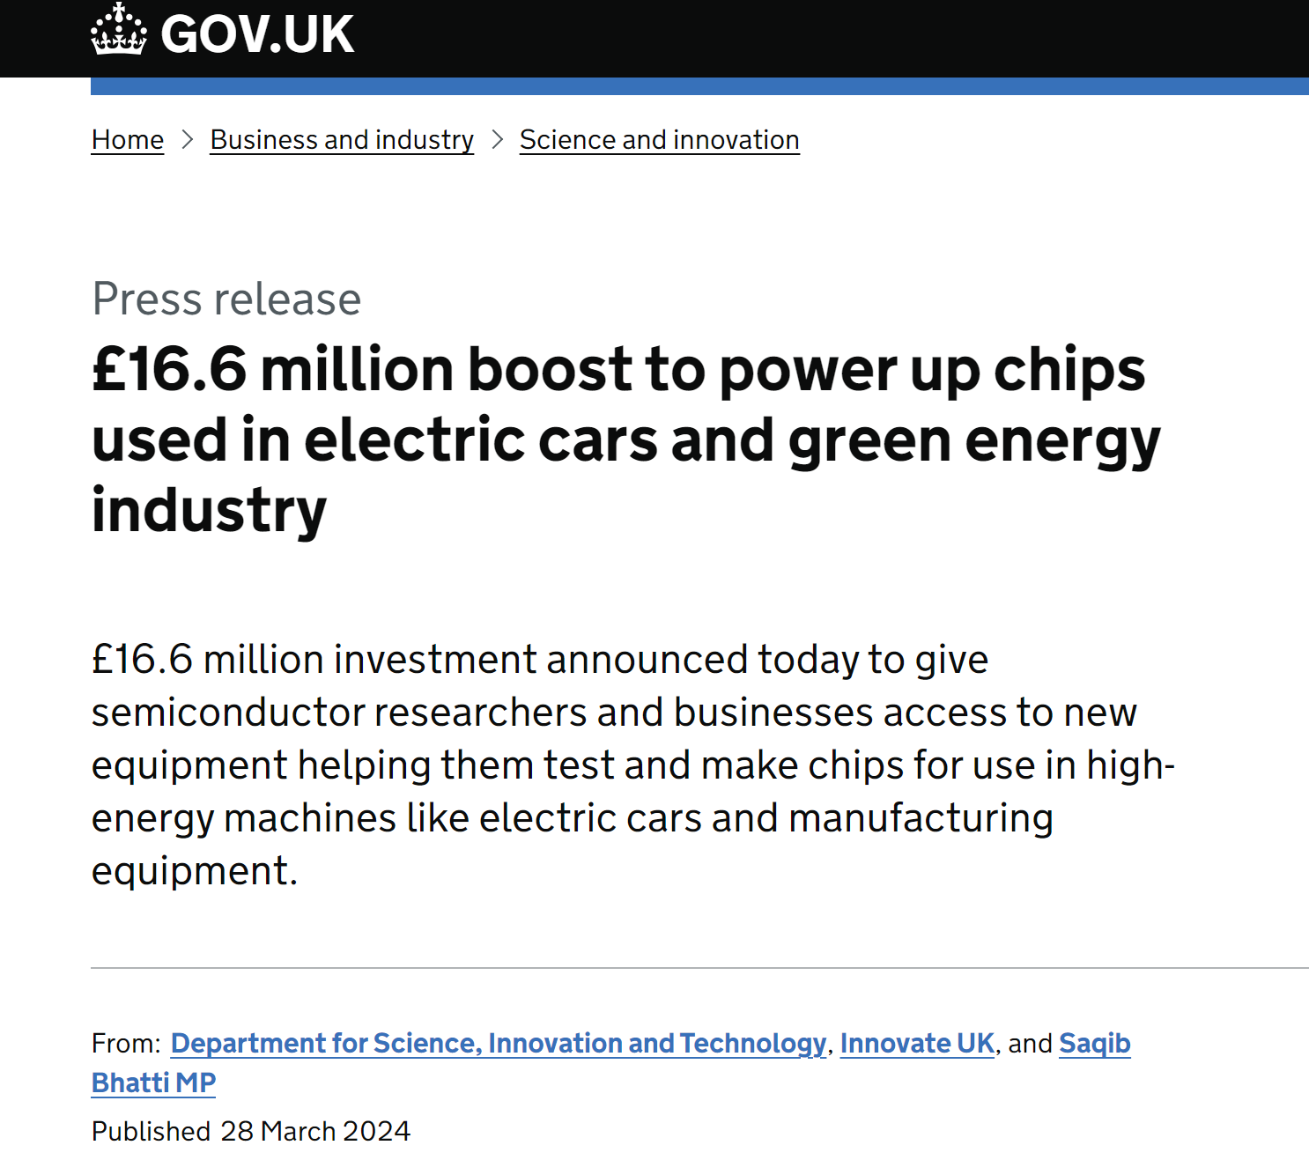
Low Carbon Transport
Transport is the biggest contributor to UK emissions in 2022
26% of the UK’s total emissions in 2021 (427 MtCO2e)Dept of Transport (2023)
A 10% increase on 2021
ZEV mandate : 80% of new cars and 70% of new vans to be zero emission by 2030, and 100% by 2035
Investment in EV infrastructure, production and market
£381 million Local Electric Vehicle (LEVI) fund to councils
Funding to reduce charging point installation by 75%
Currently 57,000 charge points and rising
Problem solved?

Slide 8
The Grid
Around 200 GW of electricity projects waiting for a grid connection (Bloomberg New Energy Finance)
All sectors need to decarbonise and greater demand for electricity (50% increase in demand predicted)
Centralised focused means investment is difficult in decentralized areas away from prioritized areas
Rural potential
A priority for transport, agriculture and manufacturing
Location of untapped renewable production

Slide 9
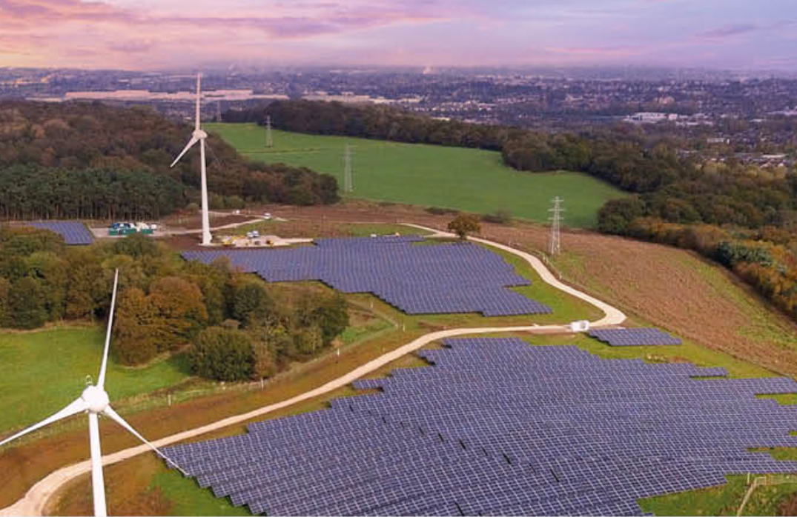
Keele’s Living Laboratory
Infrastructure
Campus with range of residences and building types
Energy park
5.5MW solar with 12,500 solar panels
two wind turbines (1.9MW)
1MW battery
Independent gas network
Electricity network
SEND
Expertise and experience
Institute of Sustainable Futures
Interdisciplinary experience and expertise in chemistry, energy, policy, economics, societal engagement, combustion and sustainability
Living laboratory approach

Slide 10
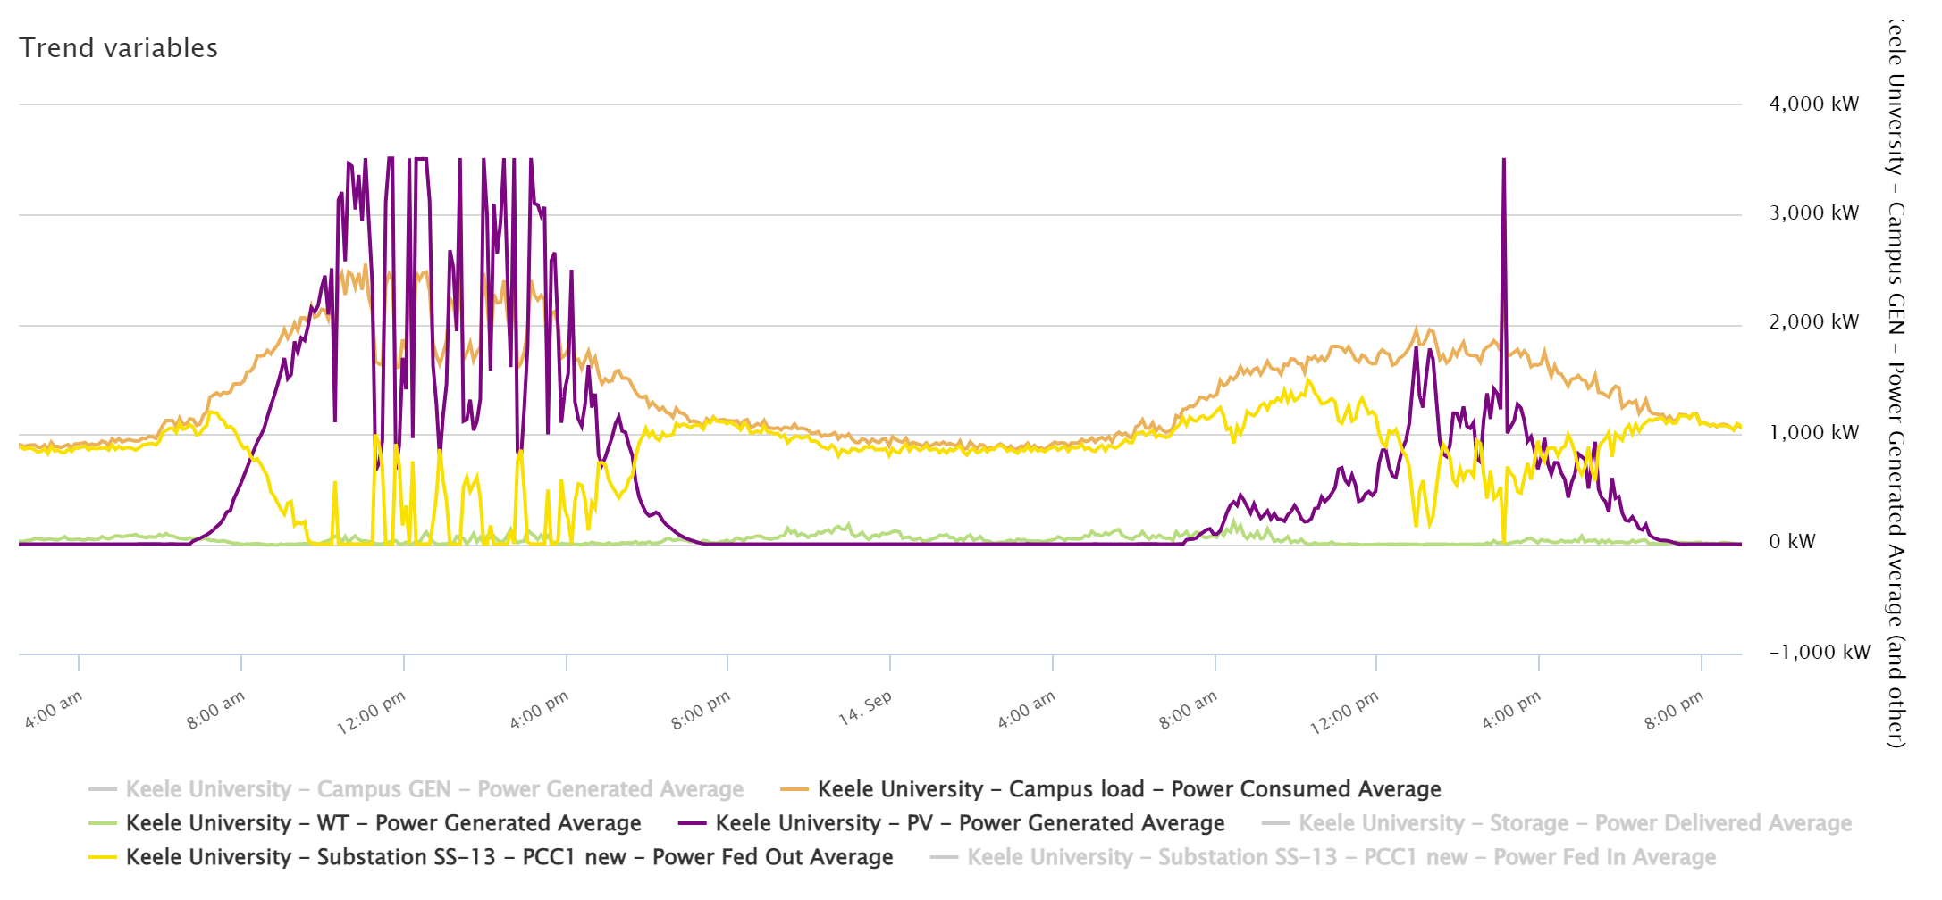
Energy generation limits
Intermittency

Slide 11
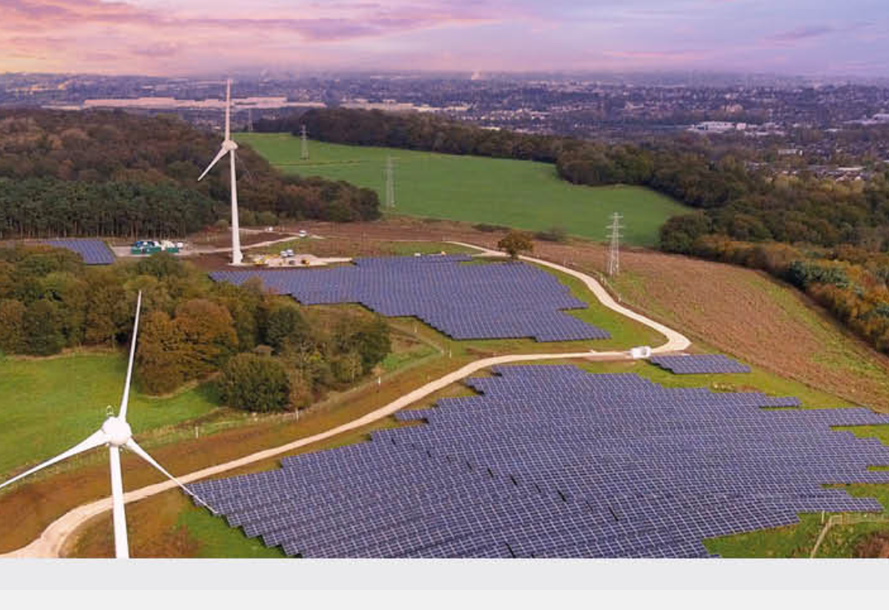
Potential for Green Hydrogen
Costs of electrolysers expected to halve by 2030
Production rates are increasing and pipelines being developed for direct transport
Confidence growing but more evidence needed for investment
Demonstration of economic performance needed
Applications to use green hydrogen directly weakened by competition with green electricity
Scaling is an issue, with need for smaller, cost-efficient systems

Slide 12
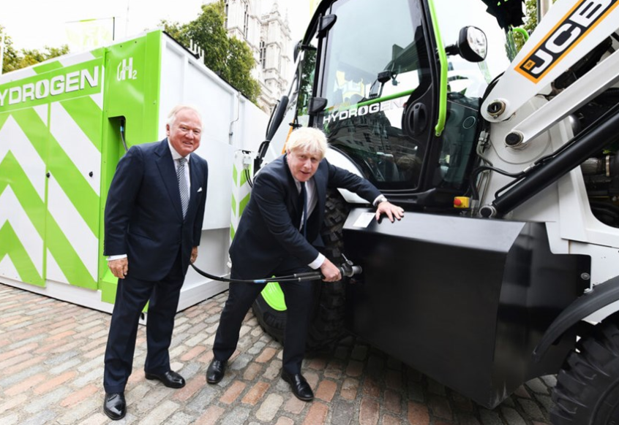
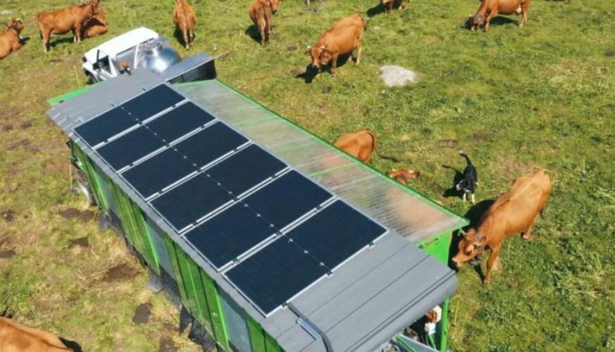
How developed is it?
READY NOW!!!!
St Helens Council ordered 10 Faun Bluepower hydrogen-powered refuse collection trucks
Hydrogen burner technology developed for industrial processes
Burners, devices and storage are commercially available
Cars available now andToyota and Yamaha developing V8 engine
JCB invested £100m on a hydrogen engine design
Four-cylinder, 4.8-litre motor
Power and torque equal to Dieselmax 448
Intelligent Energy provided a fuel cell to PowiDian (France) powering (in conjunction with solar panels and battery system) a ‘moveable’ milking shed on the Savoie Alps

Slide 13
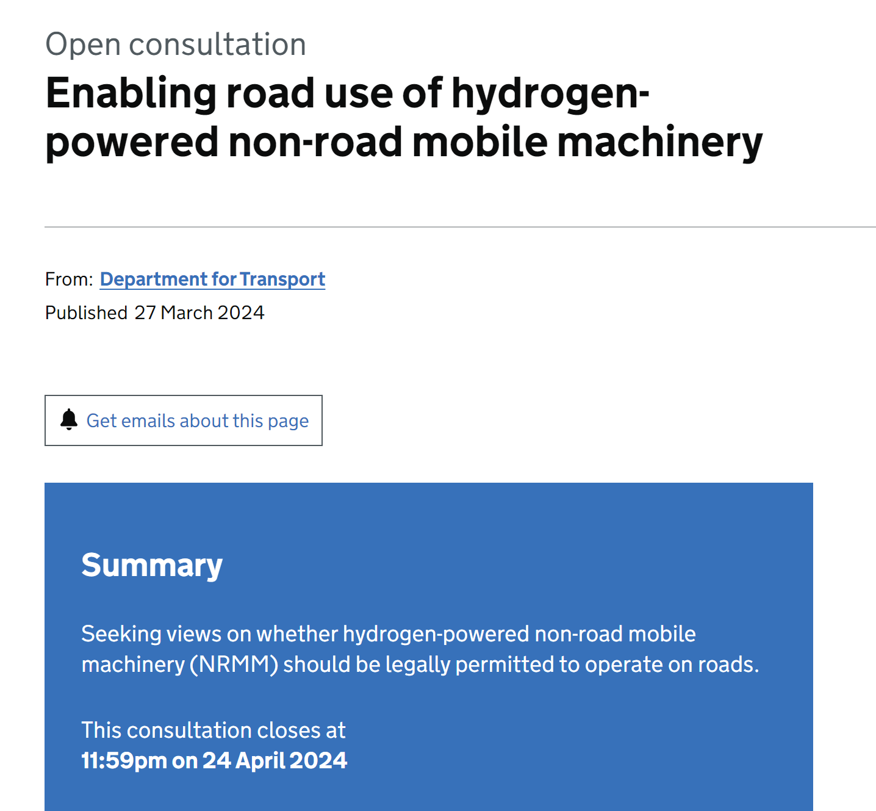
Consultation on hydrogen non-road vehicles
Link to info here
Ways to respond
Email to: ivs.consult@dft.gov.uk
Write to: International Vehicle Standards
1st Floor, Zone 4
Great Minster House
33 Horseferry Road
London SW1P 4DR

Slide 14
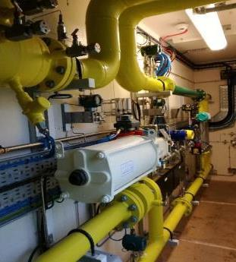
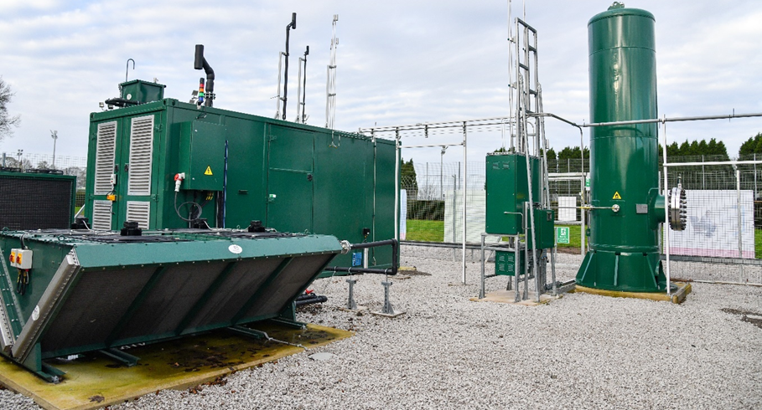
HyDEPLOY Phase 1 trial at Keele
Phase 1: October 2019 to March 2021
First UK trial in live network
100 homes, 30 university buildings
Developed the safety and technical evidence base
Exemption to Gas Safety (Management) Regulations (GS(M)R) 0.1mol% H2 limit was awarded by HSE
Enabled up to 20% H2 in network
Used in heating, cooking and commercial boilers
Grid entry blending unit
ITM electrolyser (around 11kg per hour)

Slide 15
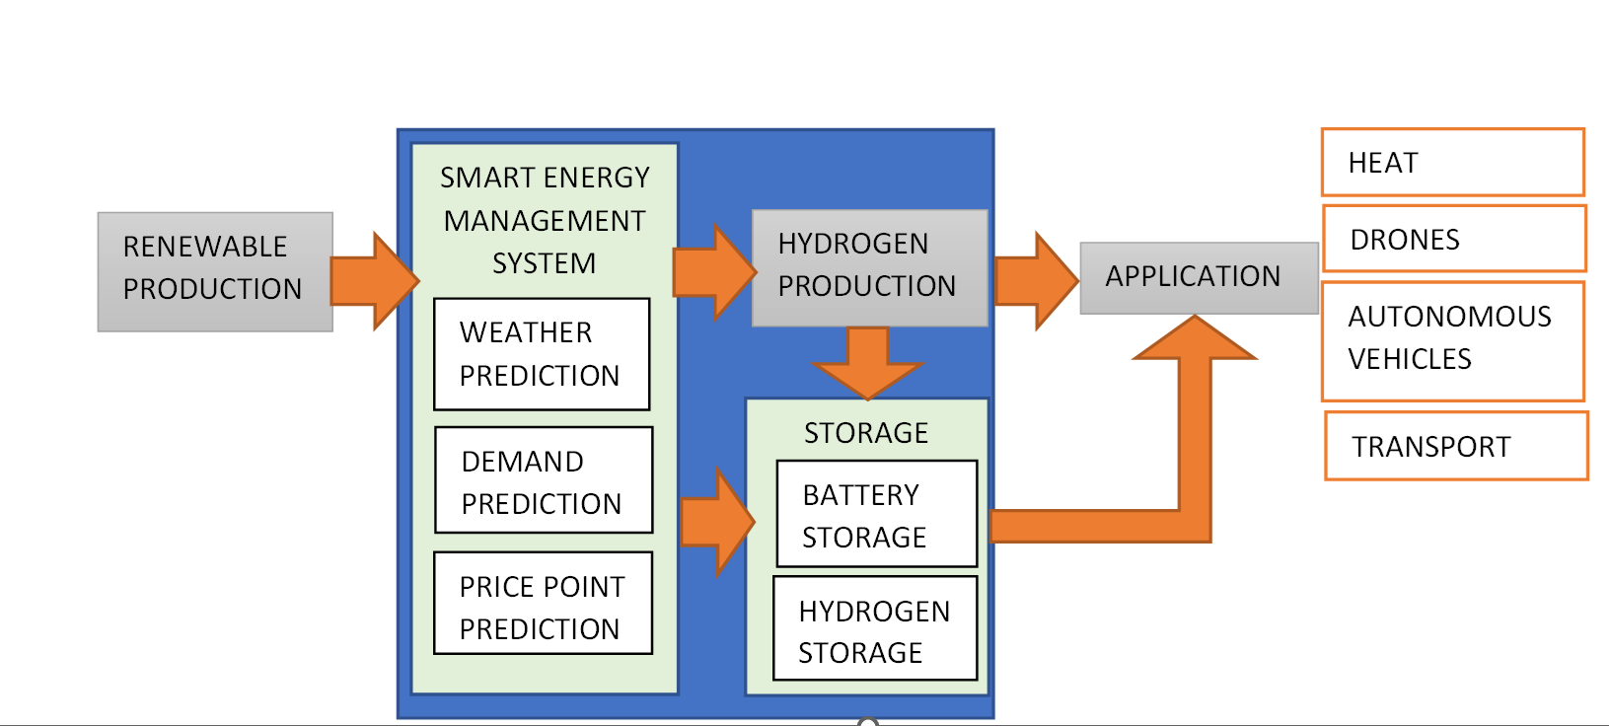
Smart Green Hydrogen Network Demonstrator
Areas of research
Public sector
Manufacturing
Rural, decentralised energy
International partnerships
Integration with SEND
Demonstration of green hydrogen optimisation through management and control
On-site prediction, and real-time verification trials
Perception and acceptance (commercial and public)

Slide 16
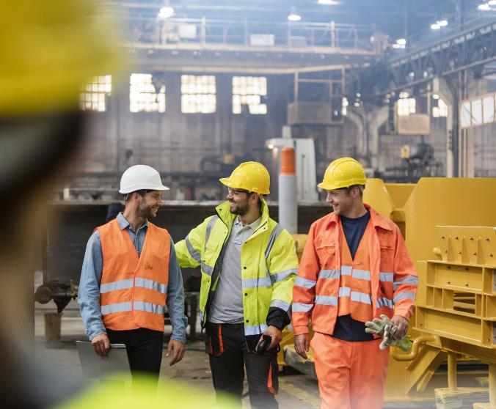
Are we ready for hydrogen?
Public understanding
Business knowledge
Supplier confidence
Regulatory frameworks
Consumer and supply-chain awareness
Technology readiness
Burner performance and NOx
Storage efficiency and safety
Materials stability
COST and OPTIMISATION

Slide 17
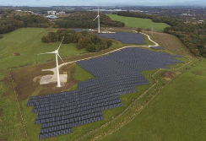
Get in Touch, Come see us!
Dr Sharon George
Senior Lecturer
HyDEX Principal Investigator
Course Director MSc ES&GT
1.15 William Smith Building Keele University ST5 5BG +44 (0)1782 733986
s.m.george@keele.ac.uk

