Slide 1

Combined – Battery Electrolyser
E. Ashton, J. G. Wilson, M. Brenton, J. Barton, D. Strickland.

Slide 2
Contents
Introduction – current green hydrogen production – is a rethink needed?
Combined Battery Electrolyser – what they are and how they work?
Application – where could a battery-electrolyser be used?
Technology development to date
Conclusion – future plans
H₂
O₂
Notes:
The way I’ve structured the next few slides is I’ll give you an introduction into our method of green hydrogen production using our combined battery and electrolyser. Where this technology can be applied, to improved renewable energy storage and delivery. Our progress with the manufacturing and performance testing of the technology so far. And then finish with conclusions and future plans.

Slide 3

1. Background
Background
Background
Element | Approx. Global abundance mg/L [1] | Cost $/g [2] | CO₂ used in extraction [3]
Platinum | 0.005 | $27 | 12,500kg CO_{2e}/kg
Iridium | 0.001 | $196 | 8,860kg CO_{2e}/kg
Lead | 14 | $0.002 | 1.3kg CO_{2e}/kg
Annual production of Iridium & Platinum only able to support 3-7.5GW of electrolyser production annually [4].
Using significant amounts of these materials to scale up production goes against the government mandate to reduce scarce material utilisation.
Most electrolysis units are manufactured at around 1MW, however, there are plans for a 20MW trial unit.
Other methods are at trial stage and not close to commercialisation
[1] https://sciencenotes.org/abundance-of-elements-in-earths-crust-periodic-table-and-list/, [2] https://www.metalary.com/iridium-price/, [3] Nuss P, Eckelman MJ (2014) Life Cycle Assessment of Metals: A Scientific Synthesis. PLoS ONE 9(7), [4] https://www.irena.org/publications/2020/Dec/Green-hydrogen-cost-reduction
Notes:
The main cost, as well as the renewable electricity required, is the cost of the materials used. For electrolysis, the rare catalysts platinum and iridium are required. These elements arent very abundant, which results in their high cost. Additionally, there are large CO2 emissions released in the extraction of these materials. Instead, we propose use using lead acid batteries as electrolysers. They don’t require any catalysis and use abundant and cheap materials. Lead.
Additionally, the annual production of Iridium and Platinum is only able to support 3-7.5 Gigawatts of electrolyser production annually. This is an issue as significant amounts of material are required leading to large CO2 emissions in the extraction and supply chain. Also most electrolyser units are manufactures at around 1MW or large units up to 20MW. Other methods are at trial stage but are not close to commercialisation.
To make electrolysers economically viable they have to be used with a high load factor. There are no low-cost electrolysers on the market that work with poor load factor such as renewable generation.

Slide 4
Combined battery-electrolyser
Background
H₂
Lead acid battery technology allows the cell to charge and discharge as a battery
O₂
Hydrogen gas is collected at the negative electrode as a method of chemical energy storage during excess renewable energy production
Electrolysis occurs when the cell is over charged – splitting water from the electrolyte into H₂ and O₂ gas.
Renewable energy is stored either as electrical energy in the battery or chemical energy as hydrogen gas
Notes:
When we over charge the battery, the excess energy splits the water from the electrolyte into hydrogen and oxygen gas. We have developed a system that separates these gases and allows us to collect the hydrogen gas for further energy uses. We can store renewable energy as electrical energy in the battery or chemical energy as hydrogen gas.

Slide 5
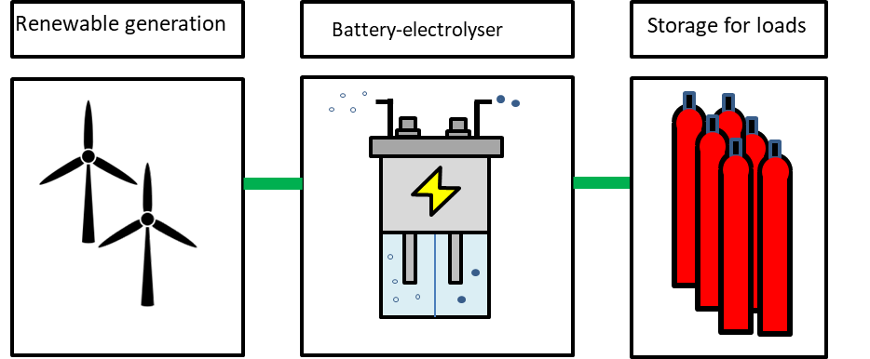
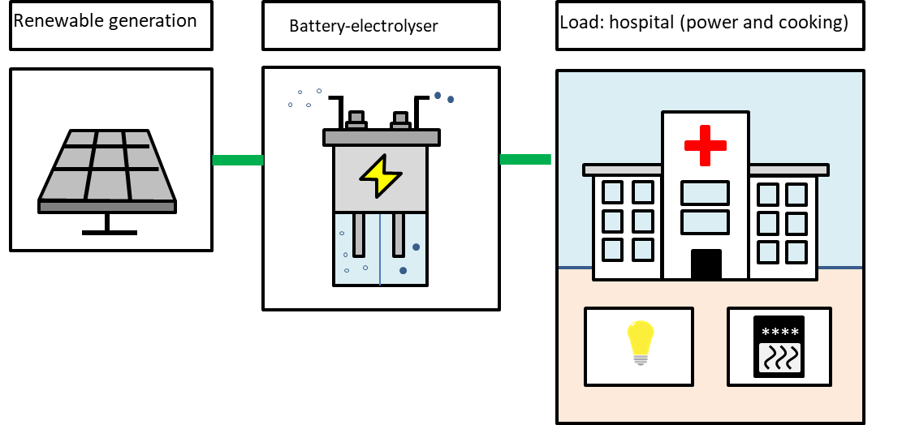
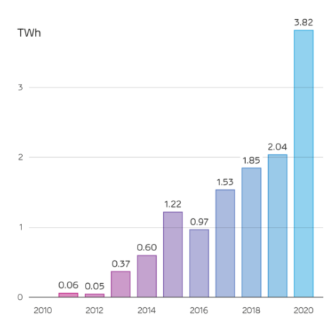


Applications
Background
Using excess wind to generate green hydrogen
Using excess solar to generate green hydrogen for cooking in developing countries
TWh curtailment [5]
There is currently no low-cost electrolyser on the market that works with poor load factor such as renewable generation
[5] https://reports.electricinsights.co.uk/q4-2020/record-wind-output-and-curtailment/
Notes:
Therefore, a combined battery and electrolyser can be used for low load applications. Such as curtailed wind energy. We can store the excess energy in the lead acid battery and once they are fully charged then convert the energy into hydrogen production via electrolysis. Again, we can also use excess solar energy to generate green hydrogen for cooking in developing countries.
improve load factor by balancing energy supply and demand
There is currently no low-cost electrolyser on the market that works with poor load factor such as renewable generation.

Slide 6
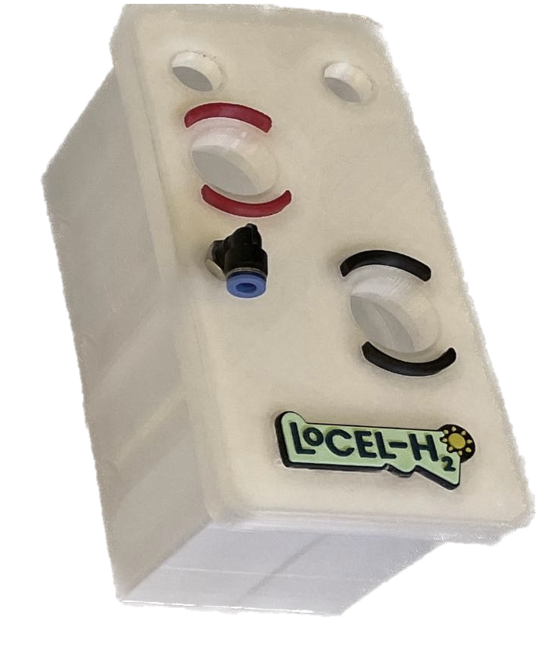
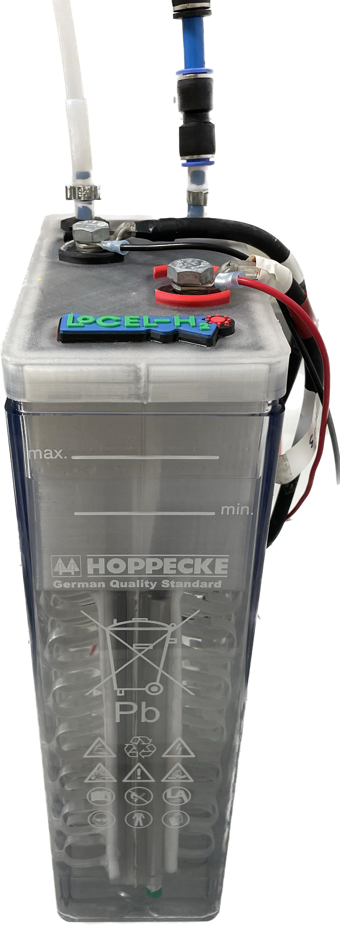

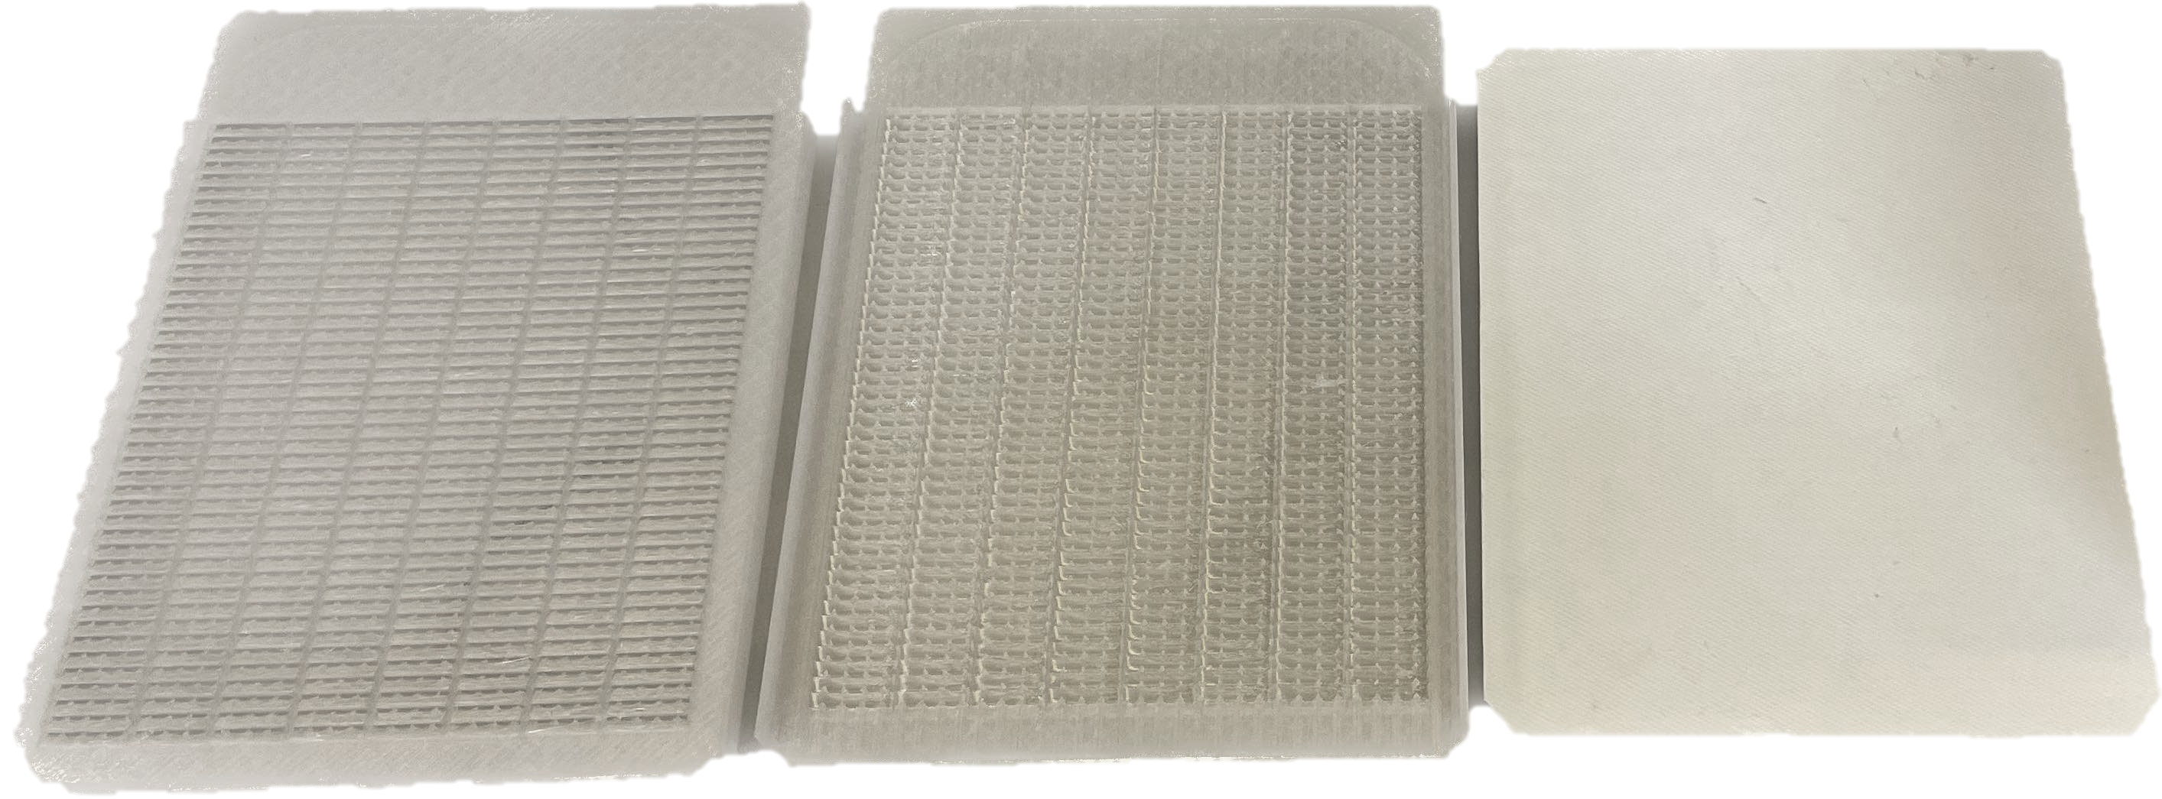
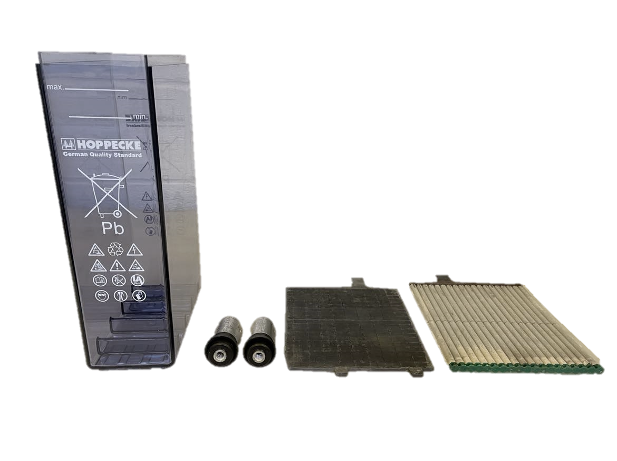
Off the shelve and 3D printed parts
H₂
O₂
Notes:
Low cost manufacture – using off the shelf components.
The main advantage is the low cost of the combined battery and electrolyser design. We use off the shelf parts supplied by Hoppecke for the LoCEL project. And then we have designed bespoke 3D printed parts for the functionality of the cell.
Go through the parts and what they are..

Slide 7

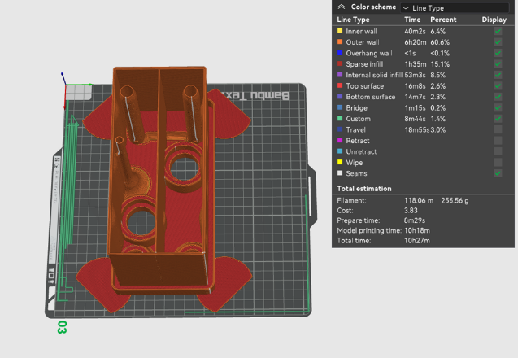
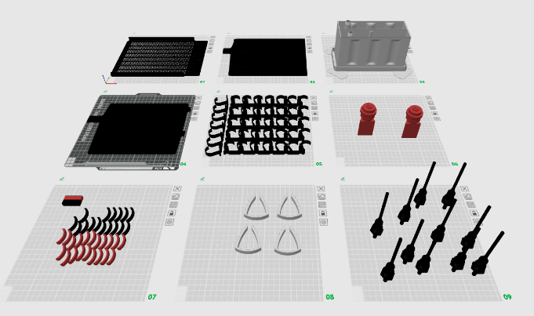
Manufacture of next 22 cells – 3D printing of parts
Co-funded by the European Union
LCH2-2023-WP3-TR-009
Notes:
10h 27mins – this is the slicing software Bambu studio Here are all the parts we 3D print. Spoke to Hoppecke about increasing the size of the boxes and plates to decrease the number of lids we need to produce.

Slide 8
GC analysis– with gas separation
GC analysis of oxygen
GC analysis of hydrogen
O₂
H₂

Slide 9
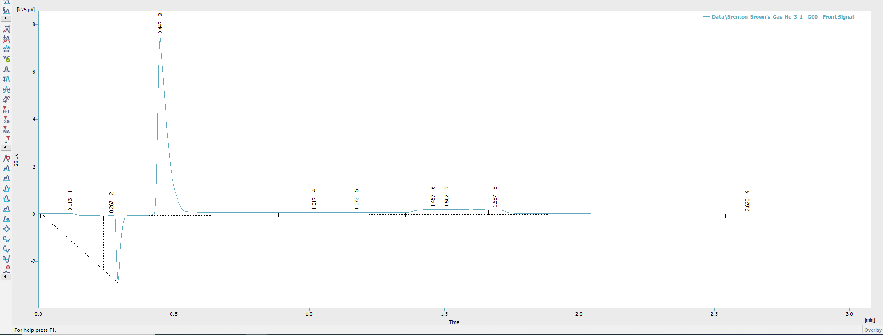
GC analysis of Hoppecke battery – without gas separation
O₂
Carrier gas He – O₂ and H₂ present
H₂

Slide 10
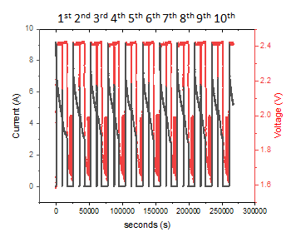
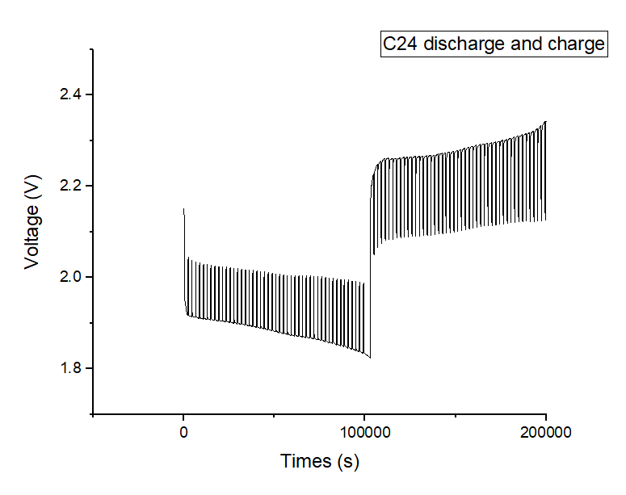
Durability and performance testing
Three full scale cells now in operation under different operating regimes.
Automated cell cycling and data collection.
No degradation yet recorded.
Cell 3 capacity discharge test
Cell 1 cycling
Cell 3 electrolysis test
Notes:
Capacity: 138 Wh - 62 Ah
OCV every 30 mins

Slide 11
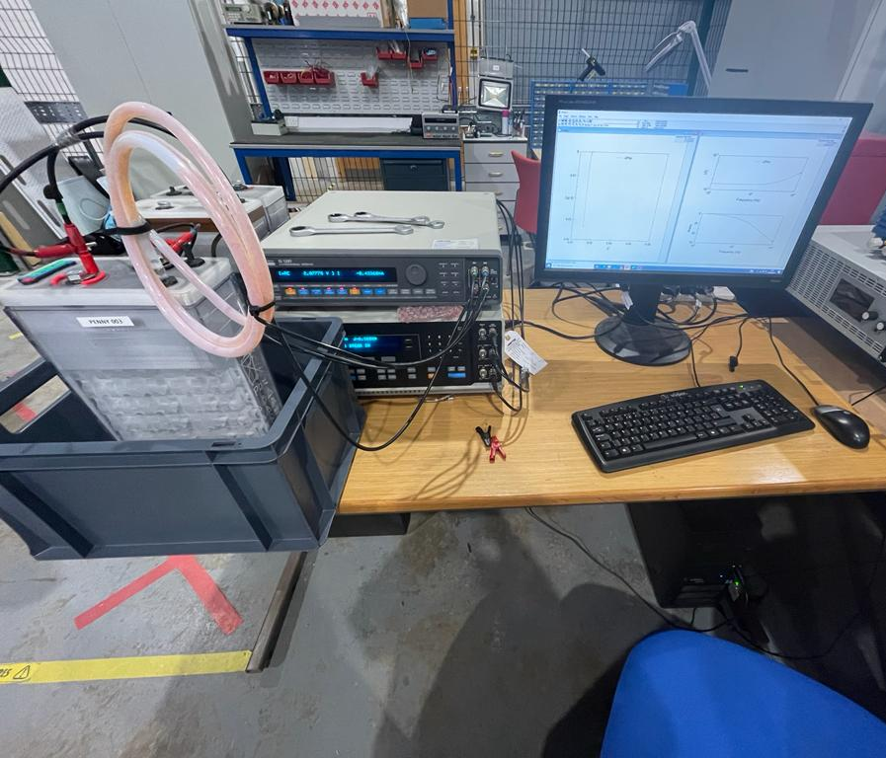
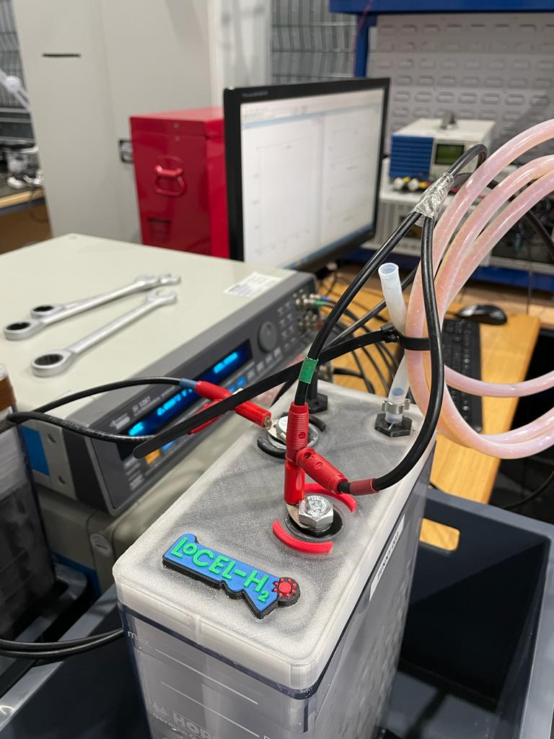
Electrochemical Impedance Spectroscopy (EIS)
EIS initial frequency of 9400 Hz and final frequency of 0.1 Hz
Notes:
The electrical impedance spectroscopy also shows similar results. With Cell 1 and 3 being also identical and a just a slight shift for cell 2, but if you look at the scale of the axis this isn’t much.

Slide 12
Electrolysis of cell 003
Average rate of O₂ production = 0.546 ± 0.017 cm³ s⁻¹
= 32.76 ± 1.02 cm³ min⁻¹
Average rate of H₂ production = 1.207 ± 0.024 cm³ s⁻¹
= 72.42 ± 1.44 cm³ min⁻¹
Notes:
12 L per min for 168 cells.

Slide 13
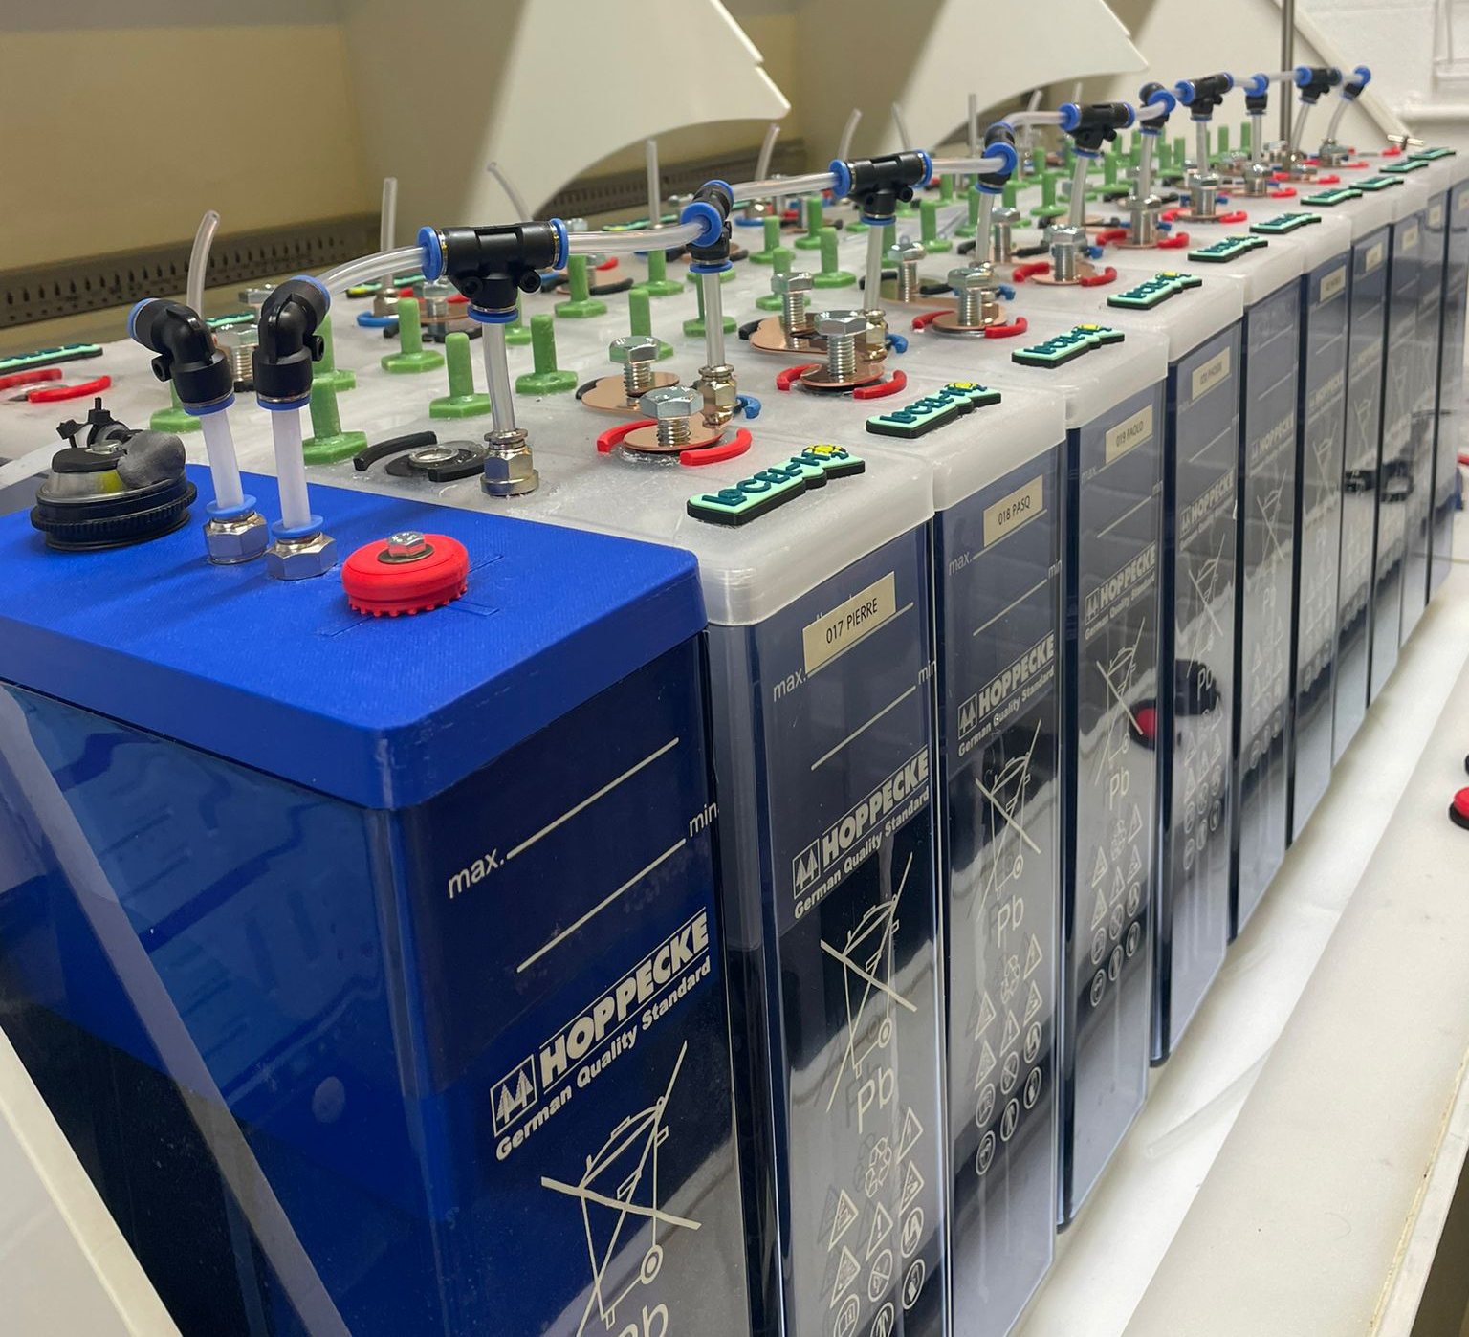
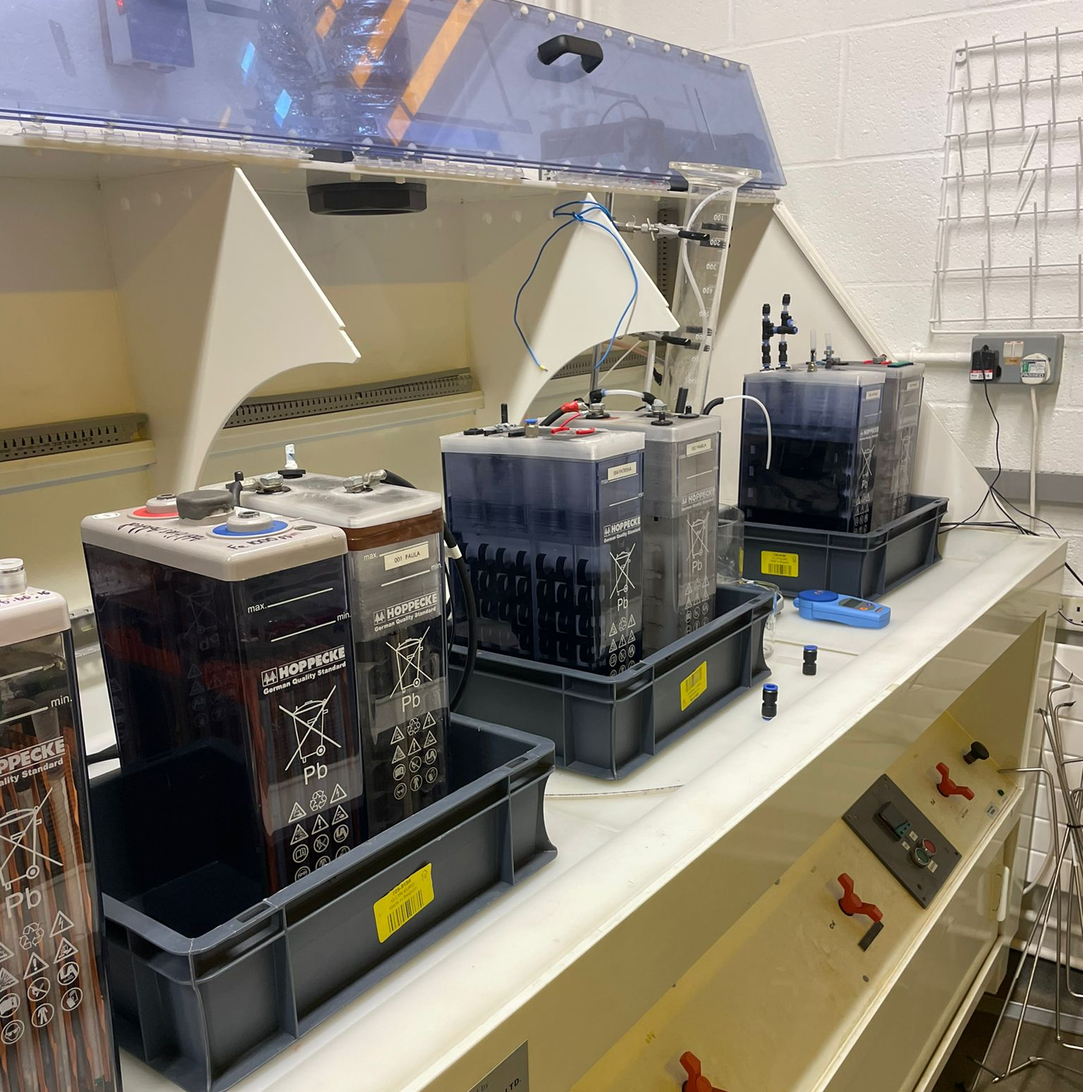
Electrolysis of 20 cell string
Notes:
12 L per min for 168 cells.

Slide 14
Sweat testing – Zambia solar data
dT (S) | PSU V | PSU A | LOAD A | PSU IO | LOAD IO | Min voltage | Program
300 | 2.9 | 9.1 | 0 | 0 | 0 | 1.75 | OCV
3600 | 0 | 0 | 9.735 | 0 | 1 | 1.75 | discharge 1h
3600 | 2.9 | 8.7 | 0 | 1 | 0 | 1.75 | charge 1h
14400 | 2.9 | 9.1 | 0 | 1 | 0 | 1.75 | charge 4h
3600 | 2.9 | 8.7 | 0 | 1 | 0 | 1.75 | charge 1h
3600 | 2.9 | 9.1 | 12.125 | 0 | 1 | 1.75 | discharge 1h
voltage (V) | current (A)
2.9 | 6.5
2.9 | 6.4
2.9 | 8.1
2.9 | 9.0
2.9 | 9.1
2.9 | 8.4
2.9 | 7.0
2.9 | 9.1
Notes:
Battery/Electrolyser
Electrolysis using the charging curve – scaled for one cell
We have scaled this so that we could create an 8 hour cycle to allow 3 cycles per day to speed up the durability and performance testing process.
We have determined these sweat testing by using the average solar data for Zambia and scaling the power to allow us to perform the tests on a single cell.
We start by ensuring the cell is fully charged, then we perform and OCV to confirm the batterys SOC. We then mimic the solar production throughout the day. So early hours of the morning we expect to be discharging the cells, then as the sun rises we begin to charge – with a peak charging current around midday when the sun is at it’s fullest. As we go into the afternoon the charge current is slightly reduced and then the evening see us discharging the cell as load rises and the sun begins to set. We use a voltage of 2.9 V so that when the cell is fully charge it also electrolysis. So this is performed on cell 002 which is the combined battery and electrolyser.
Cell 003 which we are just performing electrolysis on, we electrolyses at 2.9 V with a varying current to mimic the change in solar power through times of the day.

Slide 15
Electrolysis of 20 cell string
Notes:
12 L per min for 168 cells.

Slide 16
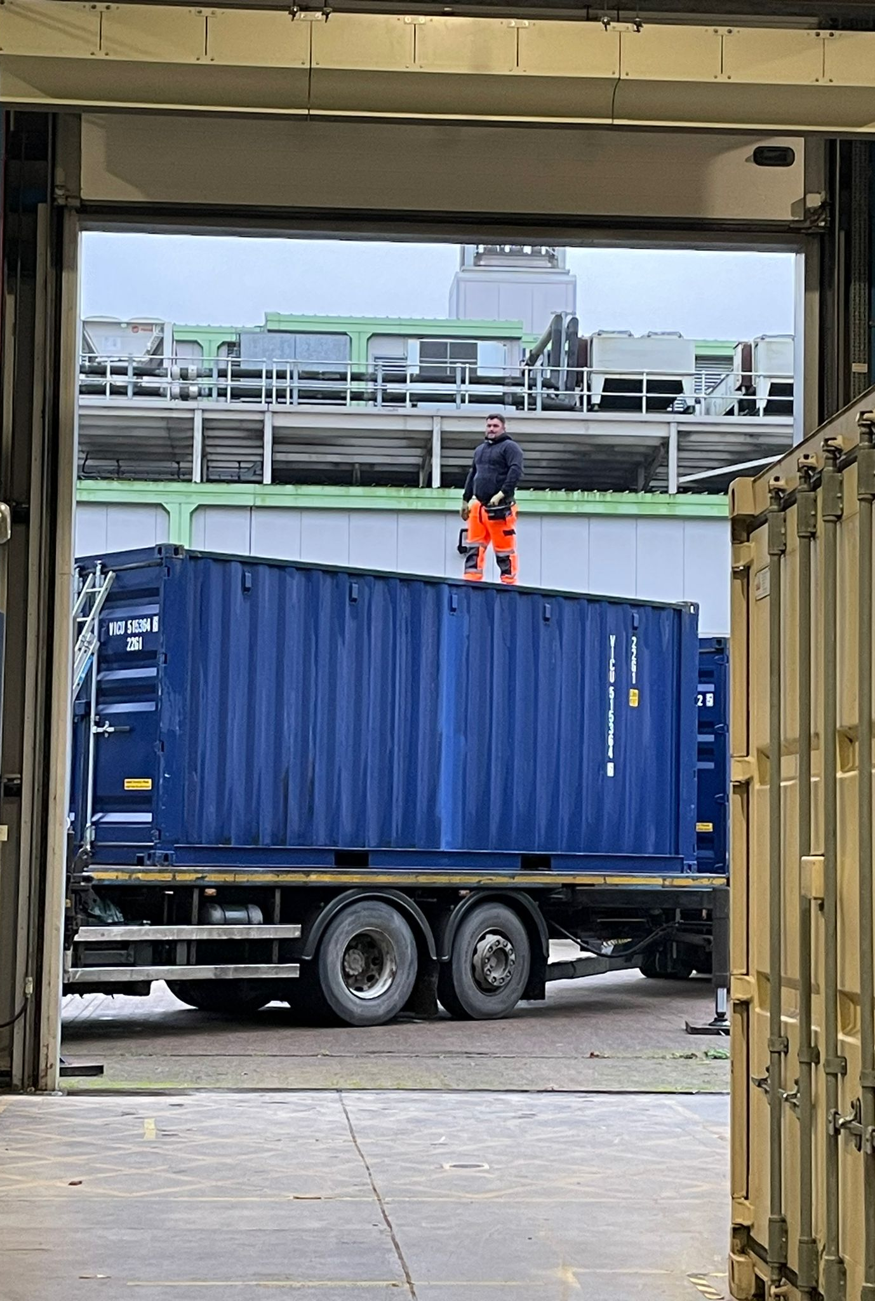
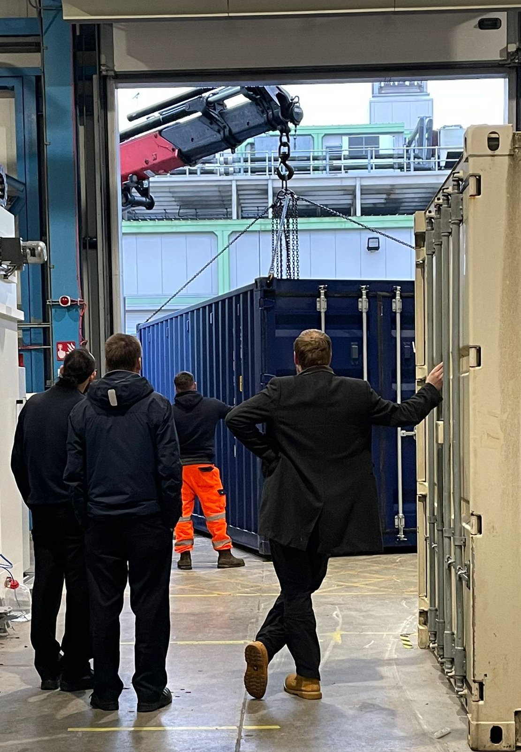
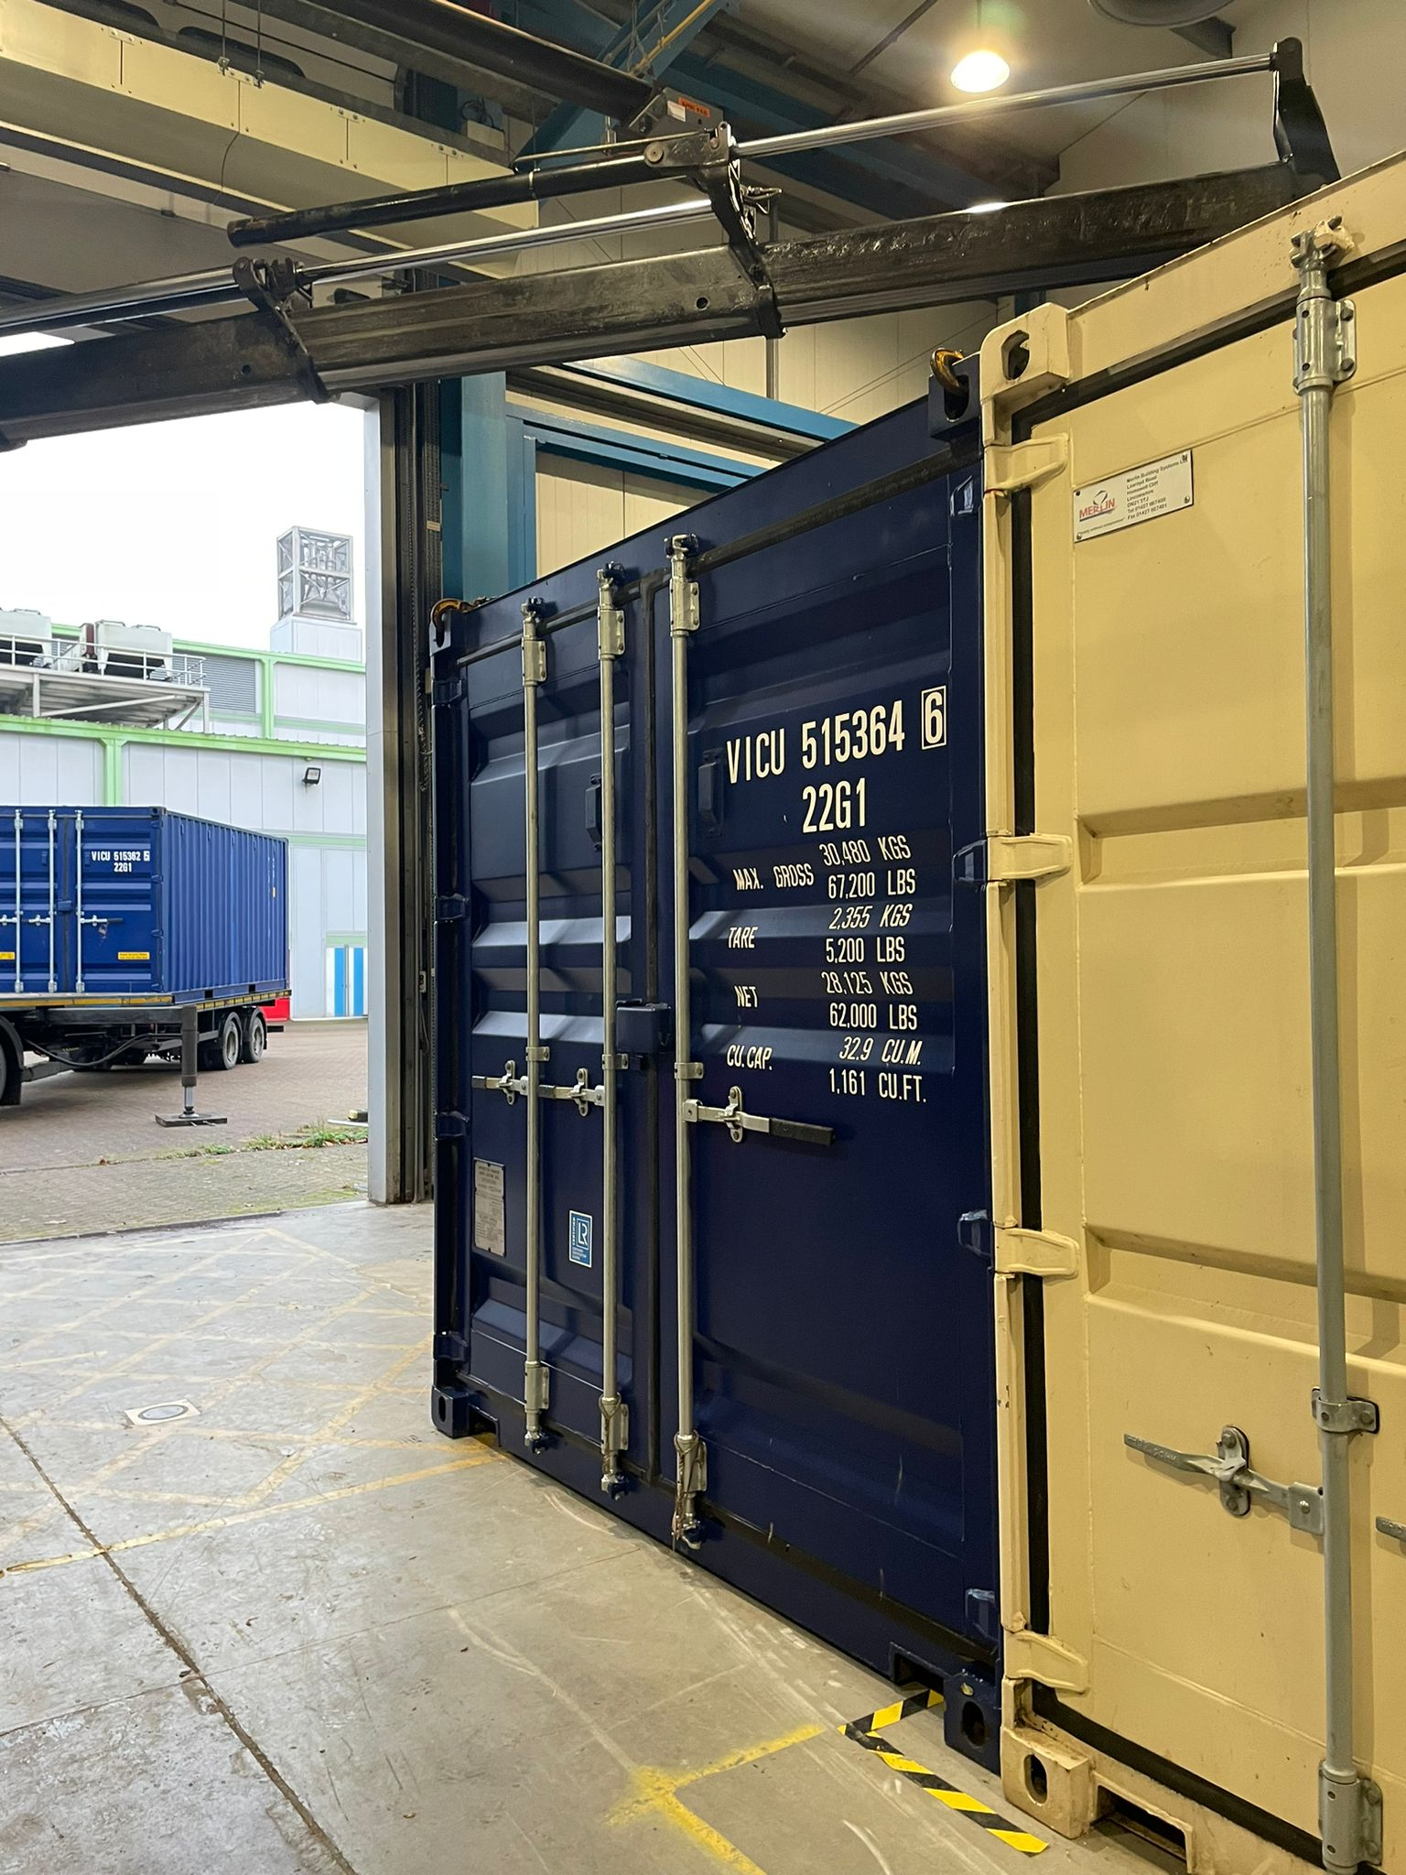
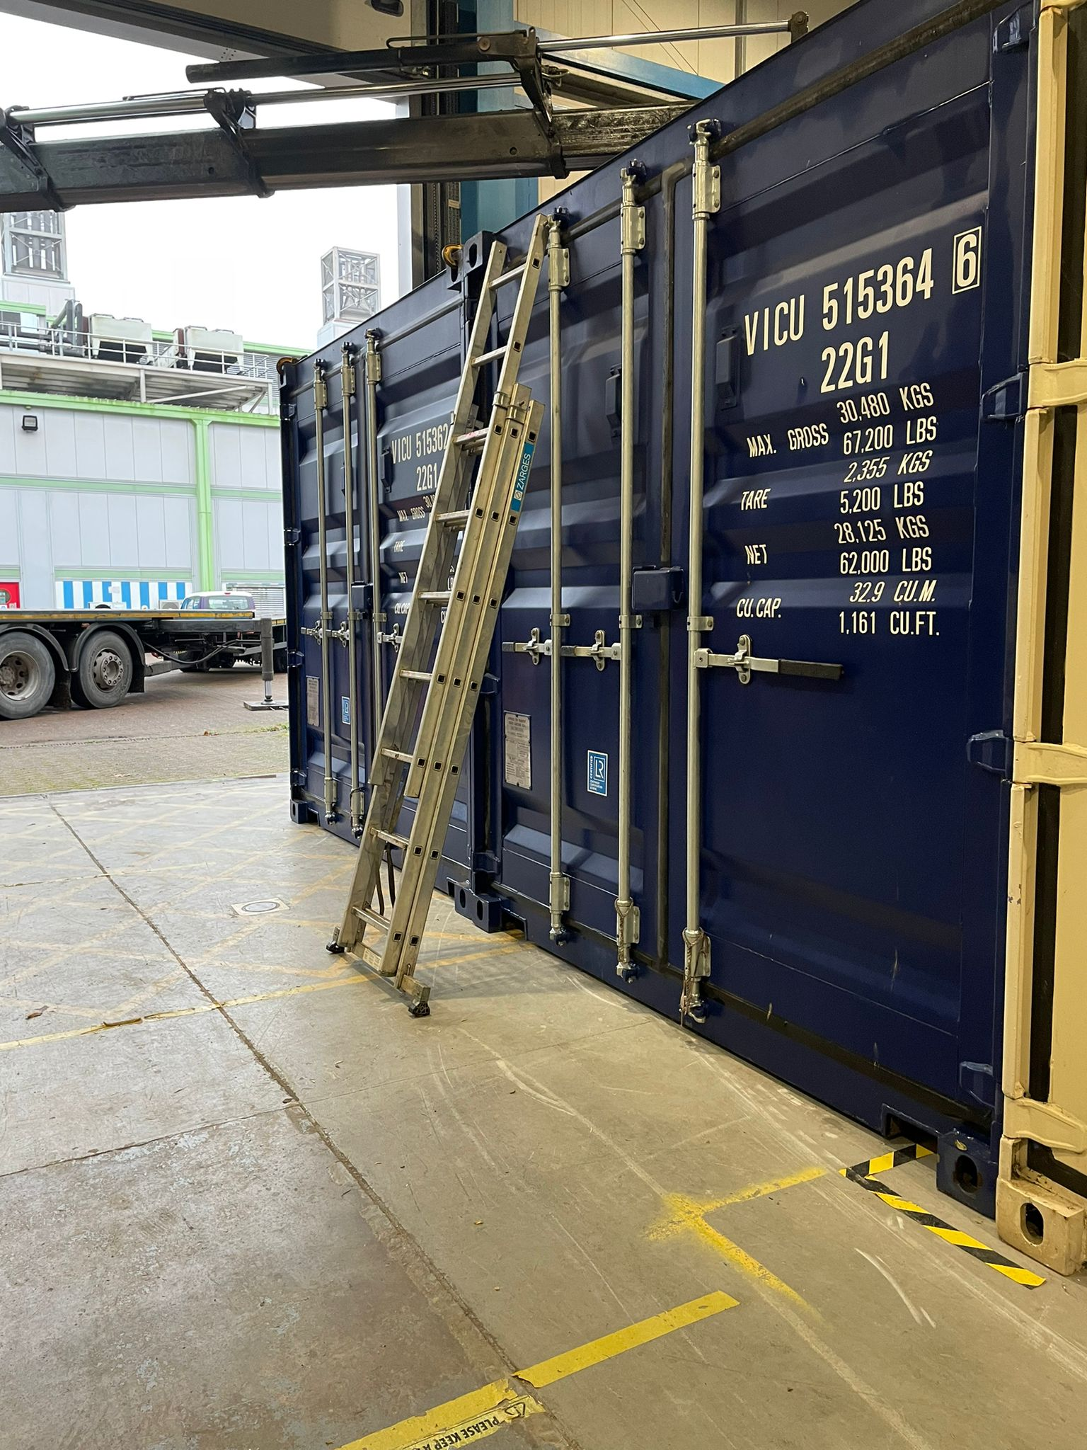
Arrival of the two containers
Co-funded by the European Union
Notes:
Two containers have arrived 20 ft.

Slide 17
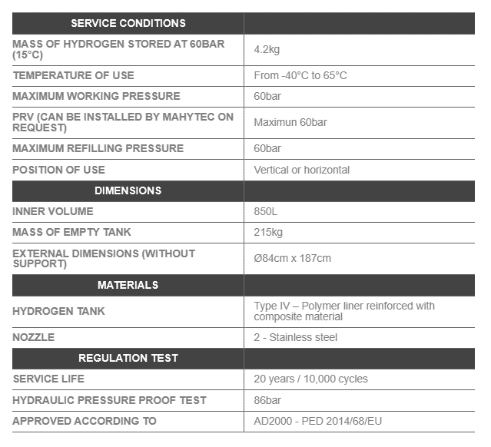
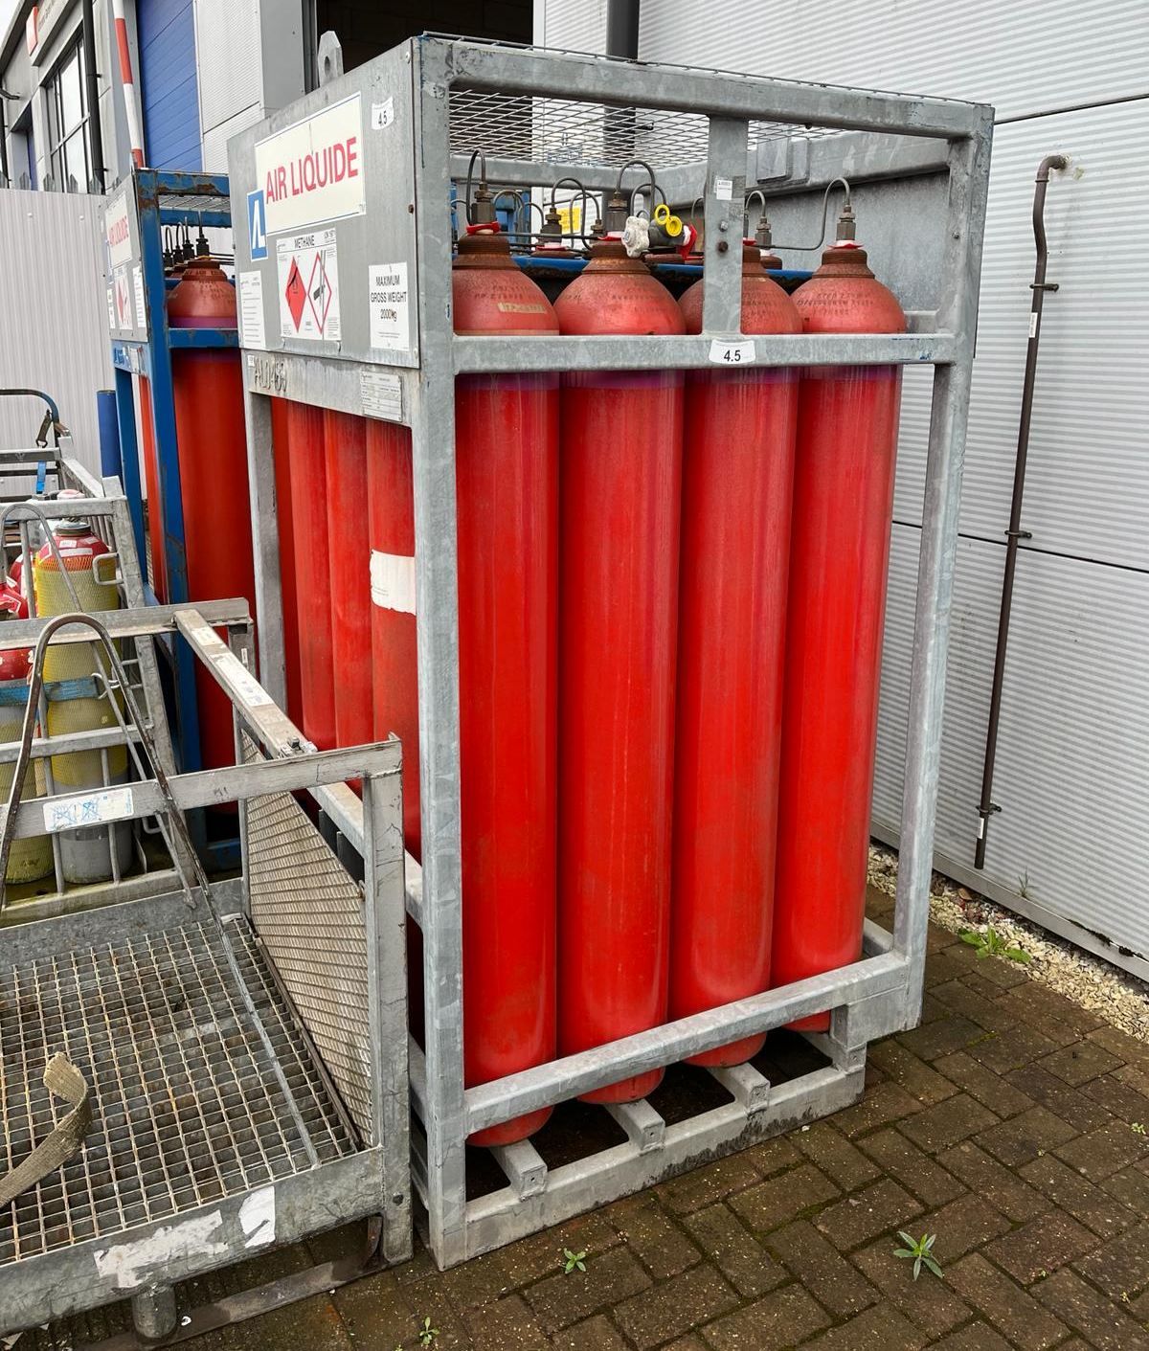
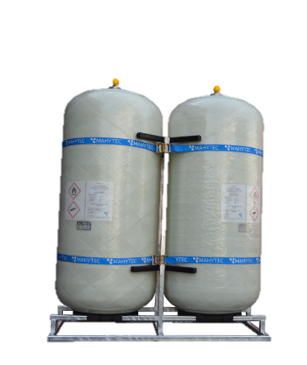
Hydrogen storage
Notes:
Discussed a few options for hydrogen storage – for the locel project going with the large single hydrogen storage tank.

Slide 18
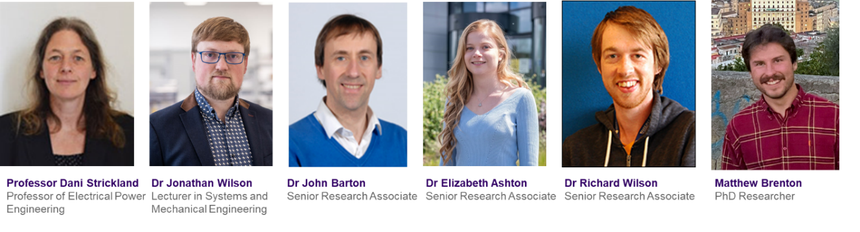
Meet the team

Slide 19



Conclusions on Technology
1
2
3
4
H₂
Battery technology
Green H₂
Manufacture
Pilot scale
Battery technology: Using lead acid battery technology we have successfully develop a combined battery and electrolyser.
Green H₂: excess renewable energy can be used to generate water via electrolysis when over charging the battery cell.
Manufacture: We have developed the combine battery and electrolyser cell design from lab scale to full scale, using off the shelf and bespoke 3D printed parts.
Pilot scale: We are now in the process of manufacturing the next 22 cells for testing, before deploying 168 cells in Zambia and the Ivory Coast.

Slide 20
Thank you

